Slide 1
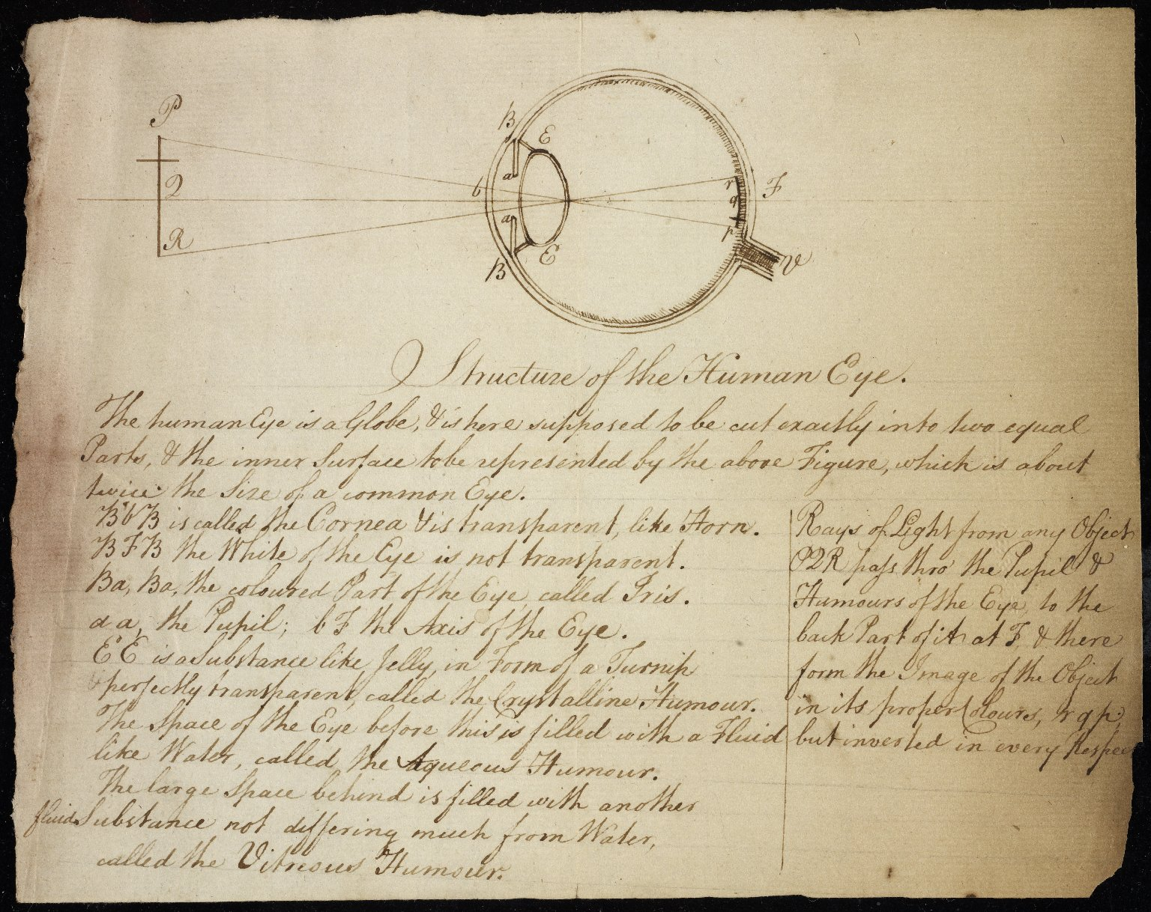
-------------
Image1
-------------
Field Data
Image Number JRL0901014dc
Reference Number Dalton MS 84
Image Title Structure of the human eye
Parent Work Title Lecture notes: Optics
Creator Dalton, John, 1766-1844
Creator Role Author
Date Created c1808
Description Illustration of the structure of the human eyeball, with Dalton's lecture notes.
Language Code eng-GB
Language English
Subject Medicine--History
Category of Material Archives
Sub-Category Illustrated works
Technique Used Drawing (image-making)
Technique Used Handwriting
Medium Ink
Support Paper
Time Period Covered 19th Century CE
People Covered Dalton, John, 1766-1844
Current Repository The University of Manchester Library, U.K.
Provenance Manchester Literary & Philosophical Society, former owner
Rights Holder - Image The University of Manchester Library
Rights holder - Work The University of Manchester Library
Access Rights <a rel="license" href="http://creativecommons.org/licenses/by-nc-sa/4.0/"><img alt="Creative Commons License" style="border-width:0" src="https://i.creativecommons.org/l/by-nc-sa/4.0/88x31.png"></a>
Date Captured (yyyy-mm-dd) 2008-08-13
Image Creation Technique Digital capture by Heritage Imaging, The University of Manchester Library
Date Image Added (yyyy-mm) 2008-11
Metadata Language eng-GB

Slide 2
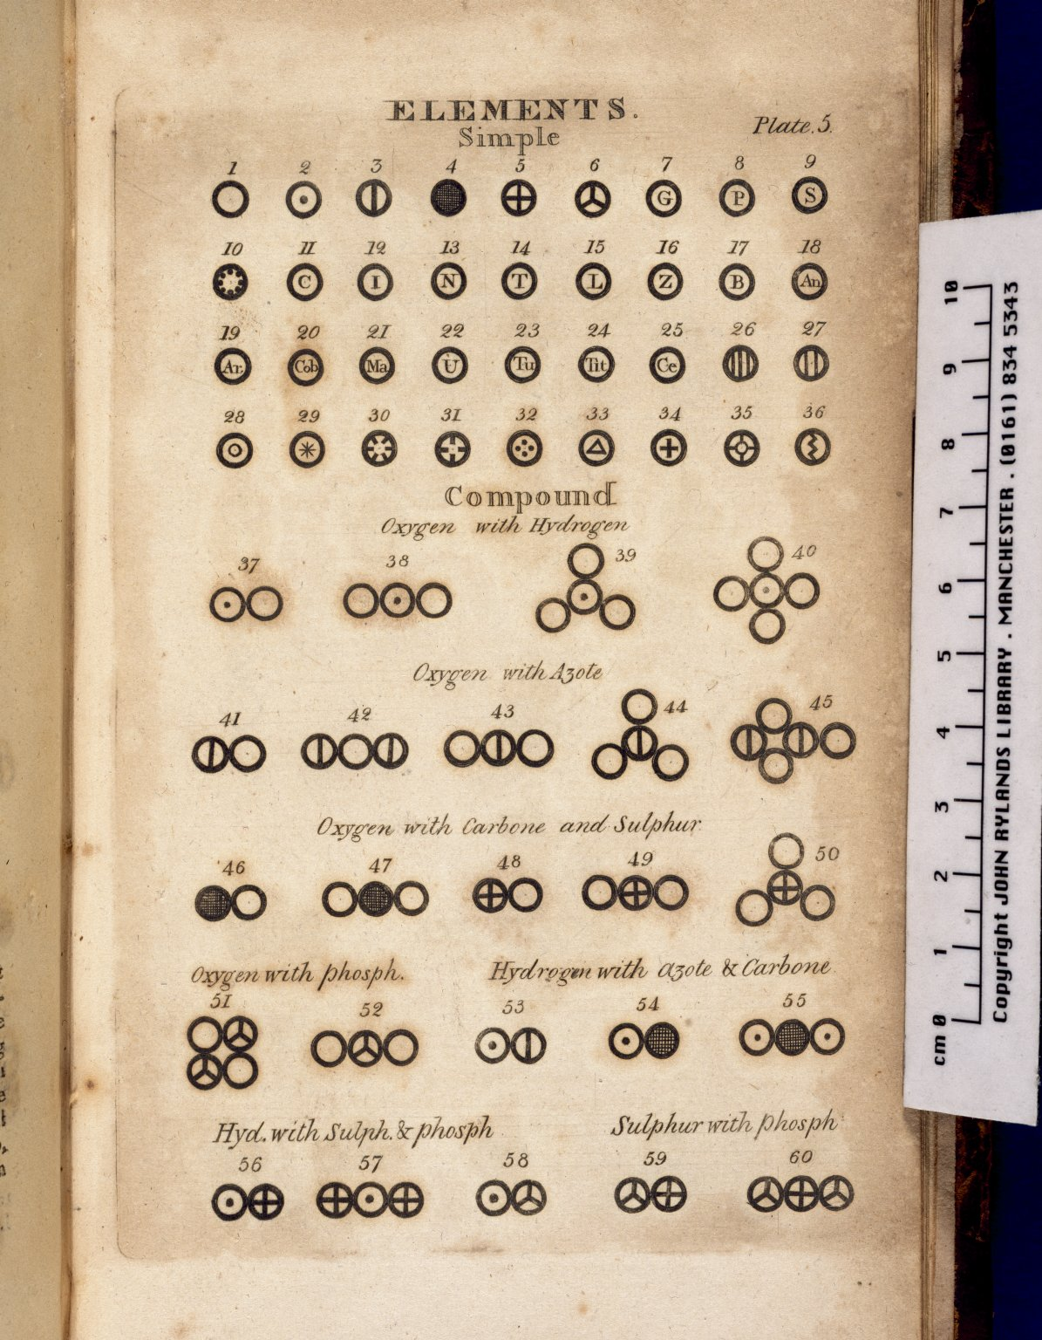
-------------
Image1
-------------
Field Data
Image Number JRL021194tr
Reference Number Partington 277-278
Link to Catalogue <A href=http://man-fe.hosted.exlibrisgroup.com/MU_VU1:BLENDED:44MAN_ALMA_DS21205694560001631>UoM online catalogue.</a>
Image Title The Elements
Parent Work Title A new system of chemical philosophy
Creator Dalton, John, 1766-1844
Creator Role Author
Date Created 1808
Publication Details Manchester : S. Russell for R. Bickerstaff
Volume 1
Page/Sheet Plate 5, opposite page 548
Image Sequence Number 548
Description Illustrated: the Elements, both simple and compound.
Language Code eng-GB
Language English
Subject Chemistry
Category of Material Printed
Sub-Category Illustrated works
Support Paper
Current Repository The University of Manchester Library, U.K.
Rights Holder - Image The University of Manchester Library
Rights holder - Work The University of Manchester Library
Image Creation Technique Scanned from colour transparency by Gten, May 2005
Metadata Language eng-GB

Slide 4
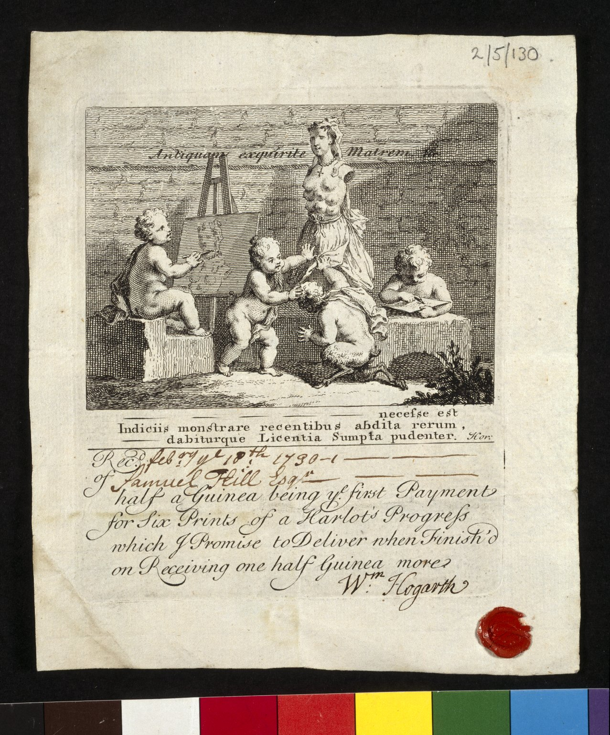
-------------
Image1
-------------
Field Data
Image Number JRL021982tr
Reference Number EGT/2/5/130
Image Title 'Boys Peeping at Nature' subscription ticket
Alternative Image Title Hogarth receipt
Series Title Papers of Samuel Hill
Parent Work Title Receipts and accounts
Creator Hogarth, William, 1697-1764
Creator Role Artist
Date Created 1730
Description Subscription ticket, signed & sealed by Hogarth, issued to Samuel Hill in receipt of the first payment for 6 prints of 'A Harlot's Progress'. Hogarth features as the satyr lifting Nature's skirts & exposing parts previously ignored by art.
Language Code eng-GB
Subject Art
Category of Material Archives
Technique Used Printing (process)
Current Repository The University of Manchester Library, U.K.
Rights Holder - Image The University of Manchester Library
Rights holder - Work The University of Manchester Library
Image Creation Technique Scanned from colour transparency by Gten, July 2004
Metadata Language eng-GB

Slide 6
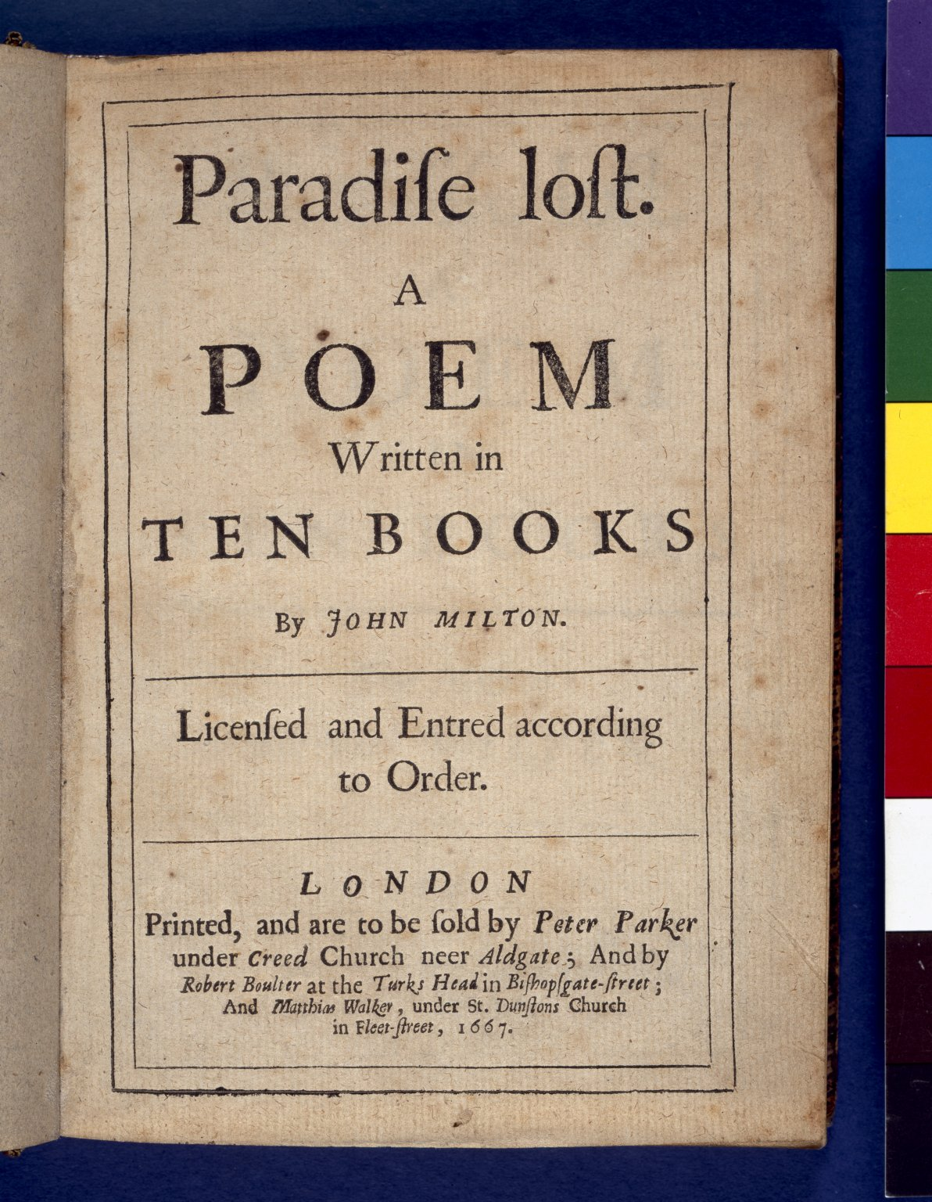
-------------
Image1
-------------
Field Data
Image Number JRL021319tr
Reference Number R4775
Link to Catalogue <A href=http://man-fe.hosted.exlibrisgroup.com/MU_VU1:BLENDED:44MAN_ALMA_DS21213225730001631>UoM online catalogue.</a>
Image Title Paradise Lost
Parent Work Title Paradise Lost
Creator Milton, John, 1608-1674
Creator Role Author
Date Created 1667
Publication Details London: Peter Parker
Page/Sheet Title page
Image Sequence Number 000
Description Title page of Milton's 'Paradise Lost'. First edition, first issue.
Language Code eng-GB
Subject Poetry
Subject English literature
Category of Material Printed
Current Repository The University of Manchester Library, U.K.
Rights Holder - Image The University of Manchester Library
Rights holder - Work The University of Manchester Library
Access Rights <a rel="license" href="http://creativecommons.org/licenses/by-nc-sa/4.0/"><img alt="Creative Commons License" style="border-width:0" src="https://i.creativecommons.org/l/by-nc-sa/4.0/88x31.png" /></a><br />This work is licensed under a <a rel="license" href="http://creativecommons.org/licenses/by-nc-sa/4.0/">Creative Commons Attribution-NonCommercial-ShareAlike 4.0 International License.</a> Copyright of The University of Manchester
Notes First Edition
Image Creation Technique Scanned from colour transparency by Gten, May 2005
Metadata Language eng-GB

