Slide 1
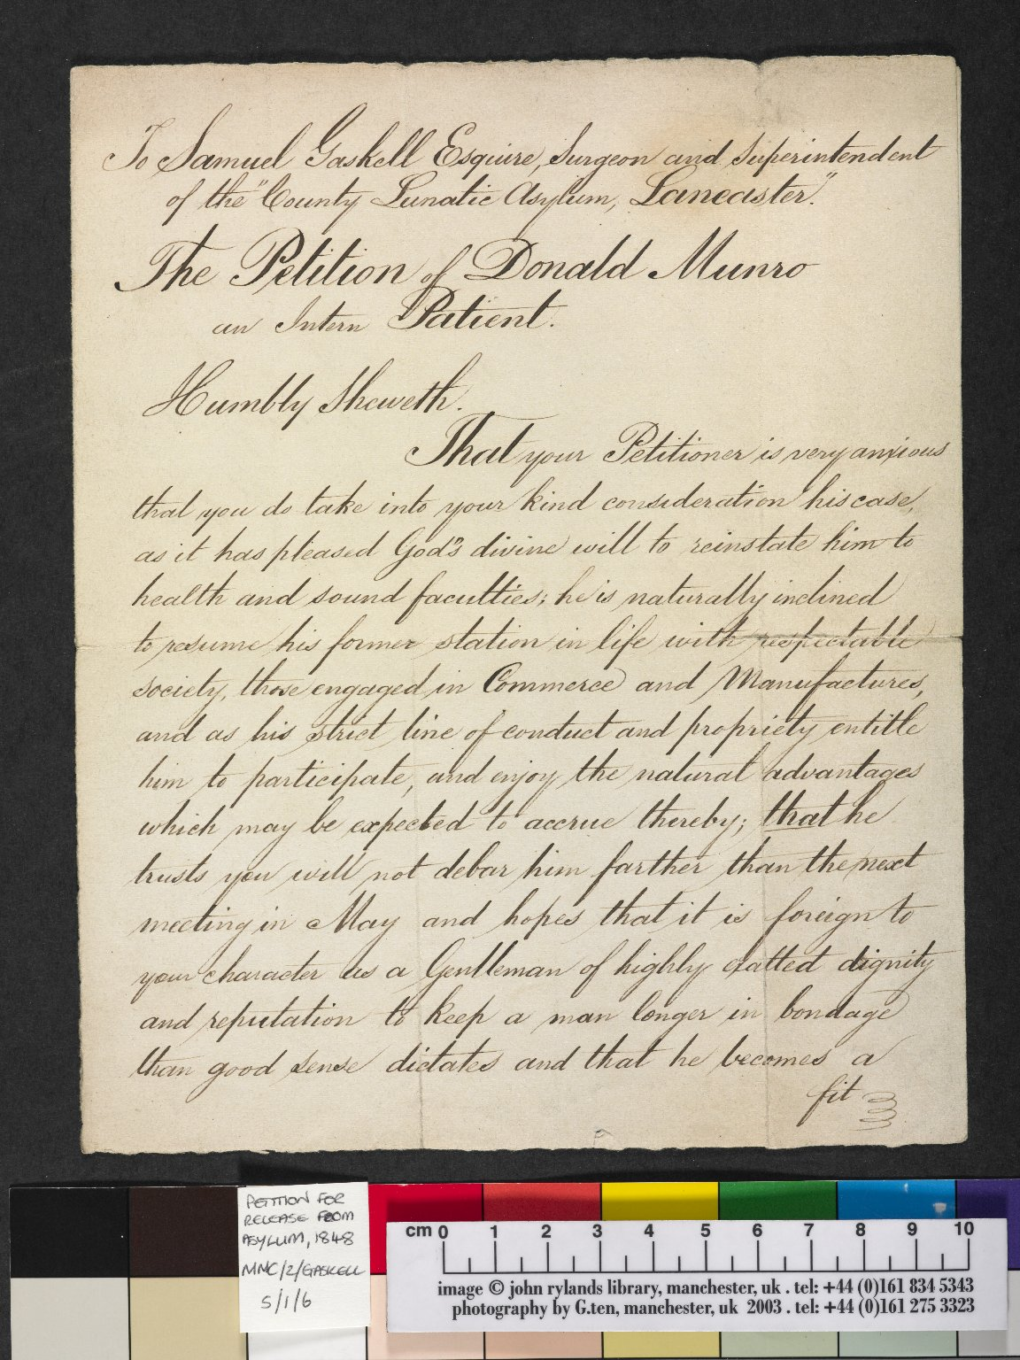
-------------
Image1
-------------
Field Data
Image Number JRL040070dc
Reference Number MMC/2/GaskellS/1/6
Link to Catalogue <a href="http://www.librarysearch.manchester.ac.uk/MU_VU1:BLENDED:44MAN_ELGAR_DSgb133mmc2a">Manchester Medical Collection: Biographical Files A-G</a>
Image Title Release Petition of Donald Munro
Parent Work Title Release Petition of Donald Munro
Date Created 1848
Page/Sheet 1
Image Sequence Number 001
Description Manchester Medical Collection. First page of a petition addressed to Samuel Gaskell, Surgeon and Superintendent of the County Lunatic Asylum in Lancaster for the release of intern patient Donald Munro.
Language Code eng-GB
Subject Medicine--History
Category of Material Archives
Technique Used Handwriting
Support Paper
Time Period Covered 19th Century CE
Current Repository The University of Manchester Library, U.K.
Rights Holder - Image The University of Manchester Library
Rights holder - Work The University of Manchester Library
Date Captured (yyyy-mm-dd) 2004-09-09
Image Creation Technique Digital capture by Gten
Metadata Language eng-GB

