Slide 1
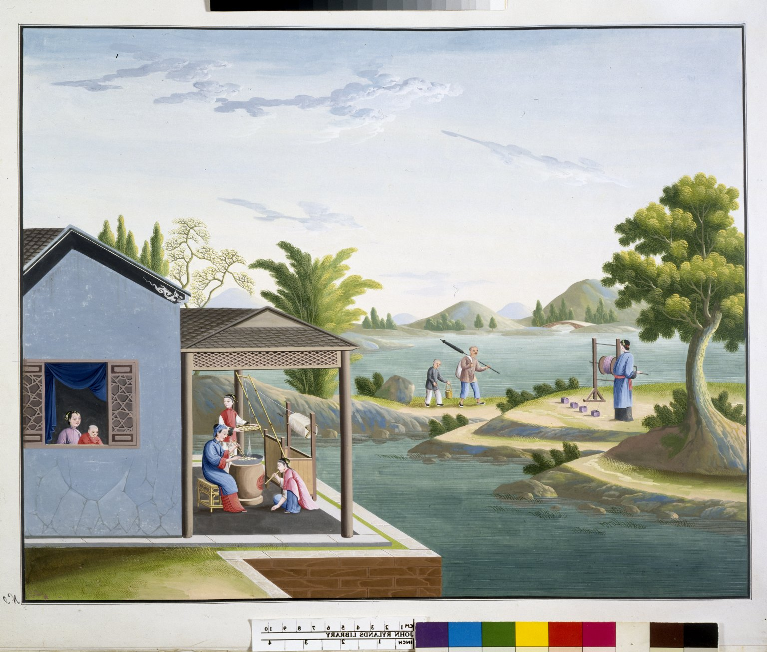
-------------
Image1
-------------
Field Data
Image Number JRL022963tr
Reference Number Chinese Drawings 13
Image Title Producing silk
Parent Work Title Chinese Drawings: Silk Production
Alternative Parent Work Title Crawford Chinese Collection: Illustrations
Date Created 18th century [late]
Volume 13
Page/Sheet No.9
Image Sequence Number 009
Description Illustrated: painting: Producing silk.
Subject Textile industry
Subject Industries
Subject Art, Chinese
Technique Used Painting (image-making)
Time Period Covered 18th Century CE
Places Covered China
Item Height 430 mm
Item Width 550 mm
Current Repository The University of Manchester Library, U.K.
Provenance Lindsay family Earls of Crawford and Balcarres, former owner
Rights Holder - Image The University of Manchester Library
Rights holder - Work The University of Manchester Library
Access Rights <a rel="license" href="http://creativecommons.org/licenses/by-nc-sa/4.0/"><img alt="Creative Commons License" style="border-width:0" src="https://i.creativecommons.org/l/by-nc-sa/4.0/88x31.png" /></a>
References Zheng Yaying, 'Crawford Chinese Collection' 1991.
Image Creation Technique Digital capture by Heritage Imaging, The University of Manchester Library
Metadata Language eng-GB

Slide 2
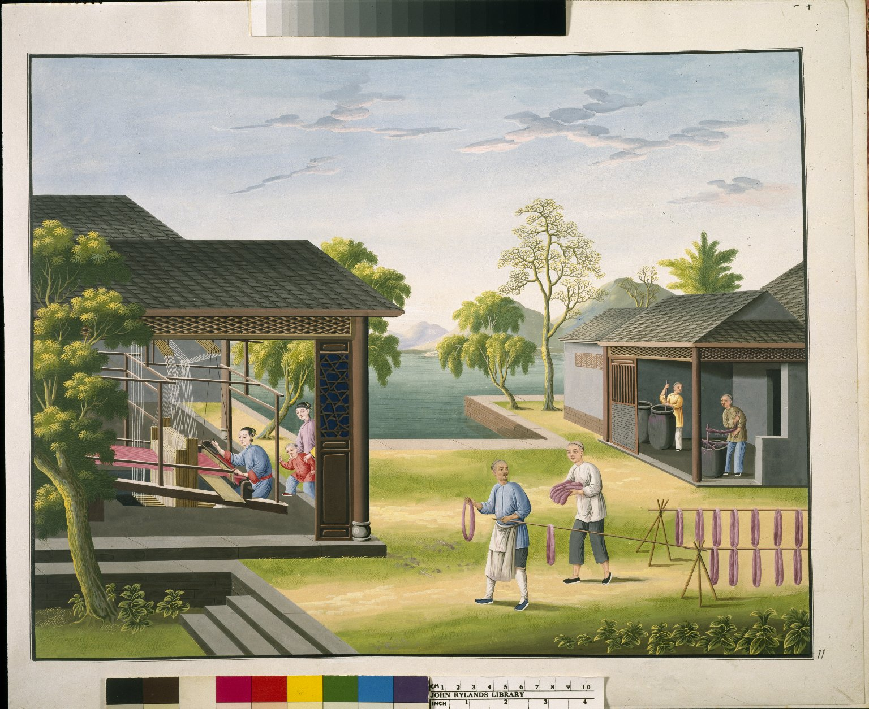
-------------
Image1
-------------
Field Data
Image Number JRL021866tr
Reference Number Chinese Drawings 13
Image Title Silk Dyeing & Weaving
Parent Work Title Chinese Drawings: Silk Production
Alternative Parent Work Title Crawford Chinese Collection: Illustrations
Date Created 18th century [late]
Page/Sheet No.11
Image Sequence Number 011
Description Illustrated: painting: Silk Dyeing and Weaving. Depictions of Chinese trades & industry. Eighteenth century.
Subject Textile industry
Subject Industries
Subject Art, Chinese
Category of Material Manuscripts
Technique Used Painting (image-making)
Places Covered China
Item Height 430 mm
Item Width 550 mm
Current Repository The University of Manchester Library, U.K.
Provenance Lindsay family Earls of Crawford and Balcarres, former owner
Rights Holder - Image The University of Manchester Library
Rights holder - Work The University of Manchester Library
Access Rights <a rel="license" href="http://creativecommons.org/licenses/by-nc-sa/4.0/"><img alt="Creative Commons License" style="border-width:0" src="https://i.creativecommons.org/l/by-nc-sa/4.0/88x31.png" /></a>
References Zheng Yaying, 'Crawford Chinese Collection' 1991.
Image Creation Technique Scanned from colour transparency by Gten, August 2003
Metadata Language eng-GB

Slide 3
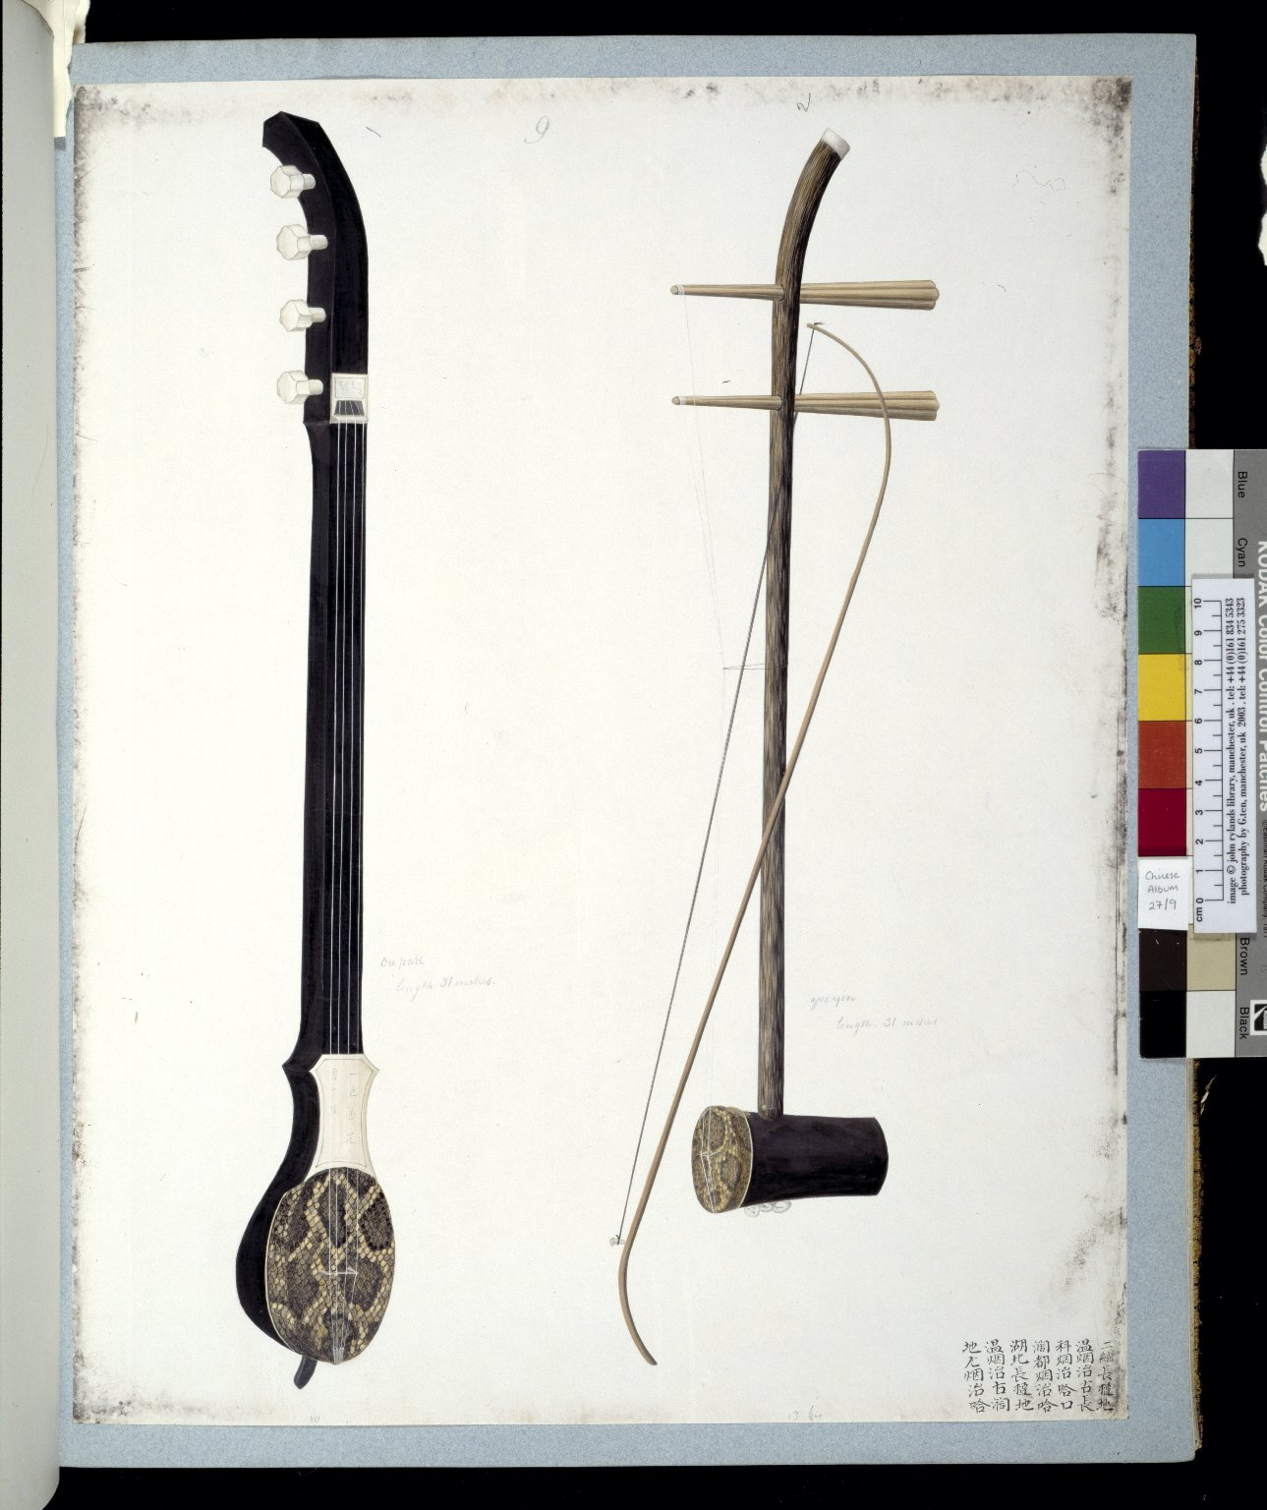
-------------
Image1
-------------
Field Data
Image Number JRL030529tr
Reference Number Chinese Drawings 27
Image Title Chinese musical instruments
Parent Work Title Chinese Drawings: Musical Instruments
Alternative Parent Work Title Crawford Chinese Collection: Illustrations
Date Created c1780
Volume 27
Page/Sheet No.9
Image Sequence Number 009
Description Illustrated: painting. 1: Mongol / Tartar mandolin with 4 strings; 2: small Chinese violin, has 2 strings through which the bow passes. In Chinese: Cantonese dialect.
Subject Musical instruments
Subject Art, Chinese
Category of Material Manuscripts
Time Period Covered 18th Century CE
Places Covered China
Item Height 475 mm
Item Width 395 mm
Current Repository The University of Manchester Library, U.K.
Provenance Lindsay family Earls of Crawford and Balcarres, former owner
Rights Holder - Image The University of Manchester Library
Rights holder - Work The University of Manchester Library
References Zheng Yaying, 'Crawford Chinese Collection' 1991.
Image Creation Technique Scanned from colour transparency by Gten, June 2004
Metadata Language eng-GB

Slide 4
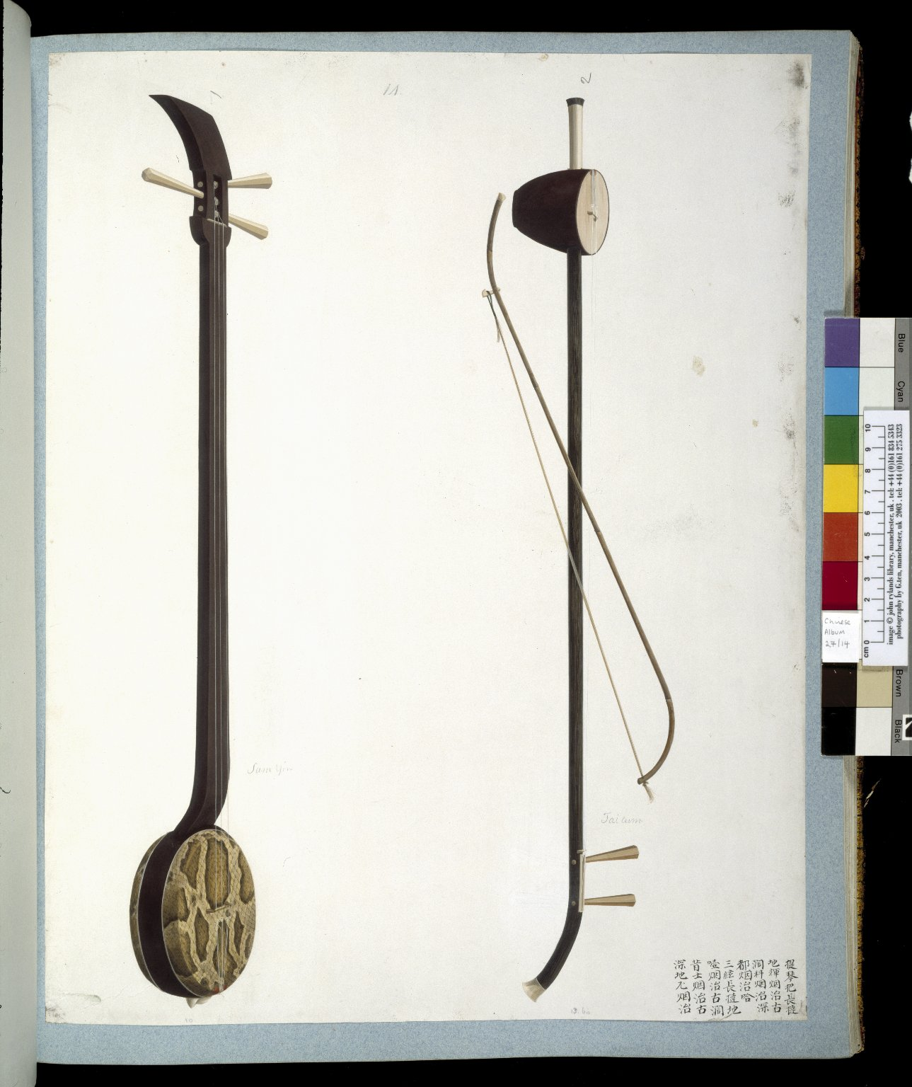
-------------
Image1
-------------
Field Data
Image Number JRL030530tr
Reference Number Chinese Drawings 27
Image Title Chinese musical instruments
Parent Work Title Chinese Drawings: Musical Instruments
Alternative Parent Work Title Crawford Chinese Collection: Illustrations
Date Created c1780
Volume 27
Page/Sheet No.14
Image Sequence Number 014
Description Illustrated: painting. 1: a 3-string zither; 2: a 2-string fiddle. In Chinese: Cantonese dialect.
Subject Musical instruments
Subject Art, Chinese
Category of Material Manuscripts
Time Period Covered 18th Century CE
Places Covered China
Item Height 475 mm
Item Width 395 mm
Current Repository The University of Manchester Library, U.K.
Provenance Lindsay family Earls of Crawford and Balcarres, former owner
Rights Holder - Image The University of Manchester Library
Rights holder - Work The University of Manchester Library
References Zheng Yaying, 'Crawford Chinese Collection' 1991.
Image Creation Technique Scanned from colour transparency by Gten, June 2004
Metadata Language eng-GB

Slide 6
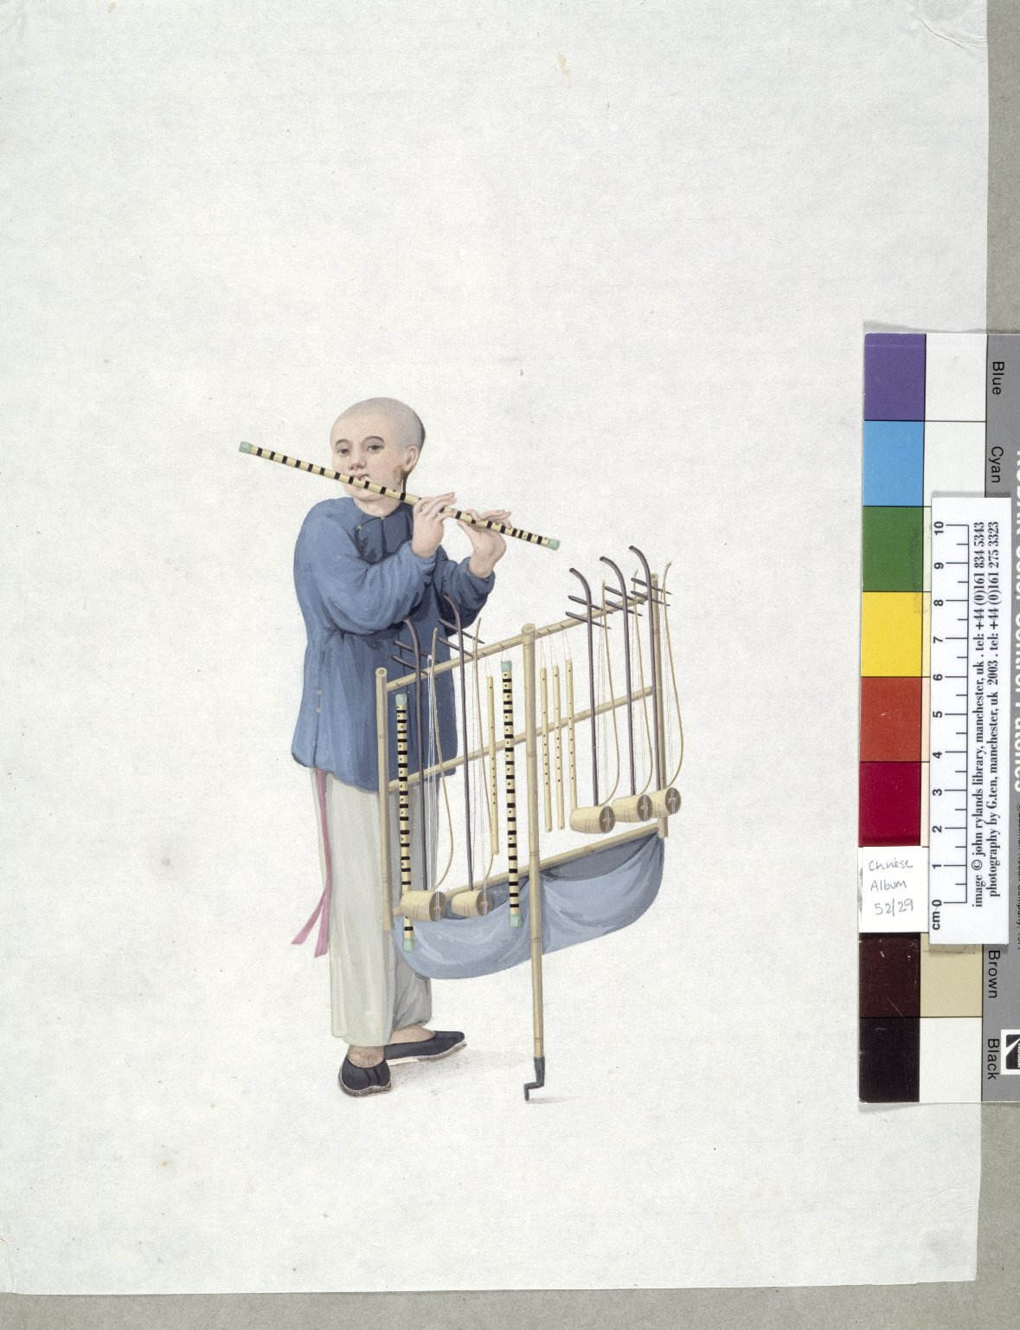
-------------
Image1
-------------
Field Data
Image Number JRL030532tr
Reference Number Chinese Drawings 52
Image Title Chinese musical instruments
Parent Work Title Chinese Drawings: Water-colours of trades and flora
Alternative Parent Work Title Crawford Chinese Collection: Illustrations
Date Created c1790
Volume 52
Page/Sheet No.29
Image Sequence Number 029
Description Illustrated: painting: Selling musical instruments, flutes and 2-stringed bowed fiddles.
Language Code chi-CN
Subject Musical instruments
Subject Art, Chinese
Category of Material Manuscripts
Technique Used Painting (image-making)
Medium Watercolour (paint)
Time Period Covered 18th Century CE
Places Covered China
Item Height 375 mm
Item Width 315 mm
Current Repository The University of Manchester Library, U.K.
Provenance Lindsay family Earls of Crawford and Balcarres, former owner
Rights Holder - Image The University of Manchester Library
Rights holder - Work The University of Manchester Library
References Zheng Yaying, 'Crawford Chinese Collection' 1991.
Image Creation Technique Scanned from colour transparency by Gten, June 2004
Metadata Language eng-GB

Slide 7
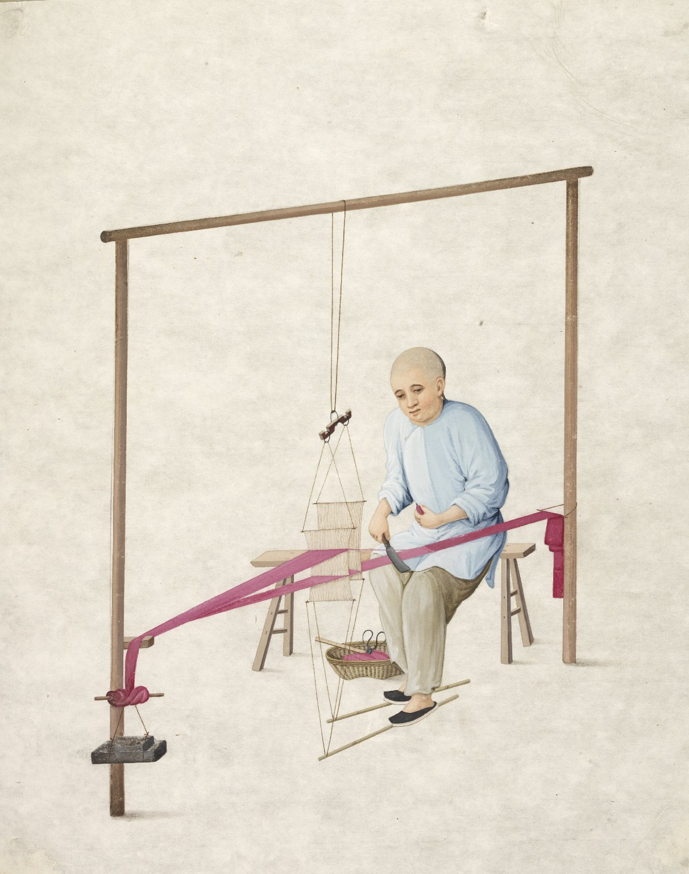
-------------
Image1
-------------
Field Data
Image Number JRL0901015dc
Reference Number Chinese Drawings 52
Image Title Weaving
Parent Work Title Chinese Drawings: Water-colours of trades and flora
Alternative Parent Work Title Crawford Chinese Collection: Illustrations
Date Created c1790
Volume 52
Page/Sheet 81
Image Sequence Number 52-081
Description Illustrated: painting: Weaving.
Subject Art, Chinese
Subject China--History
Subject Textile industry
Category of Material Manuscripts
Technique Used Painting (image-making)
Medium Watercolour (paint)
Support Paper
Time Period Covered 18th Century CE
Places Covered China
Item Height 375 mm
Item Width 315 mm
Current Repository The University of Manchester Library, U.K.
Provenance Lindsay family Earls of Crawford and Balcarres, former owner
Rights Holder - Image The University of Manchester Library
Rights holder - Work The University of Manchester Library
Date Captured (yyyy-mm-dd) 2008-08-13
Image Creation Technique Digital capture by Heritage Imaging, The University of Manchester Library
Date Image Added (yyyy-mm) 2008-11
Metadata Language eng-GB

Slide 9
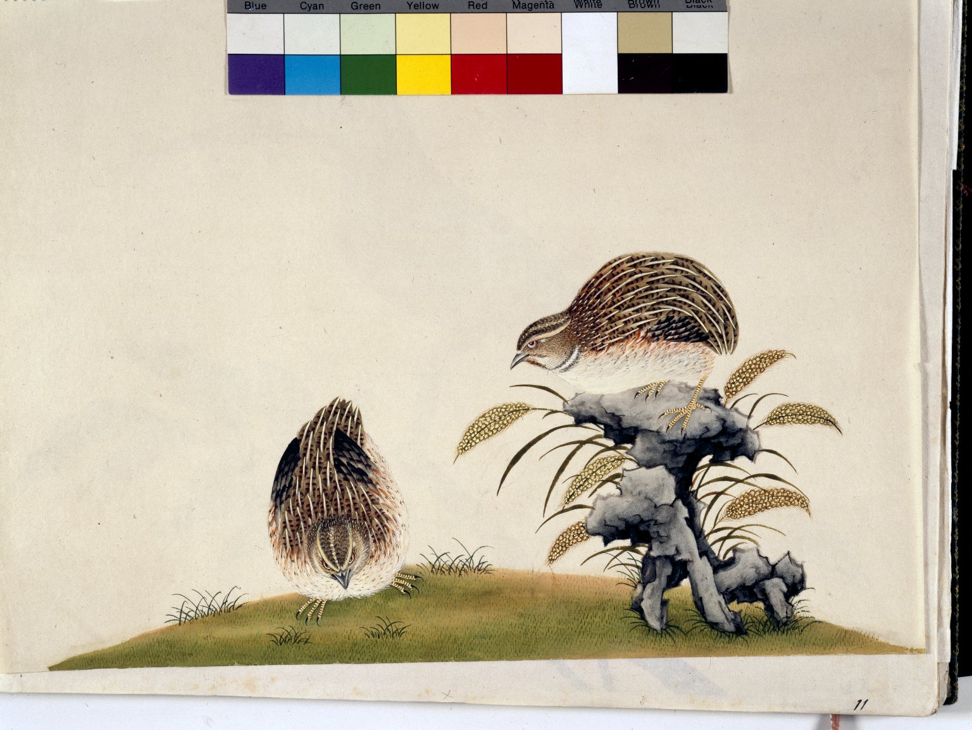
-------------
Image1
-------------
Field Data
Image Number JRL022744tr
Reference Number Chinese Drawings 21
Image Title Pair of Quails
Parent Work Title Chinese Drawings: Birds
Alternative Parent Work Title Crawford Chinese Collection: Illustrations
Date Created c1800
Volume 21
Page/Sheet No.11
Image Sequence Number 011
Description Illustrated: painting: Pair of Quails. Quails were popular in the Far East as an edible delicacy and for a version of cockfighting.
Subject Art, Chinese
Subject Birds
Subject Natural History
Category of Material Manuscripts
Technique Used Painting (image-making)
Places Covered China
Item Height 420 mm
Item Width 345 mm
Current Repository The University of Manchester Library, U.K.
Provenance Lindsay family Earls of Crawford and Balcarres, former owner
Rights Holder - Image The University of Manchester Library
Rights holder - Work The University of Manchester Library
Access Rights <a rel="license" href="http://creativecommons.org/licenses/by-nc-sa/4.0/"><img alt="Creative Commons License" style="border-width:0" src="https://i.creativecommons.org/l/by-nc-sa/4.0/88x31.png" /></a>
References 'Bulletin of the John Rylands University Library of Manchester', Vol. 82, Nos. 2 and 3, 2000. Zheng Yaying, 'Crawford Chinese Collection' 1991.
Image Creation Technique Scanned from colour transparency by Gten, March 2004
Metadata Language eng-GB

Slide 25
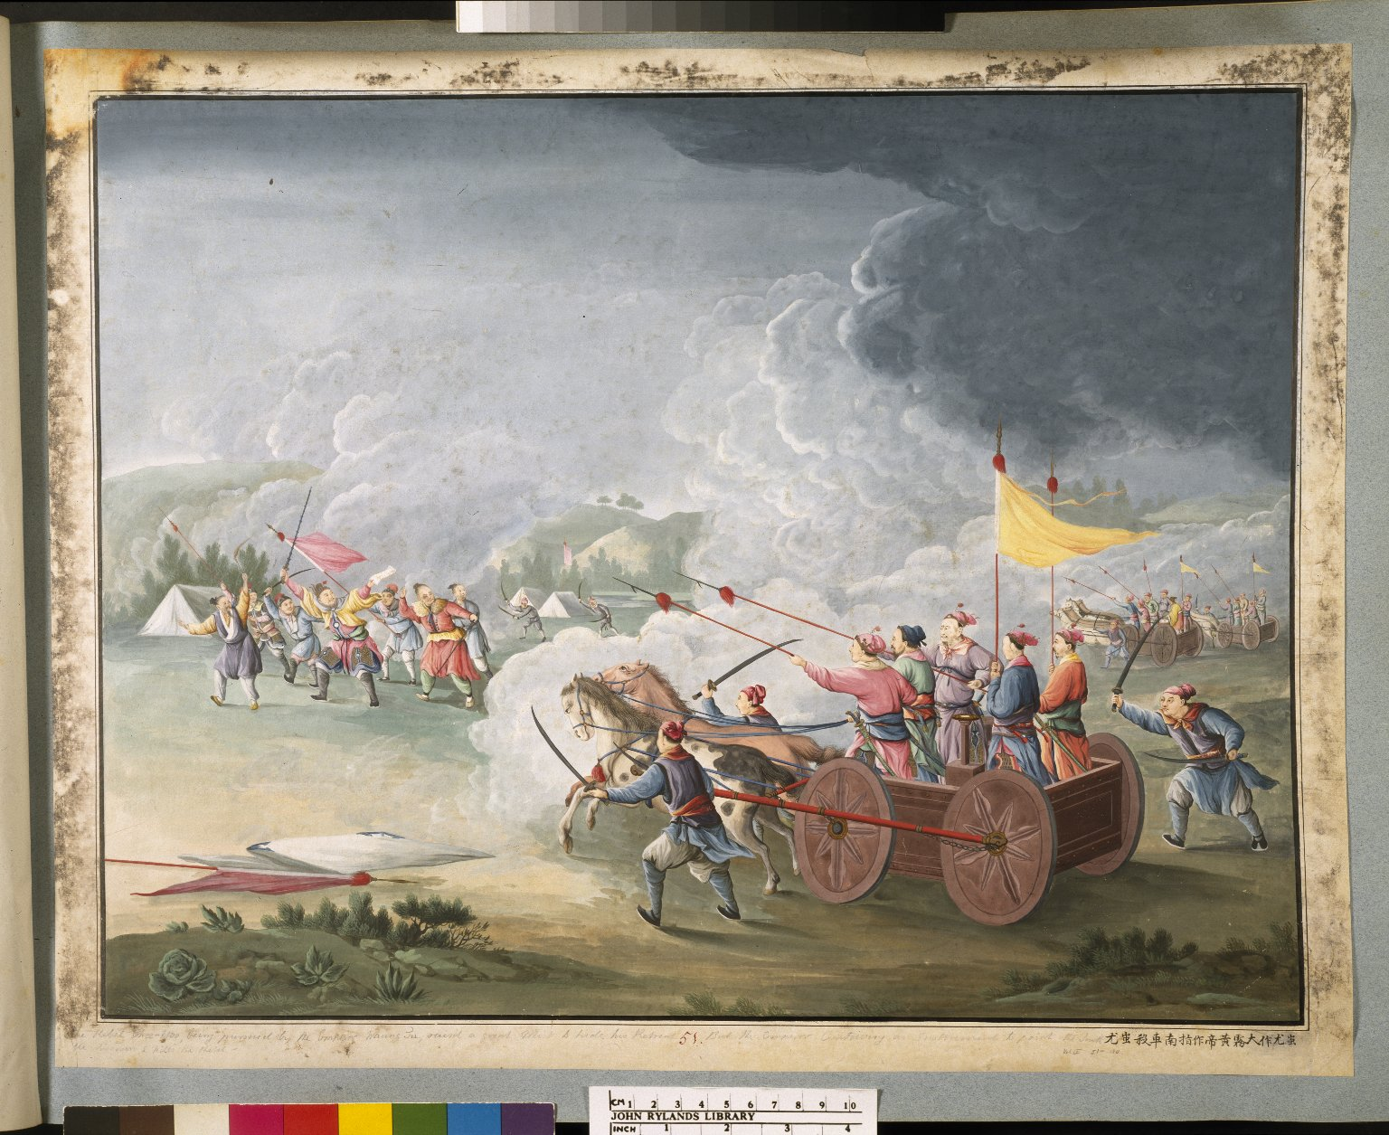
-------------
Image1
-------------
Field Data
Image Number JRL021869tr
Reference Number Chinese Drawings 56
Image Title Chi You
Parent Work Title Chinese Drawings: Historical Illustrations
Alternative Parent Work Title Crawford Chinese Collection: Illustrations
Date Created 18th century [late]
Page/Sheet No. 51
Image Sequence Number 051
Description Illustrated: painting: Chi You (a legendary rebel) made a big mist; Emperor Huang Di [2697 - 2597 BCE] made a vehicle with a wooden figure always pointing south (an early compass) & killed him. Depictions of Chinese myth, fables & historical events. Eighteenth century.
Subject Death
Subject Art, Chinese
Subject Folklore
Subject Art
Subject China--History
Category of Material Manuscripts
Technique Used Painting (image-making)
Creation Site China: Canton
Culture Cantonese
Culture Miao
Places Covered China
People Covered Emperor Huang Di, 2697-2597 BCE
Item Height 460 mm
Item Width 590 mm
Current Repository The University of Manchester Library, U.K.
Provenance Lindsay family Earls of Crawford and Balcarres, former owner
Rights Holder - Image The University of Manchester Library
Rights holder - Work The University of Manchester Library
References Zheng Yaying, 'Crawford Chinese Collection' 1991.
Image Creation Technique Scanned from colour transparency by Gten, August 2003
Metadata Language eng-GB

