Slide 1
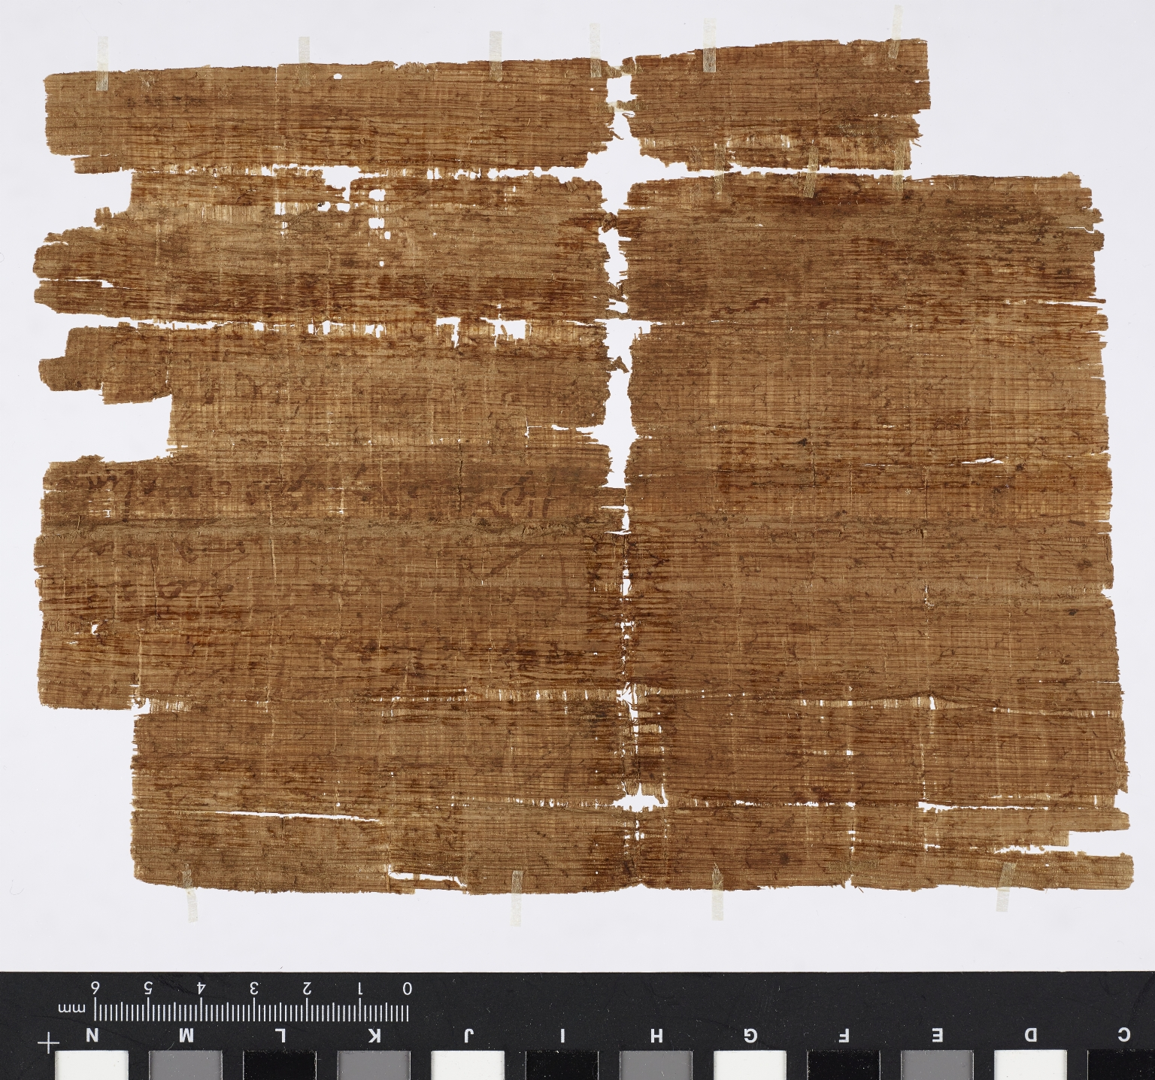
-------------
Image1
-------------
Field Data
Reference number Greek P Add 1166
Side verso
Image Number JRL16052148
Image Title Receipt for the payment of wheat (and money?)
Trismegistos Number <A href="http://www.trismegistos.org/text/697546"> 697546</a>
Publication status R. Mazza, ‘P.Ryl.Greek Add. 1166: Christian Prayer Amulet with a Tax Receipt on the Back’, Zeitschrift für Papirologie und Epigraphik 197 (2016), pp. 73-84.
Citation reference ZPE 197 (2016), p. 83-84
Description Remains of a receipt for the payment of wheat and maybe money for the annona. Translation: Village of Tertembuthis embole … through Menas for adaeratio two artabae of wheat, in total 2 artabae of wheat. And for your surety I have made this complete receipt as above written. … Tertembuthis … Menas, assistant, I agree and wrote (?) …
Creation site Egypt: Tertembythis [?]
Date created Carbon dating results: The papyrus was produced between 574 and 660 with a margin of certainty of 95.4 %; between 608 and 650 with a margin of 68.2 %.
Place covered Egypt: Tertembythis
Language Greek
Language code grc
Script grc
Item height 205 mm
Item width 160 mm
Technique used Handwriting
Support material Papyrus
Discovery site Egypt
Notes Purchased on the antiquities market at some point between 1898 and 1920.
Current repository The University of Manchester Library, U.K.
Category Manuscripts
Sub-Category Fragments
Image rights The University of Manchester Library
Work rights The University of Manchester Library
Image sequence number grcadd1166v
Image technique Digital capture by Heritage Imaging, The University of Manchester Library
Date image captured 2016-05-24
Date: issued 2017-11
Metadata language eng-GB

Slide 2
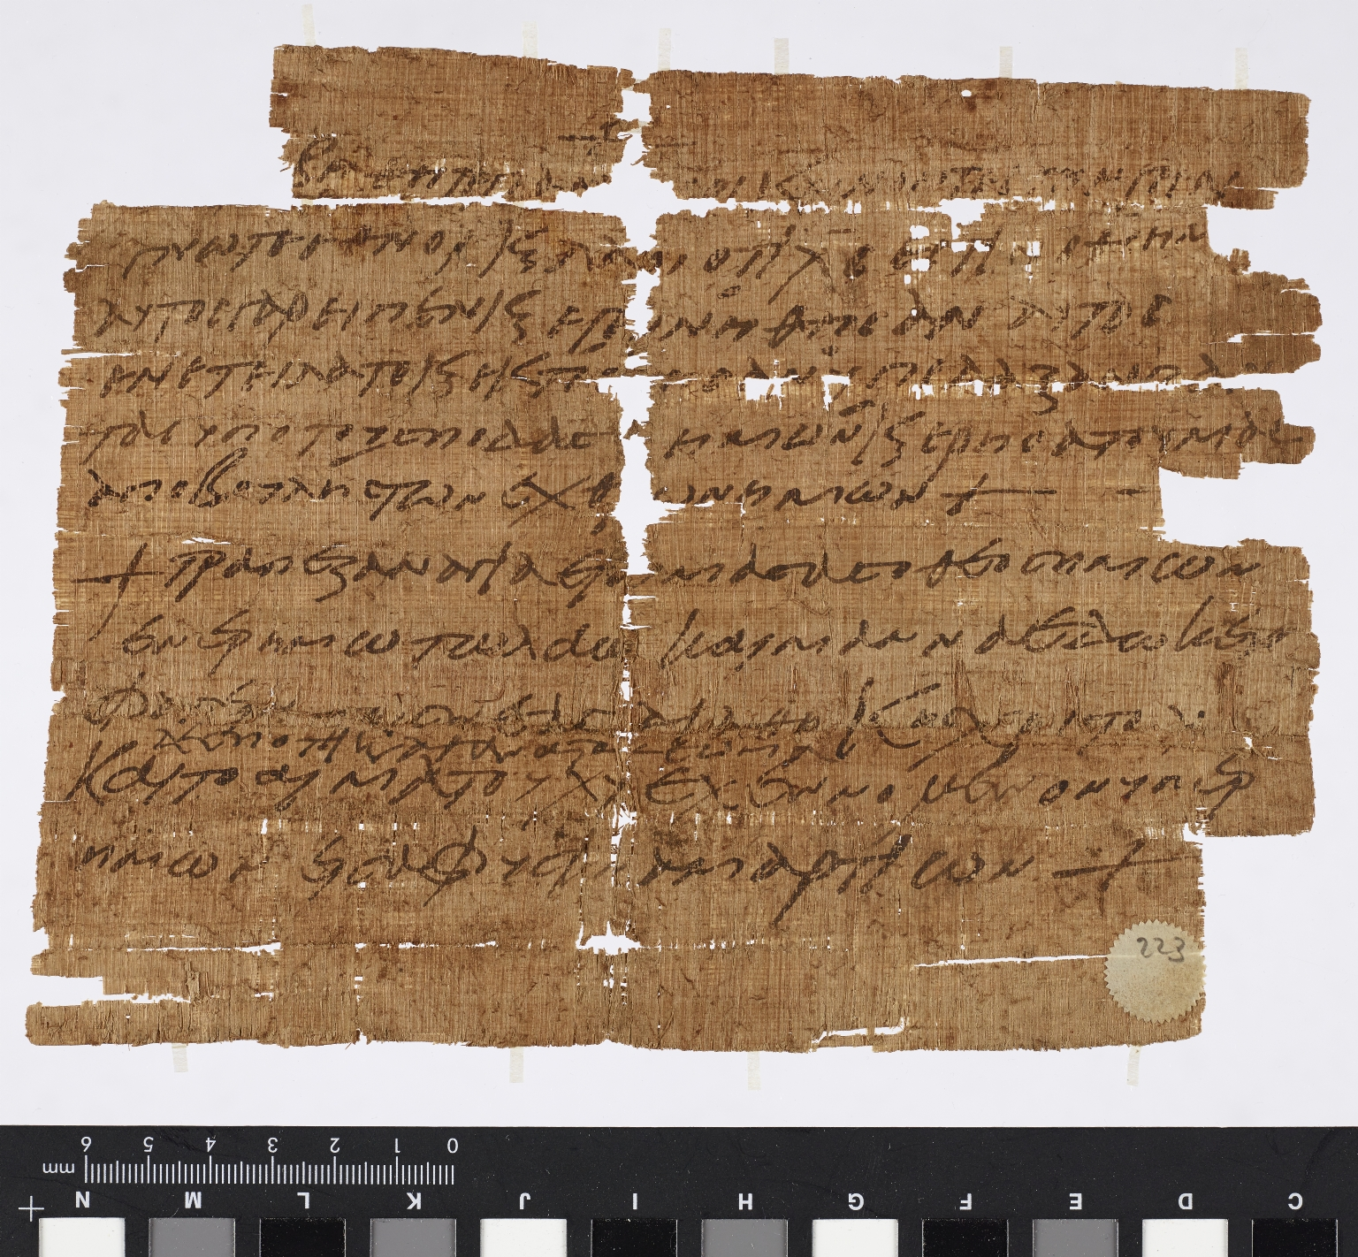
-------------
Image1
-------------
Field Data
Reference number Greek P Add 1166
Side recto
Image Number JRL16052147
Image Title Christian prayer amulet
Trismegistos Number <A href="http://www.trismegistos.org/text/697545"> 697545</a>
Publication status Published: R. Mazza, ‘P.Ryl.Greek Add. 1166: Christian Prayer Amulet with a Tax Receipt on the Back’, Zeitschrift für Papirologie und Epigraphik 197 (2016), pp. 73-84.
Citation reference ZPE 197 (2016), p.79-83
Description Christian prayer amulet. Translation: May you fear, all who rule over the earth. Know, you nations and peoples, that Christ is our God. For he spoke and they came to being, he commanded and they were created; he put all (people) under our feet and delivered us from the will of our enemies. Our God prepared a sacred table in the desert for the people and gave manna of the new covenant of Christ to eat, the Lord's immortal body and the blood of Christ poured for us in remission of sins.
Creation site Egypt: Tertembythis [?]
Date created Carbon dating results: The papyrus was produced between 574 and 660 with a margin of certainty of 95.4 %; between 608 and 650 with a margin of 68.2 %.
Language Greek
Language code grc
Script grc
Item height 205 mm
Item width 160 mm
Technique used Handwriting
Support material Papyrus
Discovery site Egypt
Notes Purchased on the antiquities market at some point between 1898 and 1920.
Current repository The University of Manchester Library, U.K.
Category Manuscripts
Sub-Category Fragments
Image rights The University of Manchester Library
Work rights The University of Manchester Library
Image sequence number grcadd1166r
Image technique Digital capture by Heritage Imaging, The University of Manchester Library
Date image captured 2016-05-24
Date: issued 2017-11
Metadata language eng-GB

