Slide 1
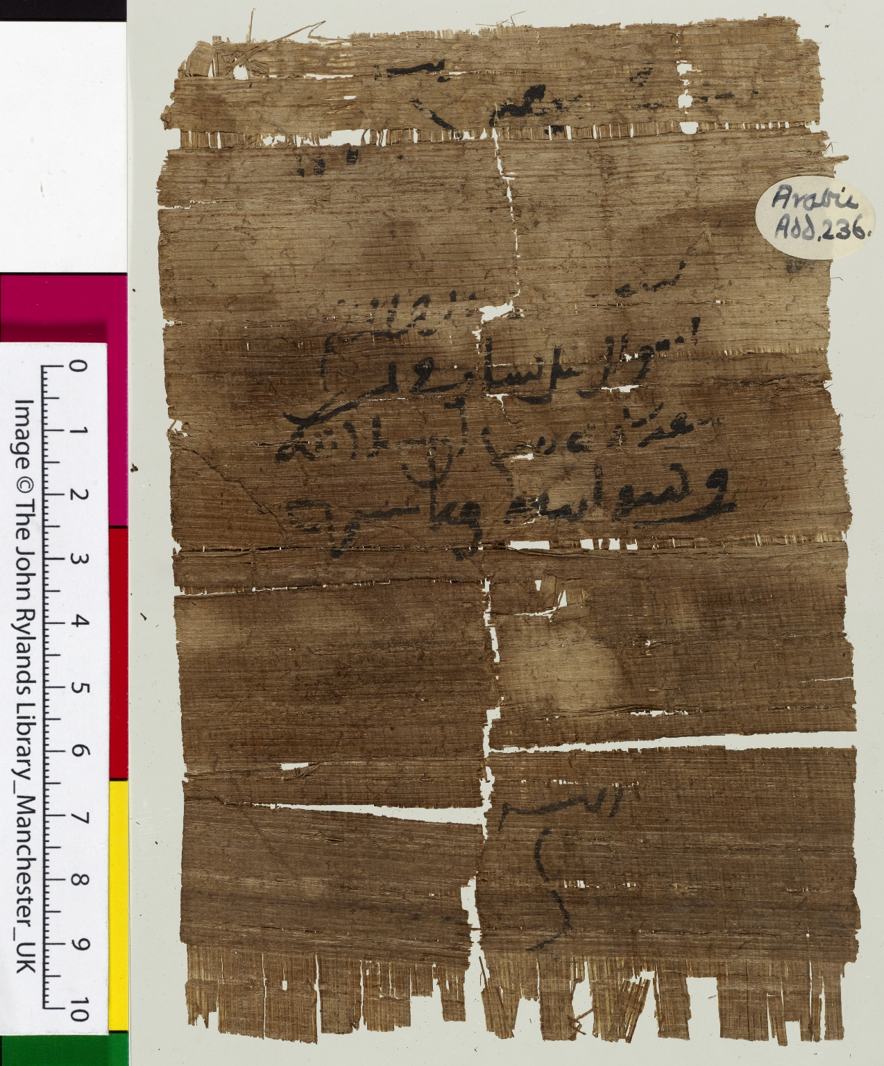
-------------
Image1
-------------
Field Data
Reference number Arabic P Add 236
Side recto
Image Number JRL1100157dc
Image Title IOU for barley
Citation reference P. Ryl. Arab. 2 236
Description An IOU for barley, dated 84 AH (703 CE), or possibly 204 AH (819 CE). If the reading of 84 is correct, this is the earliest dated Arabic papyrus in the collection.
Date created 703 CE (84 AH)
Language Arabic
Language code ara
Number of lines 7 lines
Technique used Handwriting
Medium Ink
Support material Papyrus
Bibliographic Reference G. Rex Smith and Moshalleh al-Moraekhi, 'The Arabic Papyri of the John Rylands University Library of Manchester', Bulletin of the John Rylands University Library of Manchester, vol. 78, no. 2 (1996).
Current repository The University of Manchester Library, U.K.
Former repository Lindsay family Earls of Crawford and Balcarres, former owner
Category Manuscripts
Sub-Category Fragments
Image rights The University of Manchester Library
Work rights The University of Manchester Library
Image technique Digital capture by Heritage Imaging, The University of Manchester Library
Date image captured 2010-09-06
Date: issued 2018-04
Metadata language eng-GB

Slide 2
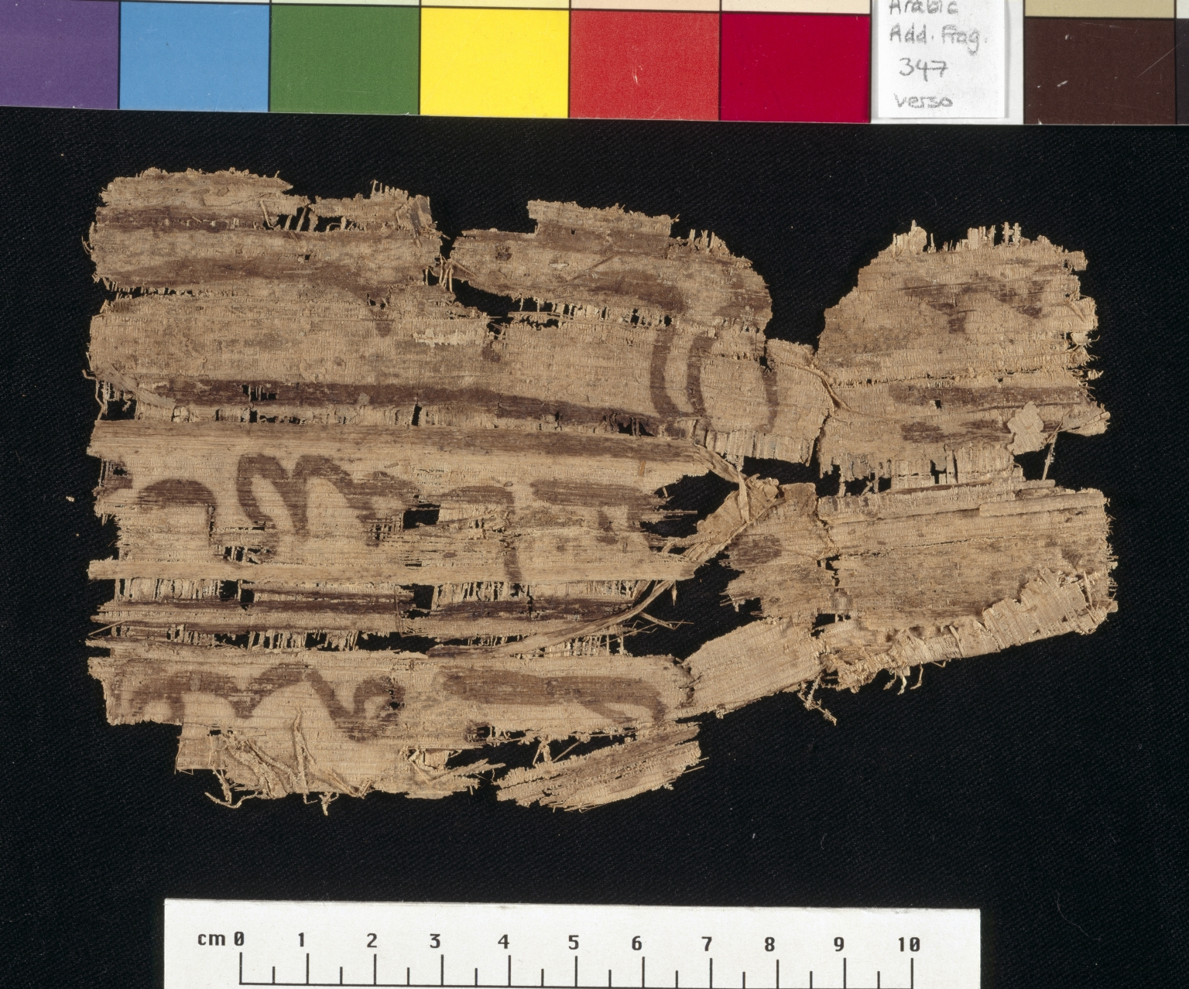
-------------
Image1
-------------
Field Data
Reference number Greek P 478 [a-b]
Side recto
Image Number JRL023051tr
Image Title Aeneid fragment
Trismegistos Number <A href="http://www.trismegistos.org/text/62954"> 62954</a>
Subject Poetry
Subject Classical literature
Creator Role Author
Creator Virgil
Source Title Aeneid
Section Volume 1
Citation reference P. Ryl. 3 478
Description Two fragments (a and b) of a manuscript of Aeneid I. Latin text with a word for word Greek translation. Both Latin and Greek texts were written by the same scribe, although there are corrections to the verses by at least one other hand.
Date created 4th century CE
Time period covered 1500 - 750 BCE
Language Latin
Language code lat
Language Greek
Language code grc
Item height Fragment a: 208 mm
Item width Fragment a: 229 mm
Technique used Handwriting
Support material Papyrus
Bibliography Hunt, Arthur S., et al. Catalogue of the Greek and Latin Papyri in the John Rylands Library, Manchester, University Press, 1911-1952
Current repository The University of Manchester Library, U.K.
Category Manuscripts
Sub-Category Fragments
Image rights The University of Manchester Library
Work rights The University of Manchester Library
Image sequence number grc0478ar
Image technique Scanned from colour transparency by Gten, October 2005
Metadata language eng-GB

