Slide 1
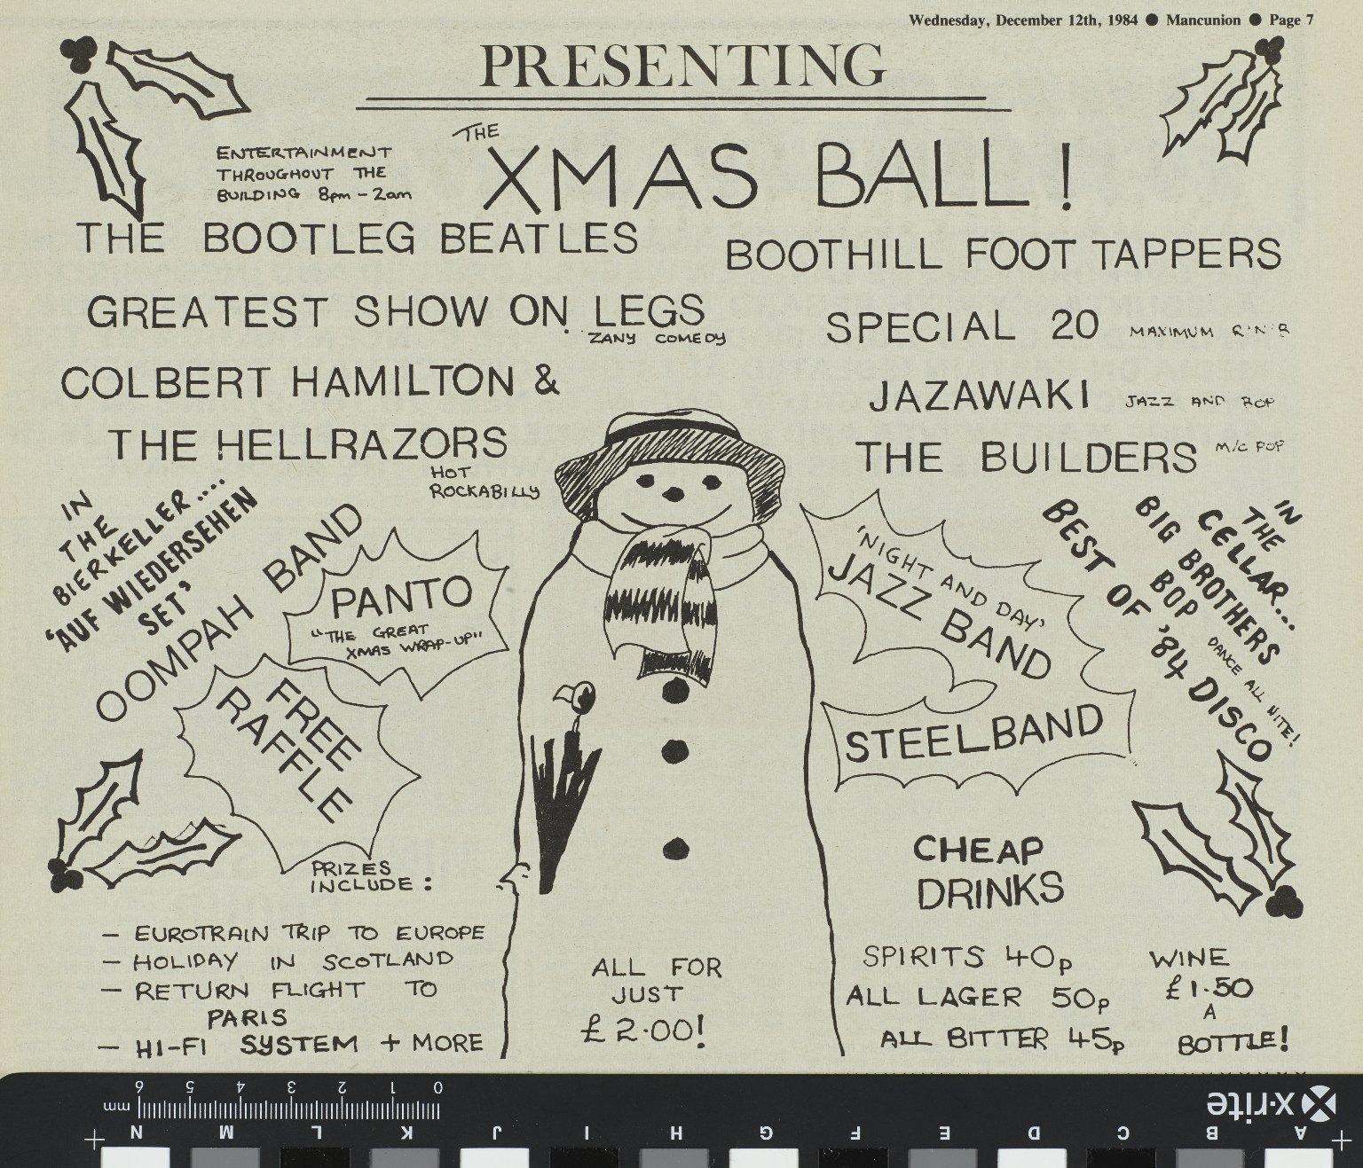
-------------
Image1
-------------
Field Data
Image Number JRL1412559
Reference Number University Archive
Image Title Advert for the Christmas Ball
Parent Work Title Mancunion
Date Created 1984-12-12
Page/Sheet 7
Description Advert for the Christmas Ball.
Language English
Language Code eng-GB
Subject University of Manchester
Category of Material Archives
Sub-Category Newspapers
Technique Used Printing (process)
Support Paper
Time Period Covered 20th Century CE
Places Covered England: Greater Manchester: Manchester
Rights Holder - Image The University of Manchester Library
Rights holder - Work The University of Manchester Library
Access Rights <a rel="license" href="http://creativecommons.org/licenses/by-nc-sa/4.0/"><img alt="Creative Commons License" style="border-width:0" src="https://i.creativecommons.org/l/by-nc-sa/4.0/88x31.png"></a>
Image Creation Technique Digital capture by Heritage Imaging, The University of Manchester Library

Slide 2
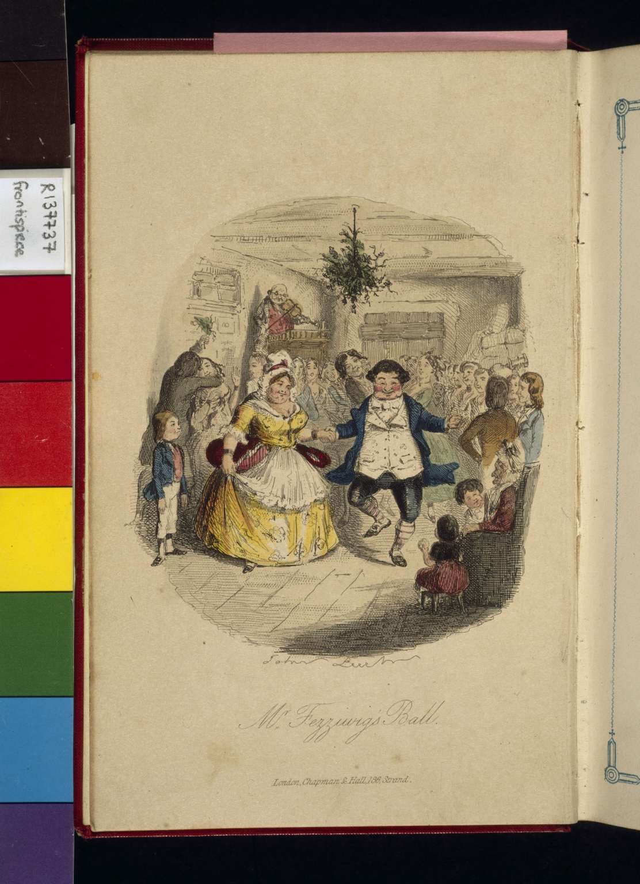
-------------
Image1
-------------
Field Data
Image Number JRL022708tr
Reference Number R137737 [Bellot Collection]
Link to Catalogue <A href=http://man-fe.hosted.exlibrisgroup.com/MU_VU1:BLENDED:44MAN_ALMA_DS21203172510001631>UoM online catalogue.</a>
Image Title Mr Fezziwig's Ball
Parent Work Title Christmas carol in prose: being a ghost story of Christmas
Creator Leech, John
Creator Role Illustrator
Creator Dickens, Charles, 1812-1870
Creator Role Author
Date Created 1844
Publication Details London: Chapman and Hall
Page/Sheet Frontispiece
Description Illustrated: Mr Fezziwig's Ball
Language Code eng-GB
Subject English literature
Category of Material Printed
Sub-Category Illustrated works
Time Period Covered 19th Century CE
Places Covered England
Current Repository The University of Manchester Library, U.K.
Provenance Bellot Collection
Rights Holder - Image The University of Manchester Library
Rights holder - Work The University of Manchester Library
Image Creation Technique Scanned from colour transparency by Gten, April 2004
Metadata Language eng-GB

Slide 3
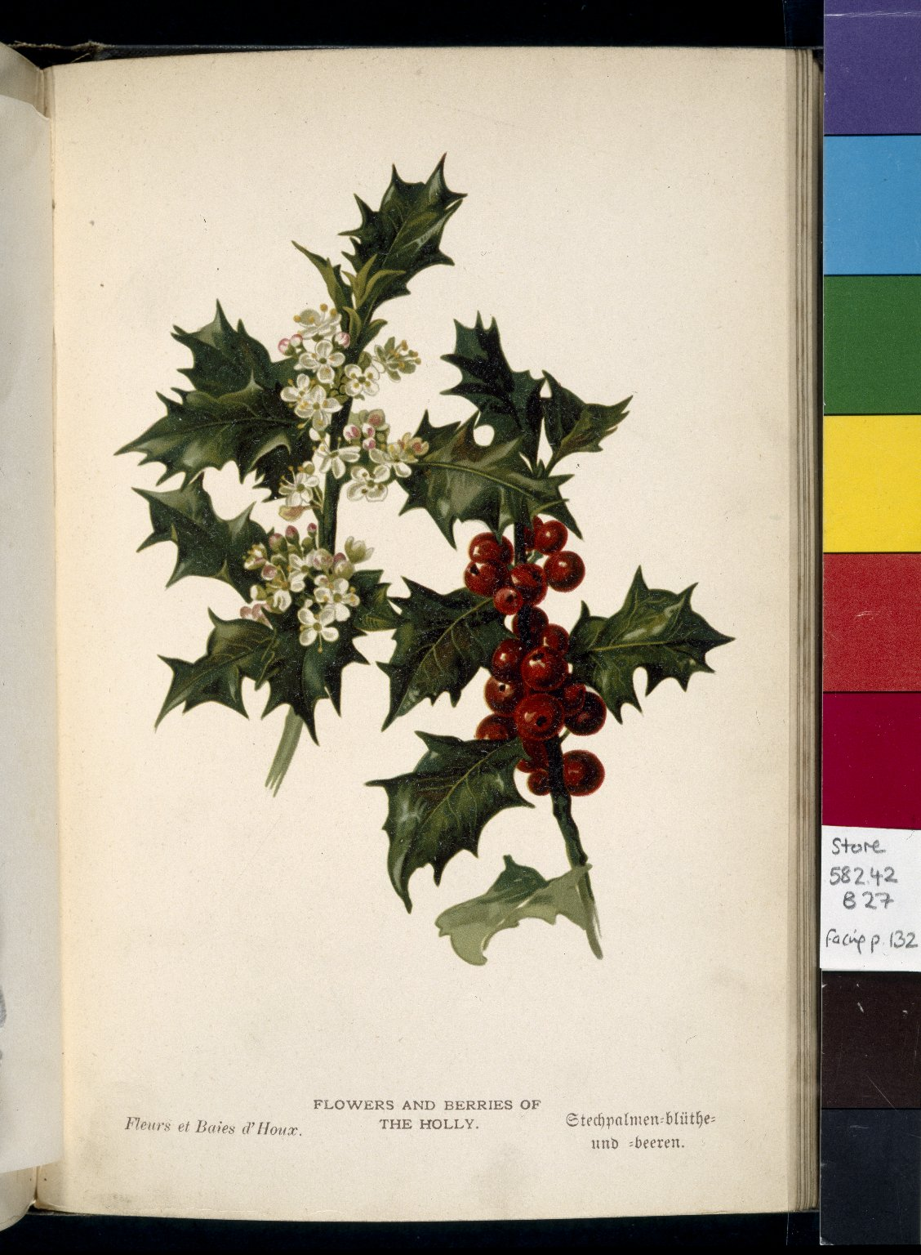
-------------
Image1
-------------
Field Data
Image Number JRL022992tr
Reference Number ML Store 582.42 B27
Link to Catalogue <A href=http://man-fe.hosted.exlibrisgroup.com/MU_VU1:BLENDED:44MAN_ALMA_DS21176292820001631>UoM online catalogue.</a>
Image Title Holly
Parent Work Title Familiar trees
Creator Boulger, George Simonds, 1853-1922
Creator Role Author
Creator Boot, W. H. J.
Creator Role Illustrator
Date Created 1887-1888
Publication Details London ; New York : Cassell & Co.
Page/Sheet Opposite page 132
Description Illustrated: Flowers and the berries of the Holly.
Language Code eng-GB
Subject Natural History
Subject Botany
Subject Trees
Category of Material Printed
Sub-Category Illustrated works
Current Repository The University of Manchester Library, U.K.
Rights Holder - Image The University of Manchester Library
Rights holder - Work The University of Manchester Library
Image Creation Technique Scanned from colour transparency by Gten, November 2005
Metadata Language eng-GB

Slide 4
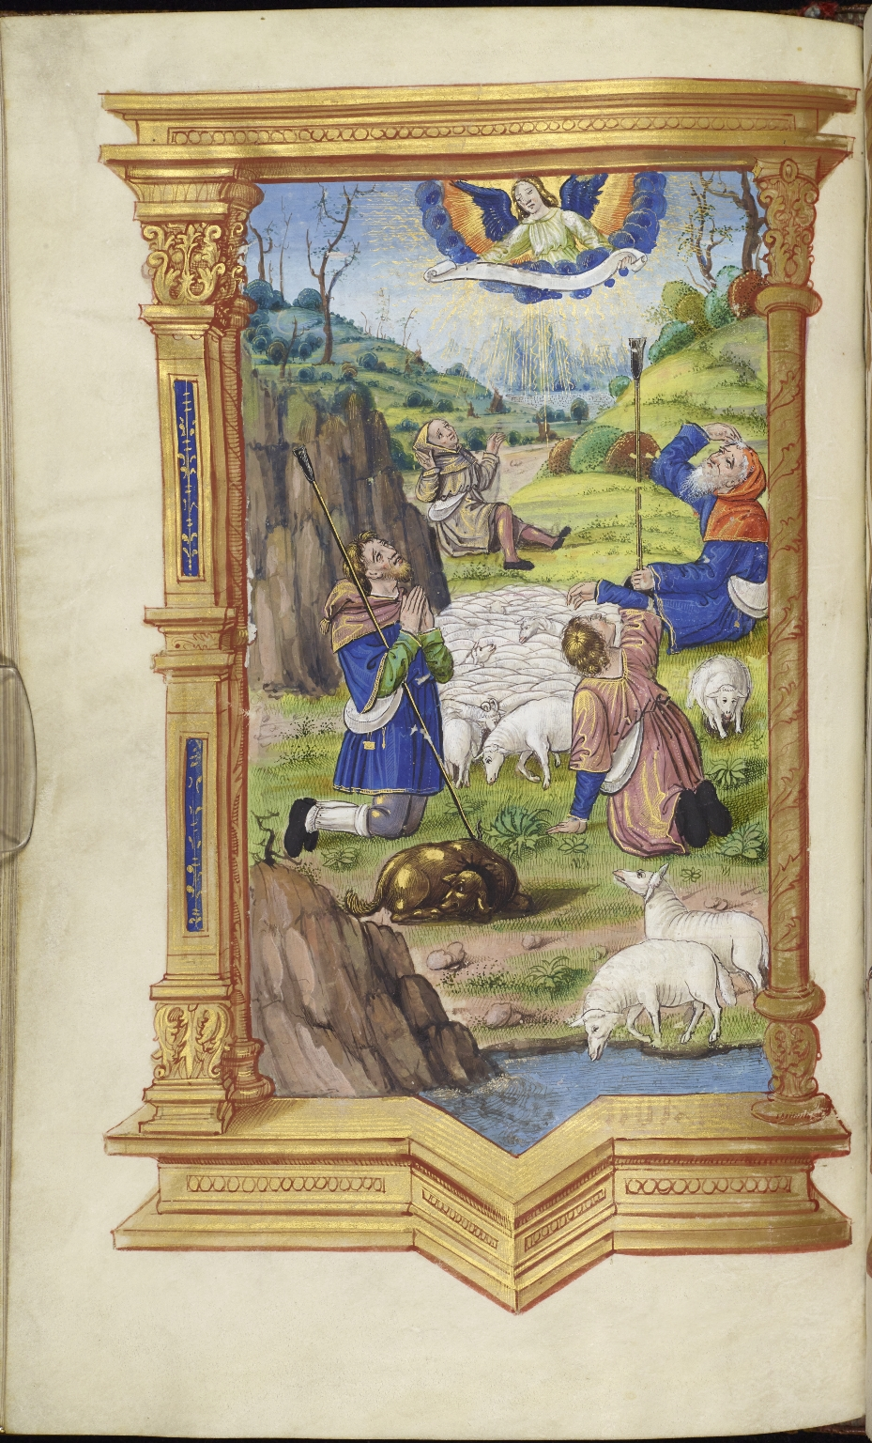
-------------
Image1
-------------
Field Data
Image Number JRL15030329
Reference Number Latin MS 38
Image Title Angel appearing to the shepherds
Parent Work Title Horae [Galiot de Genouillac]
Translated Parent Work Title Book of Hours
Date Created 16th century
Page/Sheet 48v
Image Sequence Number 048v
Description Illustrated: An angel tells the shepherds of the birth of Jesus. Full page. Sixteenth century. Commissioned for Galiot de Genouillac. The manuscript has been digitised in its entirety and can be viewed <A href=" http://luna.manchester.ac.uk/luna/servlet/s/1ur18v ">here</a>
Language Code lat-IT
Language Latin
Subject Catholic Church
Subject Christianity
Subject Books of hours
Subject Bible. New Testament
Category of Material Manuscripts
Sub-Category Codex
Sub-Category Miniatures (paintings)
Support Vellum
Item Height 259 mm
Item Width 165 mm
Current Repository The University of Manchester Library, U.K.
Provenance Lindsay family Earls of Crawford and Balcarres, former owner
Rights Holder - Image The University of Manchester Library
Rights holder - Work The University of Manchester Library
Access Rights <a rel="license" href="http://creativecommons.org/licenses/by-nc-sa/4.0/"><img alt="Creative Commons License" style="border-width:0" src="https://i.creativecommons.org/l/by-nc-sa/4.0/88x31.png" /></a><br />This work is licensed under a <a rel="license" href="http://creativecommons.org/licenses/by-nc-sa/4.0/">Creative Commons Attribution-NonCommercial-ShareAlike 4.0 International License.</a> Copyright of The University of Manchester
References M.R. James, A Descriptive Catalogue of the Latin Manuscripts in the John Rylands Library at Manchester (Manchester, 1921), reprinted with an introduction and additional notes and corrections by F. Taylor (Munich, 1980)
Date Captured (yyyy-mm-dd) 2015-03-18
Image Creation Technique Digital capture by Heritage Imaging, The University of Manchester Library
Date Image Added (yyyy-mm) 2017-12
Metadata Language eng-GB

Slide 5
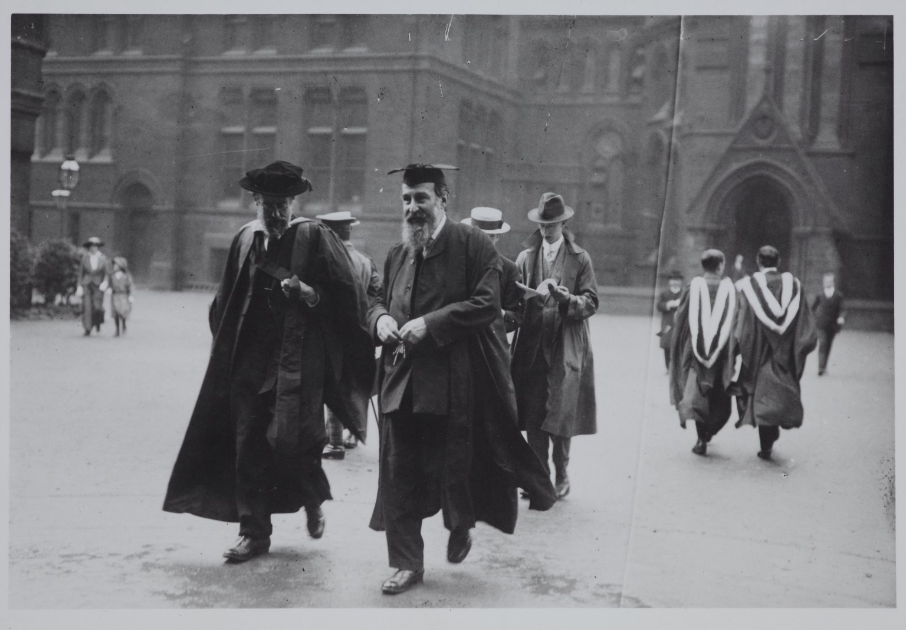
-------------
Image1
-------------
Field Data
Image Number JRL1201093
Reference Number UPC/1/1
Image Title Professor Samuel Alexander
Parent Work Title University Photographic Collection
Date Created c1920-1929
Description Black and white photograph: Professor Samuel Alexander. Alexander was Professor of Philosophy at the University of Manchester 1893-1924. The photograph shows Alexander in his robes outside the John Owens building in conversation with a colleague, possibly on their way to a degree ceremony.
Subject Philosophy
Subject University of Manchester
Category of Material Archives
Sub-Category Analogue photography
Support Paper
Creation Site England: Greater Manchester: Manchester
Time Period Covered 20th Century CE
Places Covered England: Greater Manchester: Manchester
People Covered Alexander, Samuel, 1859-1938
Item Height 164 mm
Item Width 113 mm
Rights Holder - Image The University of Manchester Library
Rights holder - Work The University of Manchester Library
Access Rights <a rel="license" href="http://creativecommons.org/licenses/by-nc-sa/4.0/"><img alt="Creative Commons License" style="border-width:0" src="https://i.creativecommons.org/l/by-nc-sa/4.0/88x31.png"></a>
Image Creation Technique Digital capture by Heritage Imaging, The University of Manchester Library

