Slide 1
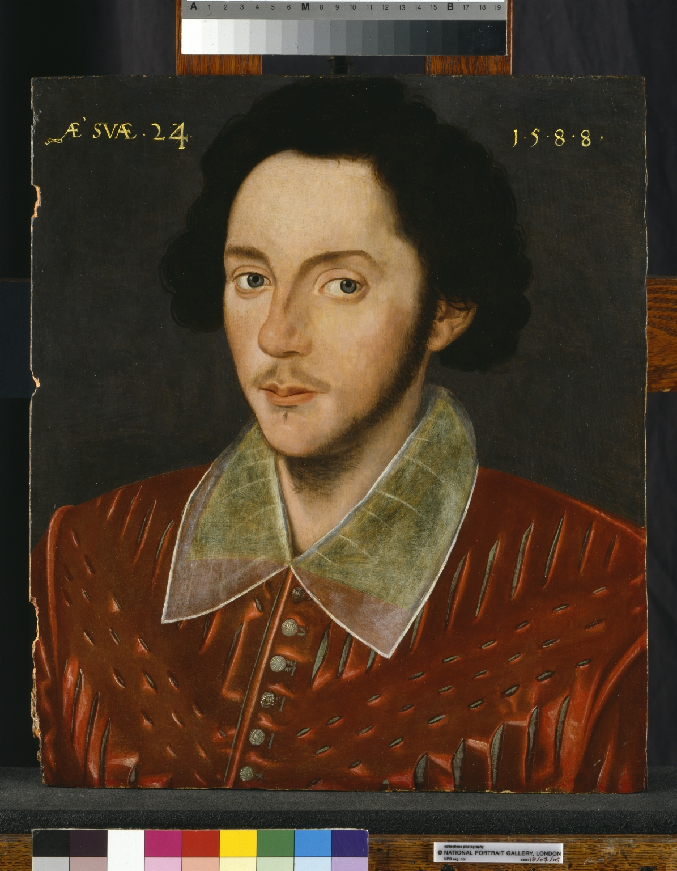
-------------
Image1
-------------
Field Data
Image Number JRL0700930tr
Reference Number VFA.5
Image Title Grafton portrait restored
Creator Artist unknown
Date Created 1588
Description Portrait of an unknown young man, known as the Grafton portrait. Despite lack of evidence, facial similarities between this & the Shakespeare portrait in the collected plays (1623) have encouraged a belief that this is a portrait of Shakespeare, aged 24. Left to the Library in 1914 by Thomas Kay of Stockport. Newly restored by the National Portrait Gallery in 2005.
Subject Art
Category of Material Fine Art
Sub-Category Portraits
Technique Used Painting (image-making)
Medium Oil paint
Support Wood
Time Period Covered 16th Century CE
Current Repository The University of Manchester Library, U.K.
Rights Holder - Image The University of Manchester Library
Rights holder - Work The University of Manchester Library
Notes Photograph dated 18th July 2005
Date Captured (yyyy-mm-dd) 2005-07-18
Image Creation Technique Scanned from colour transparency by Gten
Date Image Added (yyyy-mm) 2007-01
Metadata Language eng-GB

Slide 2
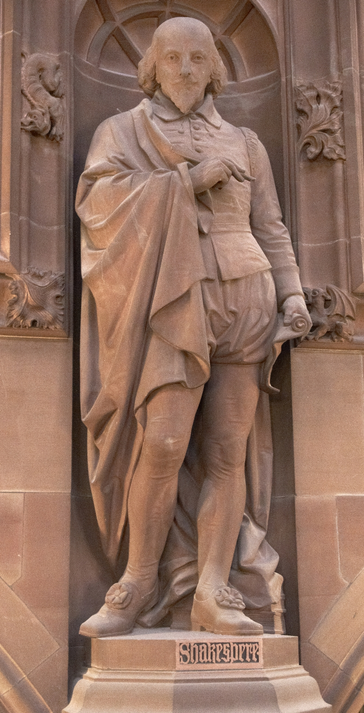
-------------
Image1
-------------
Field Data
Image Number JRL1212210
Image Title William Shakespeare
Creator Champneys, Basil, 1842-1935
Creator Role Architect
Creator Robert Bridgeman & Sons Ltd
Creator Role Sculptor
Date Created 1895-1897
Description Statue of William Shakespeare in the Historic Reading Room, John Rylands Library. William Shakespeare was an English poet, playwright, and actor, widely regarded as the greatest writer in the English language and the world's pre-eminent dramatist. He is often called England's national poet, and the "Bard of Avon".
Subject Architecture
Subject Library buildings
Subject John Rylands Library
Sub-Category Sculpture
Technique Used Sculpting
Support Shawk stone
Creation Site England: Manchester
Time Period Covered 19th Century CE
Places Covered England: Greater Manchester: Manchester
Current Site The John Rylands Library, Deansgate, Manchester, U.K.
Rights Holder - Image The University of Manchester Library
Rights holder - Work The University of Manchester Library
Access Rights <a rel="license" href="http://creativecommons.org/licenses/by-nc-sa/4.0/"><img alt="Creative Commons License" style="border-width:0" src="https://i.creativecommons.org/l/by-nc-sa/4.0/88x31.png"></a>
Date Captured (yyyy-mm-dd) 2012-02-13
Image Creation Technique Digital capture by Heritage Imaging, The University of Manchester Library
Metadata Language eng-GB
Date Image Added (yyyy-mm) 2015-11

Slide 3
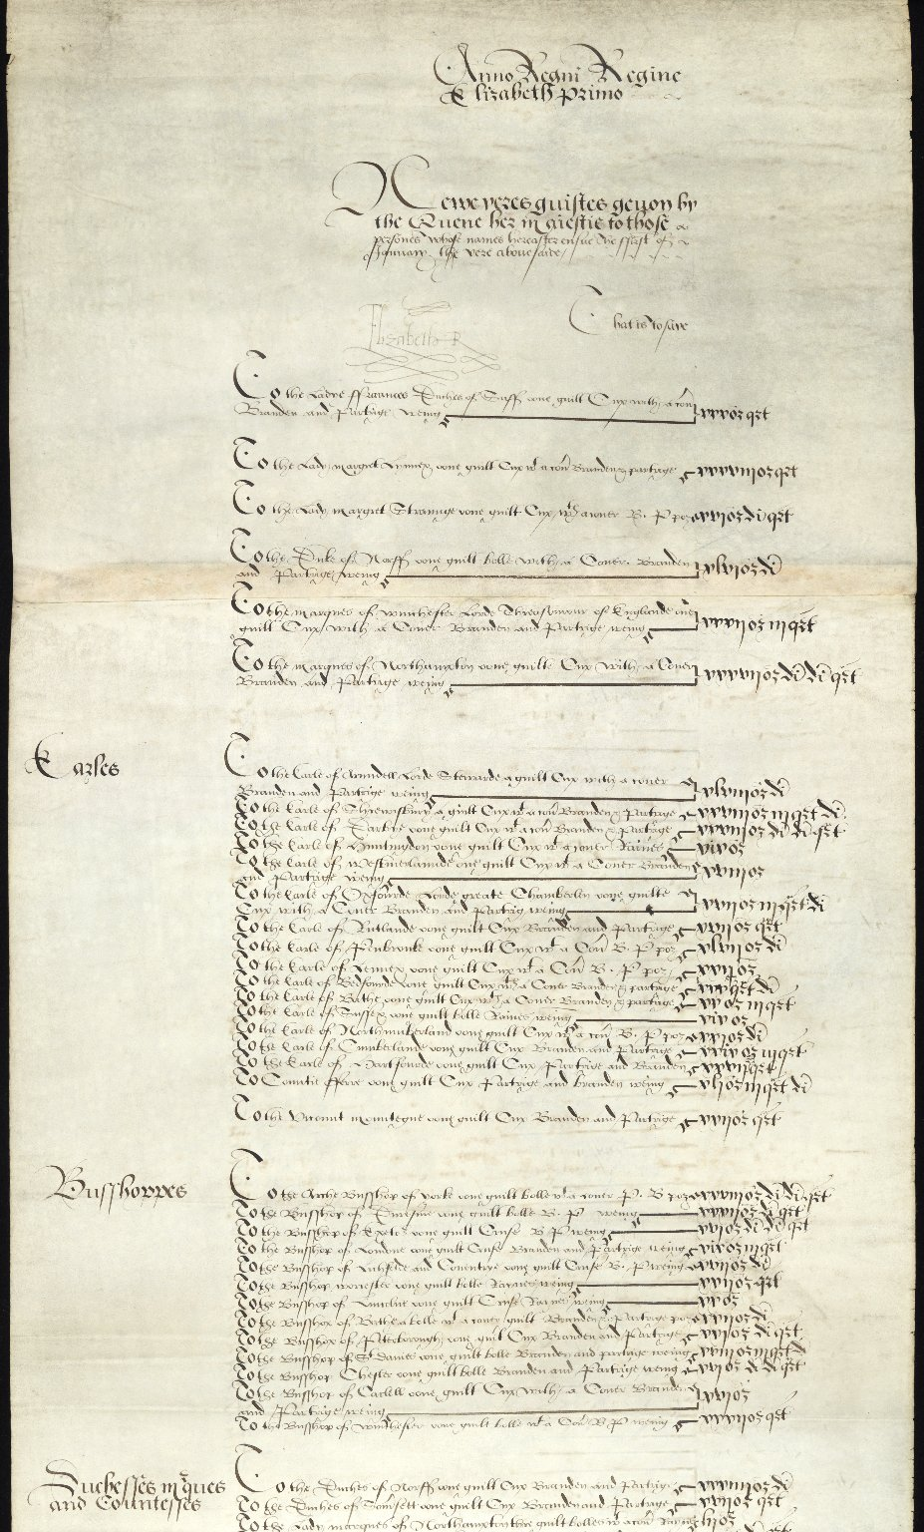
-------------
Image1
-------------
Field Data
Image Number JRL1101032dc
Reference Number English MS 117
Parent Work Title Elizabeth I's New Year's Gifts of 1559
Date Created 1558-1559
Volume Roll two
Page/Sheet Frame two
Image Sequence Number 002
Image Sequence Total 015
Description Second of 15 digital sections:Text from the second roll of two rollers attached. A list of gifts made by the Queen. The signature Elizabeth R. at the head and foot of the roll.
Language Code eng-GB
Language English
Subject Diplomatic gifts
Category of Material Manuscripts
Sub-Category Rolls
Technique Used Handwriting
Medium Ink
Support Vellum
Time Period Covered 16th Century CE
People Covered Elizabeth I, Queen of England, 1533-1603
Item Height 3470 mm
Item Width 428 mm
Current Repository The University of Manchester Library, U.K.
Provenance Joy, Frederick Walker (former owner)
Rights Holder - Image The University of Manchester Library
Access Rights <a rel="license" href="http://creativecommons.org/licenses/by-nc-sa/4.0/"><img alt="Creative Commons License" style="border-width:0" src="https://i.creativecommons.org/l/by-nc-sa/4.0/88x31.png"></a>
References Tyson, Moses. Hand-List of the Collection of English Manuscripts in the John Rylands Library, 1928
Date Captured (yyyy-mm-dd) 2010-09-30
Image Creation Technique Digital capture by Heritage Imaging, The University of Manchester Library
Metadata Language eng-GB

