Slide 3
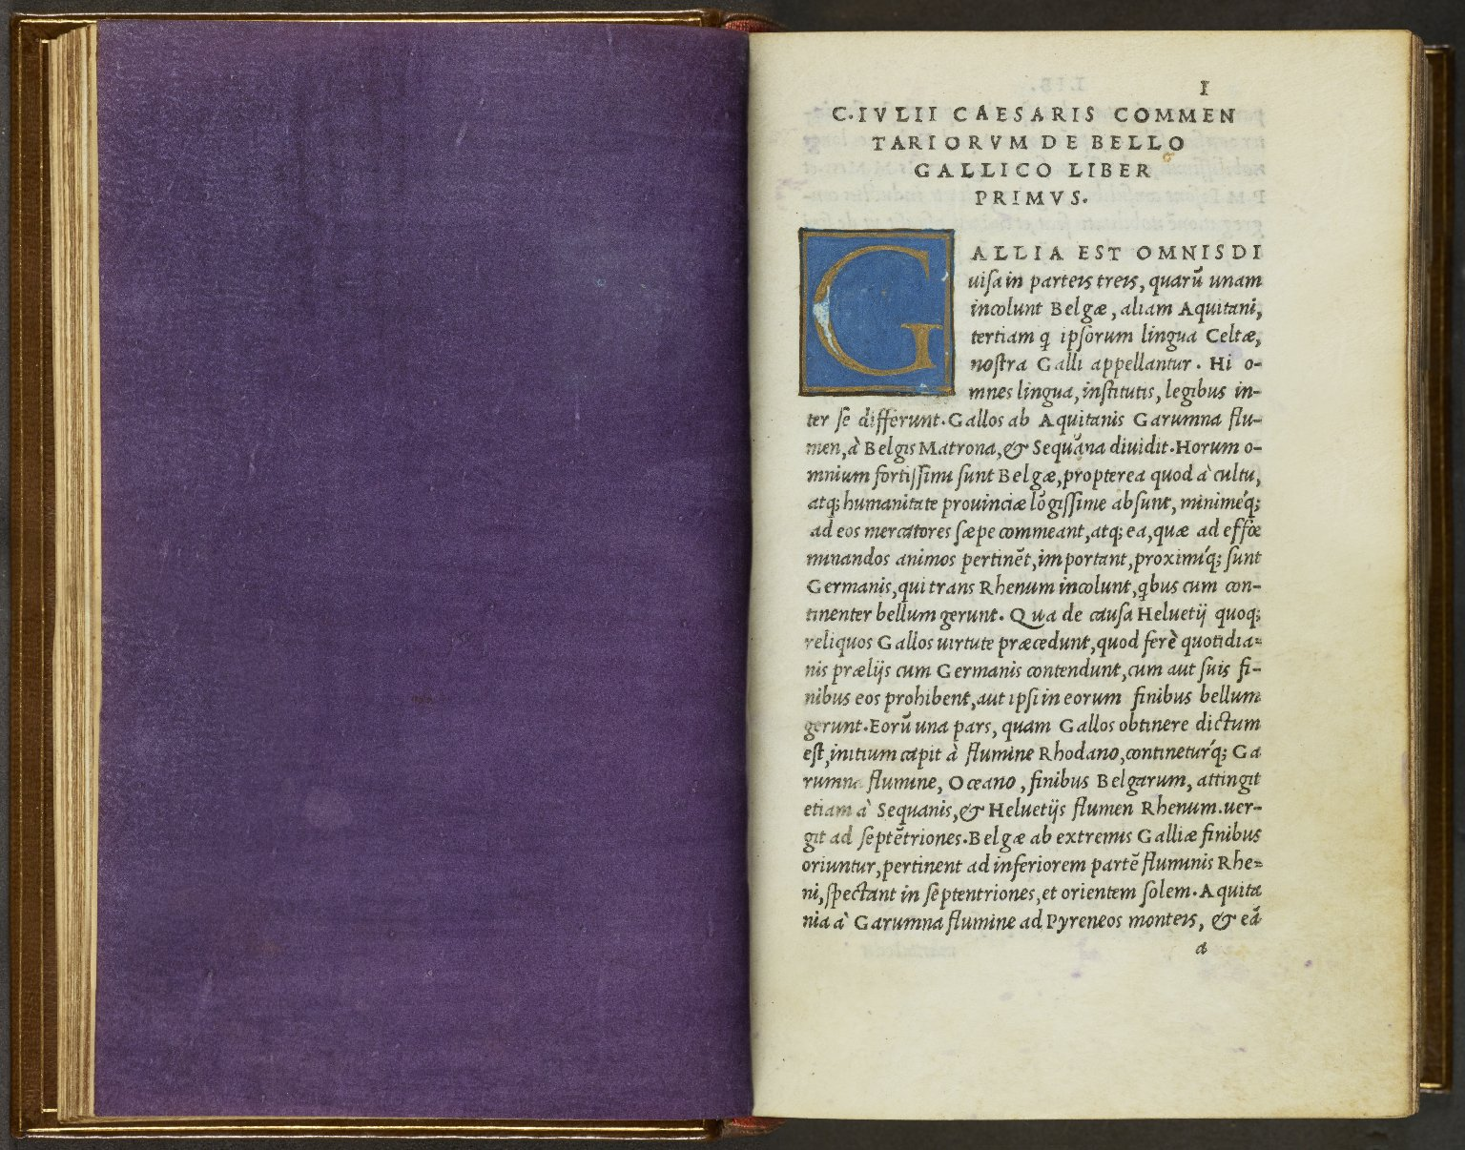
-------------
Image1
-------------
Field Data
Image Number JRL1500854
Reference Number Aldine 3553
Link to Catalogue <A href="http://man-fe.hosted.exlibrisgroup.com/MU_VU1:44MAN_ALMA_DS21164282330001631">UoM online catalogue.</a>
Image Title Opening text
Parent Work Title Hoc volvmine continentvr haec. Commentariorum de bello Gallico libri VIII ; De bello ciuili pompeiano. libri IIII. ; De bello Alexandrino. liber I. ; De bello Africano. liber I. ; De Bello Hispaniensi. liber I. : Pictura totius Galliæ, diuisæ in parteis treis, secundum C. Cæsaris Commentarios. Nomina locorum, urbiumq[ue];, & populorum Galliæ, ut olim dicebantur latine, & nunc dicuntur gallice, secundum ordinem alphabeti. Pictura pontis in Rheno. Item Auarici. Alexiæ. Vxelloduni. Massiliæ. Literæ Max. Pontificum, nequis libros cura nostra excusos imprimat, uendatue &c. ut in literis sub pœna excommunicationis lata sententia.
Creator Caesar, Julius
Creator Role Author
Creator Manuzio, Aldo, 1449 or 50-1515
Creator Role Printer
Creator Torresanus, Andreas, de Asula, 1451-1529
Creator Role Printer
Creator Giocondo, Giovanni, approximately 1433-1515
Creator Role Editor
Date Created 1513-04
Publication Details Venetiis: in aedibus Aldi, et Andreae soceri
Page/Sheet a1r
Description Digitally stitched image: inserted purple vellum leaf and opening text.
Keyword Aldus Manutius; Aldine Press.
Language Code lat-IT
Language Latin
Subject Rome -- History, Military -- 265-30 B.C
Subject Rome -- History -- Republic, 265-30 B.C -- Early works to 1800
Subject Military history
Category of Material Printed
Technique Used Illumination (image-making process)
Medium Ink
Support Vellum
Current Repository The University of Manchester Library, U.K.
Provenance Spencer, George John Spencer, Earl, 1758-1834, former owner
Rights Holder - Image The University of Manchester Library
Rights holder - Work The University of Manchester Library
Notes Composite image of JRL1500771 and JRL1500772
Date Captured (yyyy-mm-dd) 2014-09-11
Image Creation Technique Digital capture by Heritage Imaging, The University of Manchester Library
Date Image Added (yyyy-mm) 2014-09
Metadata Language eng-GB

Slide 4
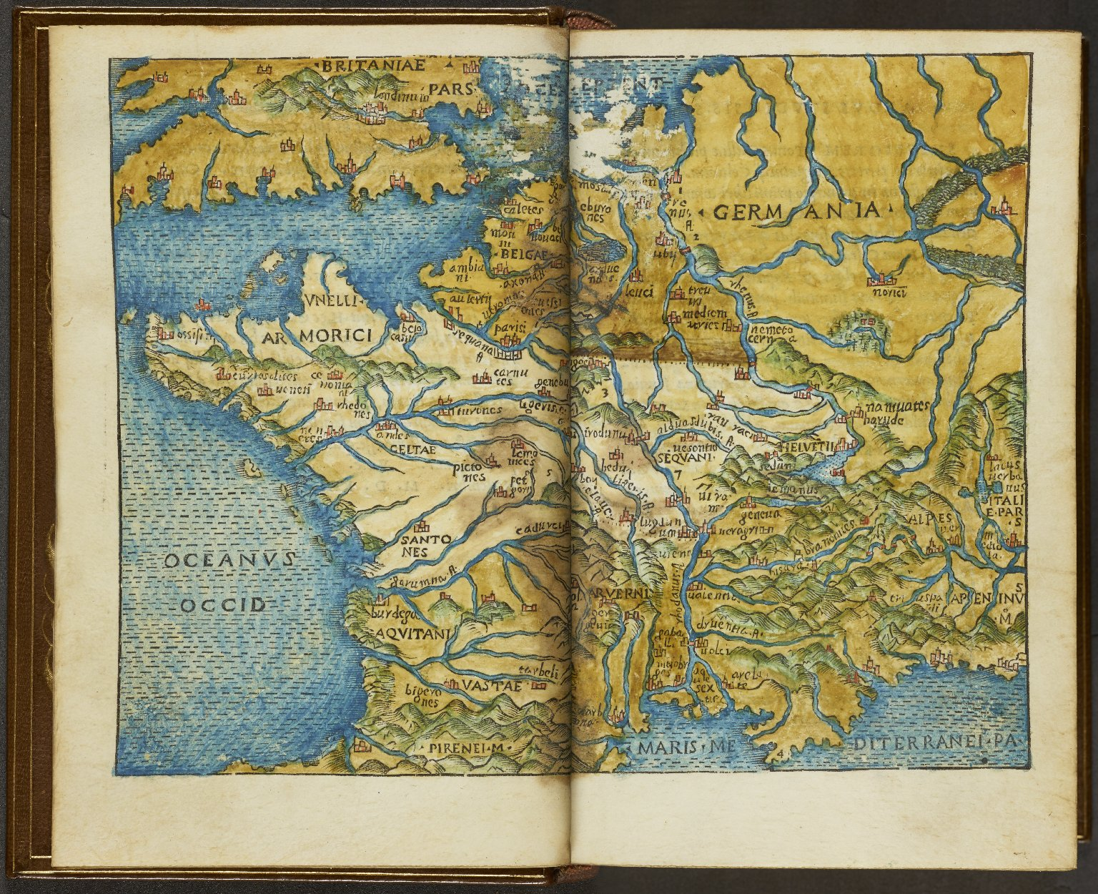
-------------
Image1
-------------
Field Data
Image Number JRL1500853
Reference Number Aldine 3553
Link to Catalogue <A href="http://man-fe.hosted.exlibrisgroup.com/MU_VU1:44MAN_ALMA_DS21164282330001631">UoM online catalogue.</a>
Image Title Map of Gaul
Parent Work Title Hoc volvmine continentvr haec. Commentariorum de bello Gallico libri VIII ; De bello ciuili pompeiano. libri IIII. ; De bello Alexandrino. liber I. ; De bello Africano. liber I. ; De Bello Hispaniensi. liber I. : Pictura totius Galliæ, diuisæ in parteis treis, secundum C. Cæsaris Commentarios. Nomina locorum, urbiumq[ue];, & populorum Galliæ, ut olim dicebantur latine, & nunc dicuntur gallice, secundum ordinem alphabeti. Pictura pontis in Rheno. Item Auarici. Alexiæ. Vxelloduni. Massiliæ. Literæ Max. Pontificum, nequis libros cura nostra excusos imprimat, uendatue &c. ut in literis sub pœna excommunicationis lata sententia.
Creator Manuzio, Aldo, 1449 or 50-1515
Creator Role Printer
Creator Caesar, Julius
Creator Role Author
Creator Torresanus, Andreas, de Asula, 1451-1529
Creator Role Printer
Creator Giocondo, Giovanni, approximately 1433-1515
Creator Role Editor
Date Created 1513-04
Publication Details Venetiis: in aedibus Aldi, et Andreae soceri
Description Digitally stitched opening: hand coloured map of Gaul.
Keyword Aldus Manutius; Aldine Press.
Language Code lat-IT
Language Latin
Subject Rome -- History, Military -- 265-30 B.C
Subject Rome -- History -- Republic, 265-30 B.C -- Early works to 1800
Subject Military history
Category of Material Printed
Category of Material Maps
Medium Ink
Support Vellum
Places Covered France
Places Covered Germany
Current Repository The University of Manchester Library, U.K.
Provenance Spencer, George John Spencer, Earl, 1758-1834, former owner
Rights Holder - Image The University of Manchester Library
Rights holder - Work The University of Manchester Library
Notes Composite image of JRL1500769 and JRL1500770
Date Captured (yyyy-mm-dd) 2014-09-11
Image Creation Technique Digital capture by Heritage Imaging, The University of Manchester Library
Date Image Added (yyyy-mm) 2014-09
Metadata Language eng-GB

Slide 5
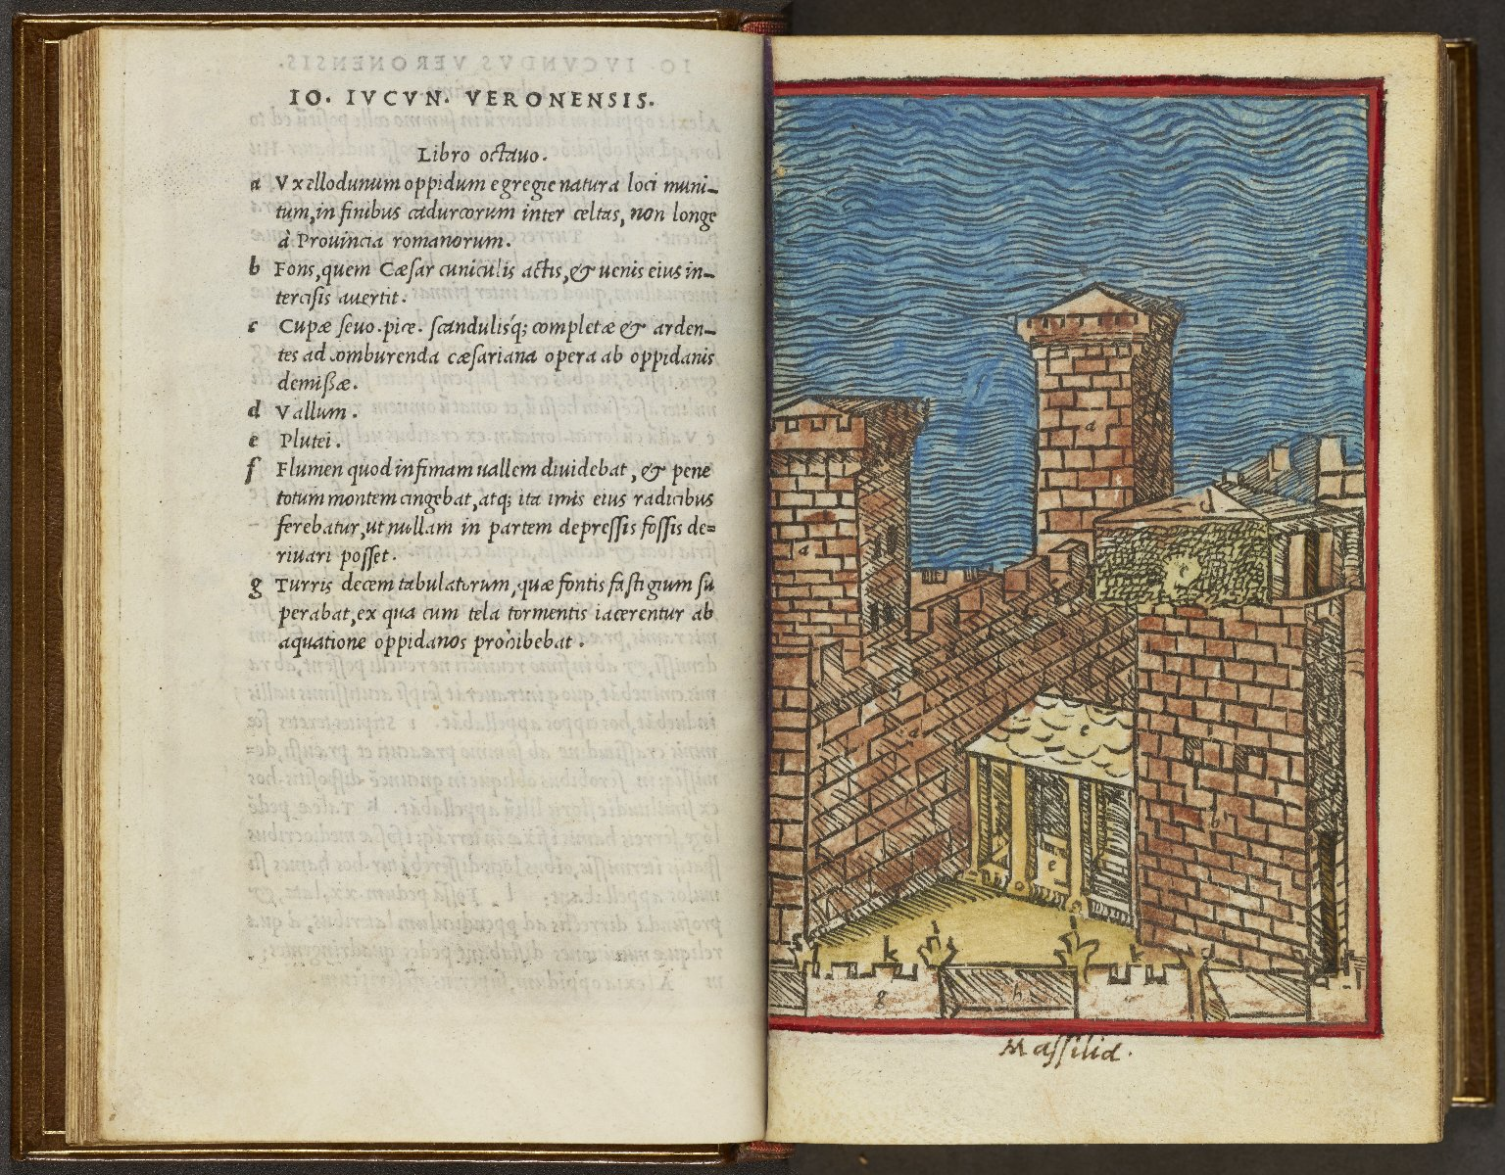
-------------
Image1
-------------
Field Data
Image Number JRL1500852
Reference Number Aldine 3553
Link to Catalogue <A href="http://man-fe.hosted.exlibrisgroup.com/MU_VU1:44MAN_ALMA_DS21164282330001631">UoM online catalogue.</a>
Image Title Text and woodcut illustration
Alternative Image Title Massilia
Parent Work Title Hoc volvmine continentvr haec. Commentariorum de bello Gallico libri VIII ; De bello ciuili pompeiano. libri IIII. ; De bello Alexandrino. liber I. ; De bello Africano. liber I. ; De Bello Hispaniensi. liber I. : Pictura totius Galliæ, diuisæ in parteis treis, secundum C. Cæsaris Commentarios. Nomina locorum, urbiumq[ue];, & populorum Galliæ, ut olim dicebantur latine, & nunc dicuntur gallice, secundum ordinem alphabeti. Pictura pontis in Rheno. Item Auarici. Alexiæ. Vxelloduni. Massiliæ. Literæ Max. Pontificum, nequis libros cura nostra excusos imprimat, uendatue &c. ut in literis sub pœna excommunicationis lata sententia.
Creator Manuzio, Aldo, 1449 or 50-1515
Creator Role Printer
Creator Caesar, Julius
Creator Role Author
Creator Torresanus, Andreas, de Asula, 1451-1529
Creator Role Printer
Creator Giocondo, Giovanni, approximately 1433-1515
Creator Role Editor
Date Created 1513-04
Publication Details Venetiis: in aedibus Aldi, et Andreae soceri
Page/Sheet b8v - c1r
Description Digitally stitched opening: text and woodcut illustration relating to important places in Caesar's conquests: Massilia. The woodcut has been hand coloured.
Keyword Aldus Manutius; Aldine Press.
Language Code lat-IT
Language Latin
Subject Rome -- History, Military -- 265-30 B.C
Subject Rome -- History -- Republic, 265-30 B.C -- Early works to 1800
Subject Military history
Category of Material Printed
Sub-Category Illustrated works
Technique Used Woodcut (process)
Medium Ink
Support Vellum
Places Covered France: Marseilles
Current Repository The University of Manchester Library, U.K.
Provenance Spencer, George John Spencer, Earl, 1758-1834, former owner
Rights Holder - Image The University of Manchester Library
Rights holder - Work The University of Manchester Library
Notes Composite image of JRL1500767 and JRL1500768
Date Captured (yyyy-mm-dd) 2014-09-11
Image Creation Technique Digital capture by Heritage Imaging, The University of Manchester Library
Date Image Added (yyyy-mm) 2014-09
Metadata Language eng-GB

Slide 6
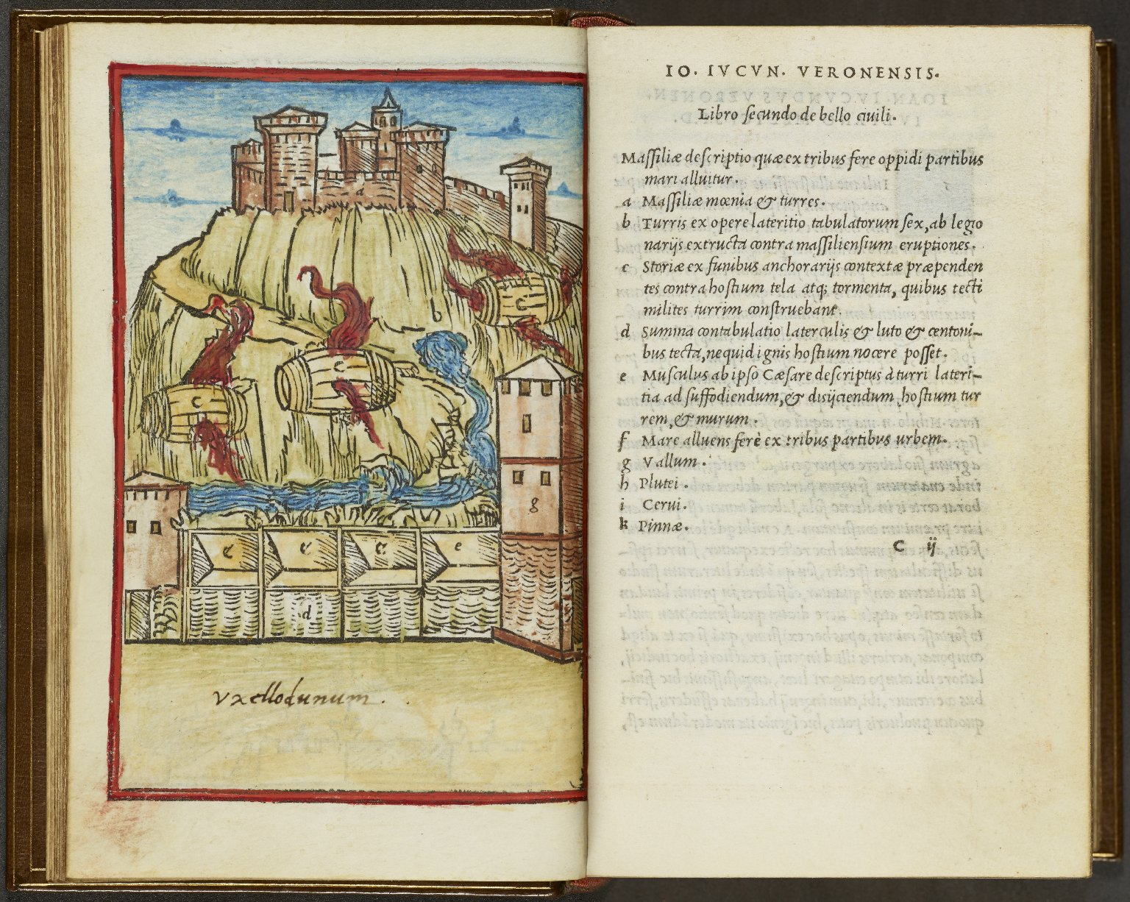
-------------
Image1
-------------
Field Data
Image Number JRL1500851
Reference Number Aldine 3553
Link to Catalogue <A href="http://man-fe.hosted.exlibrisgroup.com/MU_VU1:44MAN_ALMA_DS21164282330001631">UoM online catalogue.</a>
Image Title Text and woodcut illustration
Alternative Image Title Uxellodunum
Parent Work Title Hoc volvmine continentvr haec. Commentariorum de bello Gallico libri VIII ; De bello ciuili pompeiano. libri IIII. ; De bello Alexandrino. liber I. ; De bello Africano. liber I. ; De Bello Hispaniensi. liber I. : Pictura totius Galliæ, diuisæ in parteis treis, secundum C. Cæsaris Commentarios. Nomina locorum, urbiumq[ue];, & populorum Galliæ, ut olim dicebantur latine, & nunc dicuntur gallice, secundum ordinem alphabeti. Pictura pontis in Rheno. Item Auarici. Alexiæ. Vxelloduni. Massiliæ. Literæ Max. Pontificum, nequis libros cura nostra excusos imprimat, uendatue &c. ut in literis sub pœna excommunicationis lata sententia.
Creator Manuzio, Aldo, 1449 or 50-1515
Creator Role Printer
Creator Caesar, Julius
Creator Role Author
Creator Torresanus, Andreas, de Asula, 1451-1529
Creator Role Printer
Creator Giocondo, Giovanni, approximately 1433-1515
Creator Role Editor
Date Created 1513-04
Publication Details Venetiis: in aedibus Aldi, et Andreae soceri
Page/Sheet c1v - c2r
Description Digitally stitched opening: text and woodcut illustration relating to important places in Caesar's conquests: Uxellodunum. The woodcut has been hand coloured.
Keyword Aldus Manutius; Aldine Press.
Language Code lat-IT
Language Latin
Subject Military history
Subject Rome -- History, Military -- 265-30 B.C
Subject Rome -- History -- Republic, 265-30 B.C -- Early works to 1800
Category of Material Printed
Sub-Category Illustrated works
Technique Used Woodcut (process)
Medium Ink
Support Vellum
Places Covered France: Midi-Pyrénées: Lot
Current Repository The University of Manchester Library, U.K.
Provenance Spencer, George John Spencer, Earl, 1758-1834, former owner
Rights Holder - Image The University of Manchester Library
Rights holder - Work The University of Manchester Library
Notes Composite image of JRL1500765 and JRL1500766
Date Captured (yyyy-mm-dd) 2014-09-11
Image Creation Technique Digital capture by Heritage Imaging, The University of Manchester Library
Date Image Added (yyyy-mm) 2014-09
Metadata Language eng-GB

Slide 8
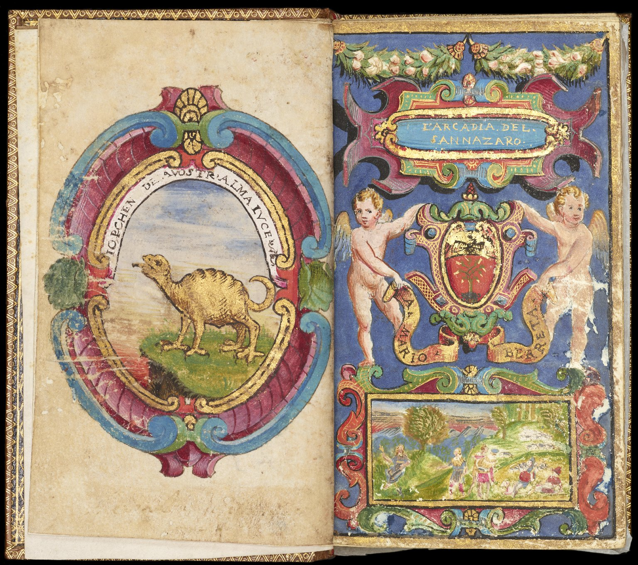
-------------
Image1
-------------
Field Data
Image Number JRL1500847
Reference Number Aldine 7595
Link to Catalogue <A href="http://man-fe.hosted.exlibrisgroup.com/MU_VU1:44MAN_ALMA_DS21192887640001631">UoM online catalogue.</a>
Image Title Inserted leaf and title page
Parent Work Title Arcadia / del Sannazaro
Alternative Parent Work Title Arcadia
Creator Manuzio, Aldo, 1449 or 50-1515
Creator Role Printer
Creator Sannazaro, Jacopo, 1458-1530
Creator Role Author
Date Created 1514-09
Publication Details Impresso in Vinegia Venice: nelle case d'Aldo Romano
Description Digitally stitched opening: verso of the extra leaf added before title-page and the title-page. Hand-coloured and illuminated cartouche showing a prehistoric creature [possibly an arcadia?] in a landscape, with the words: "[I?]opchen[?] de[l]a vostr'alma lvce. There is a faint inscription, now illegible at foot of this leaf. The title-page has been transmogrified: hand-coloured and illuminated. The design includes a shield with tree, supported by cherubs; in a scroll beneath: A Mario Berreta. Above, in gilt in a cartouche: L'Arcadia. del. Sannazaro.; below is a pastoral scene.
Keyword Aldus Manutius; Aldine Press.
Language Code lat-IT
Language Latin
Language Code ita-IT
Language Italian
Subject Italian literature
Subject Italian literature -- Early works to 1800
Subject Pastoral poetry, Italian -- 16th century
Subject Illumination of books and manuscripts -- Specimens
Category of Material Printed
Sub-Category Illustrated works
Technique Used Illumination (image-making process)
Technique Used Handwriting
Medium Gold leaf
Support Vellum
Current Repository The University of Manchester Library, U.K.
Provenance Spencer, George John Spencer, Earl, 1758-1834, former owner
Provenance Berreta, Mario, former owner
Provenance Pinelli, Maffeo, 1736-1785, former owner
Rights Holder - Image The University of Manchester Library
Rights holder - Work The University of Manchester Library
Notes Composite image of JRL1500750 and JRL1500751
Date Captured (yyyy-mm-dd) 2014-09-11
Image Creation Technique Digital capture by Heritage Imaging, The University of Manchester Library
Date Image Added (yyyy-mm) 2014-09
Metadata Language eng-GB

Slide 9
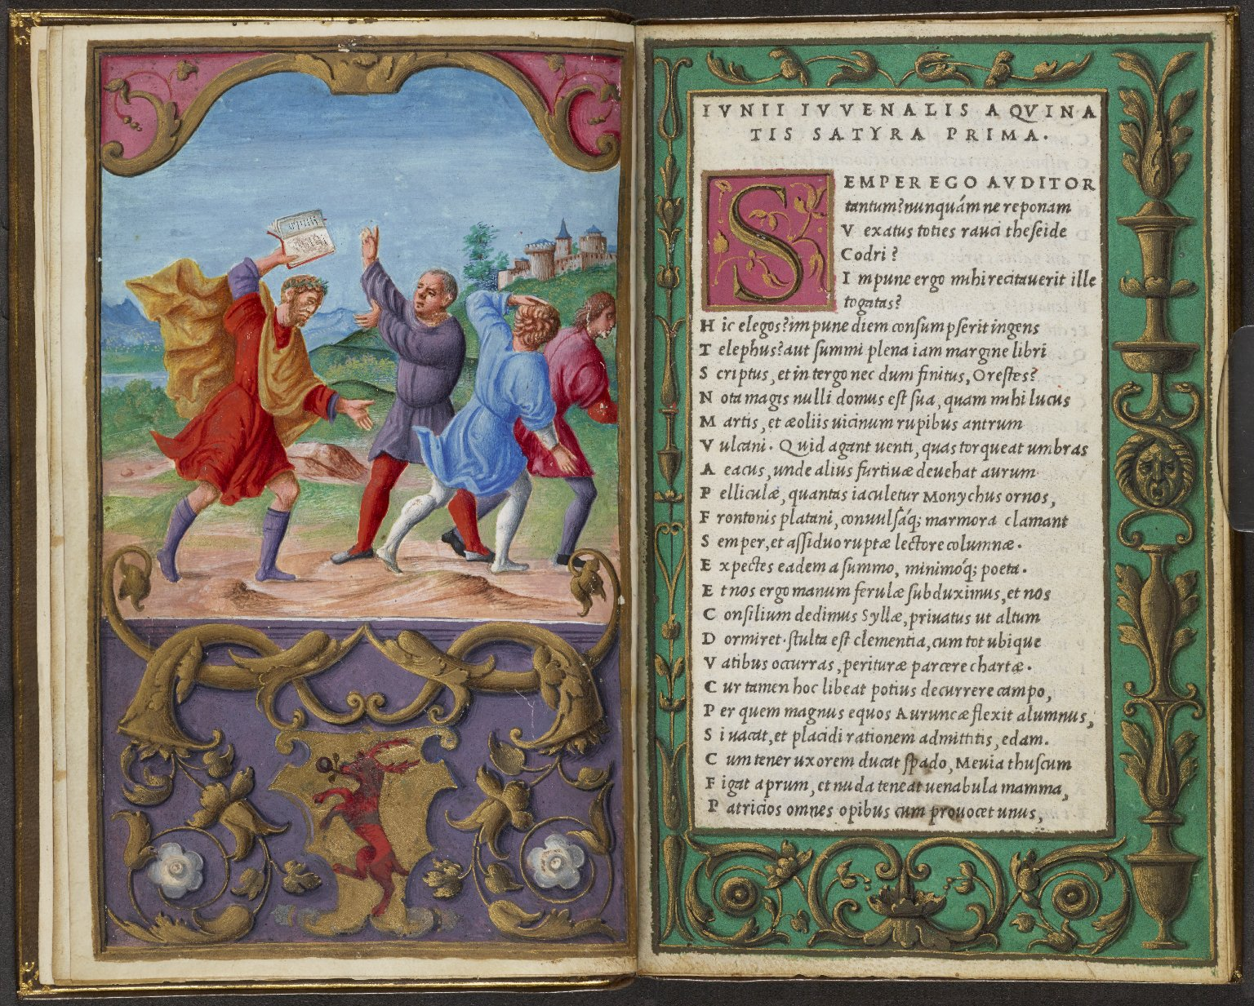
-------------
Image1
-------------
Field Data
Image Number JRL1505089
Reference Number Aldine 8666
Link to Catalogue <A href="http://man-fe.hosted.exlibrisgroup.com/MU_VU1:44MAN_ALMA_DS21171326060001631">UoM online catalogue.</a>
Image Title Juvenal chasing the wicked
Alternative Image Title Opening text with illuminated border
Alternative Image Title Juvenal pursuing the Vices
Parent Work Title Iuuenalis. Persius.
Alternative Parent Work Title Works
Creator Juvenal
Creator Role Author
Creator Manuzio, Aldo, 1449 or 50-1515
Creator Role Printer
Creator Bordon, Benedetto, 1450-1530
Creator Role Illuminator
Date Created 1501-08
Publication Details Venetiis: In aedibus Aldi.
Page/Sheet aiv - aiir (additional leaf)
Description Digitally stitched opening: Illuminated Illustration: Juvenal chasing the vices and threatening them with his book. Below are the illuminated arms of Civran of Venice, painted over those of the Mocenigo. Opposite is the opening text with an illuminated initial and full border.
Keyword Aldus Manutius; Aldine Press.
Language Code lat-IT
Language Latin
Subject Classical literature
Subject Poetry
Subject Heraldry
Subject Verse satire, Latin
Subject Satire, Latin -- Early works to 1800
Category of Material Printed
Sub-Category Illustrated works
Technique Used Illumination (image-making process)
Medium Ink
Medium Gold leaf
Support Vellum
Current Repository The University of Manchester Library, U.K.
Provenance Spencer, George John Spencer, Earl, 1758-1834, former owner
Rights Holder - Image The University of Manchester Library
Rights holder - Work The University of Manchester Library
Notes Szépe attributes the illumination to Benedetto Bordon, and speculates that the Mocenigo family ordered and subsequently rejected this copy. Cf. Szépe, Helena K., Bordon, Dürer and modes of illuminating Aldines, in Aldus Manutius and renaissance culture, edited by David S. Zeidberg, Olschki, 1998.
Date Captured (yyyy-mm-dd) 2014-11-04
Image Creation Technique Digital capture by Heritage Imaging, The University of Manchester Library
Date Image Added (yyyy-mm) 2014-11
Metadata Language eng-GB

Slide 10
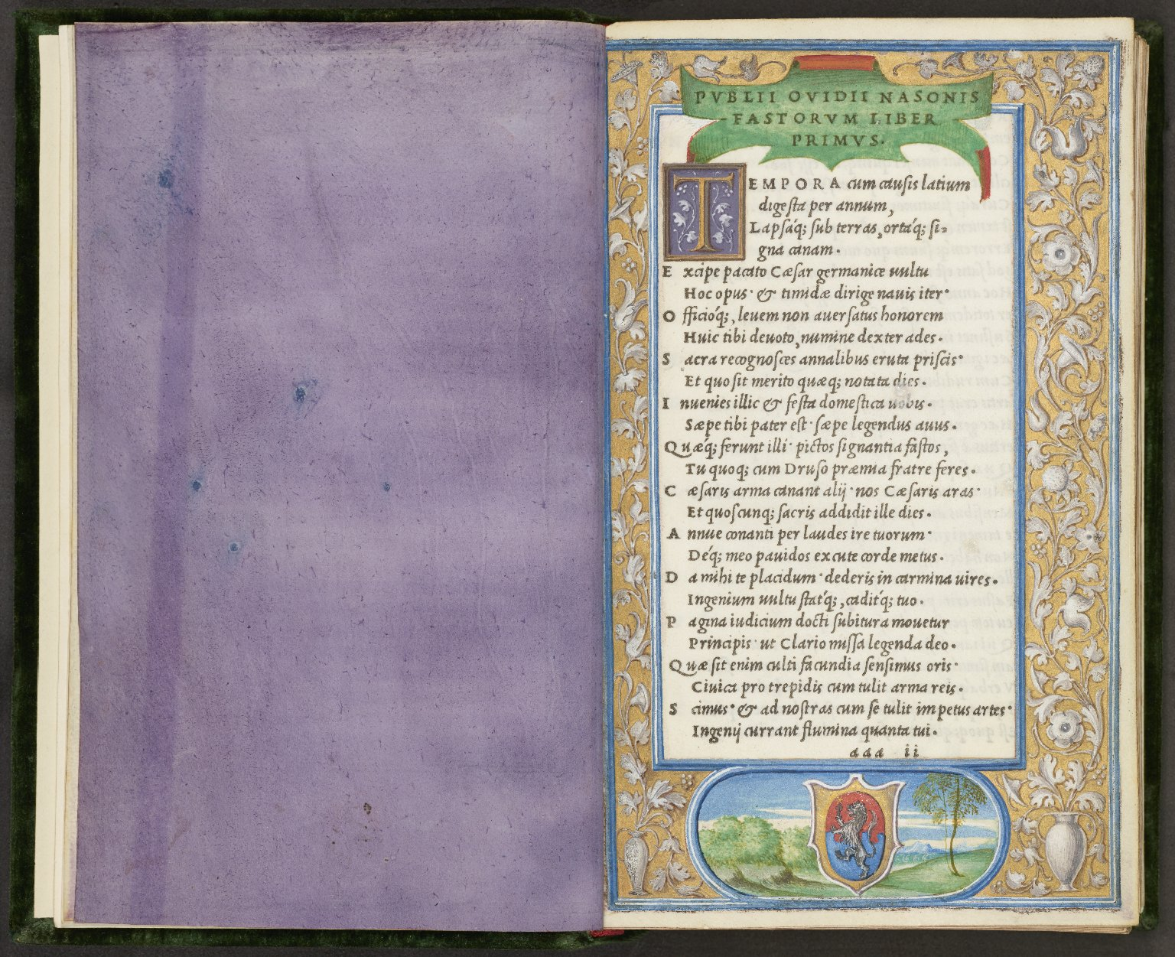
-------------
Image1
-------------
Field Data
Image Number JRL1500846
Reference Number Aldine 3366.3
Link to Catalogue <A href="http://man-fe.hosted.exlibrisgroup.com/MU_VU1:44MAN_ALMA_DS21164877790001631">UoM online catalogue.</a>
Image Title Opening text with illustrated border
Alternative Image Title Inserted leaf
Parent Work Title Publii Ouidii Nasonis, quae hoc in libello continentur. Fastorum. Libri. VI. De Tristibus. Libri. V. De Ponto. Libri. IIII.
Alternative Parent Work Title Works
Creator Manuzio, Aldo, 1449 or 50-1515
Creator Role Editor
Creator Ovid, 43 B.C.-17 A.D. or 18 A.D.
Creator Role Author
Creator Bordon, Benedetto, 1450-1530
Creator Role Illuminator
Creator Navagero, Andrea, 1483-1529
Creator Role Editor
Date Created 1503-02
Publication Details Venetiis: in Academia Aldi
Page/Sheet aaaiir
Description Digitally stitched image of inserted purple leaf and opening text with full illuminated border.
Keyword Aldus Manutius; Aldine Press.
Language Code lat-IT
Language Latin
Language Code eng-IT
Language English
Subject Latin poetry -- Early works to 1800
Category of Material Printed
Sub-Category Illustrated works
Technique Used Illumination (image-making process)
Medium Ink
Support Vellum
Current Repository The University of Manchester Library, U.K.
Provenance Spencer, George John Spencer, Earl, 1758-1834, former owner
Rights Holder - Image The University of Manchester Library
Rights holder - Work The University of Manchester Library
Notes Composite image of JRL1500748 and JRL1500749
Date Captured (yyyy-mm-dd) 2014-09-11
Image Creation Technique Digital capture by Heritage Imaging, The University of Manchester Library
Date Image Added (yyyy-mm) 2014-09
Metadata Language eng-GB

