Slide 1
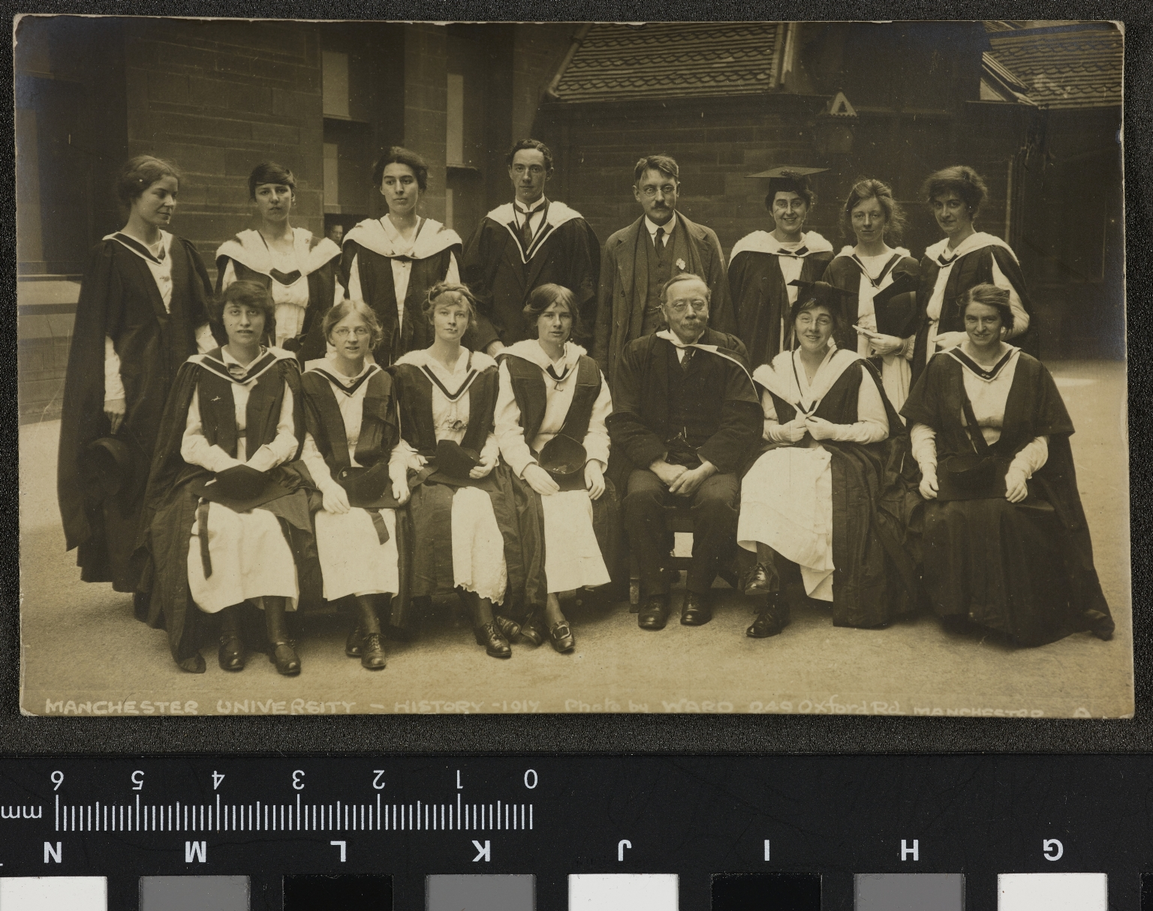
-------------
Image1
-------------
Field Data
Image Number JRL17021104
Reference Number Box 31 & 32
Image Title Manchester University, History 1917
Series Title Papers of Thomas Frederick Tout
Creator Ward, E
Creator Role Photographer
Date Created 1917
Description Group shot of Manchester University History students and Professor T.F. Tout, 1917.
Keyword Manchester History School; History; Victoria University of Manchester.
Language English
Language Code eng-GB
Subject History
Subject University of Manchester
Category of Material Archives
Sub-Category Portraits
Sub-Category Analogue photography
Support Paper
Creation Site England: Greater Manchester: Manchester
Time Period Covered 20th Century CE
Places Covered England: Greater Manchester: Manchester
People Covered Tout, T. F. (Thomas Frederick), 1855-1929
Rights Holder - Image The University of Manchester Library
Rights holder - Work The University of Manchester Library
Access Rights <a rel="license" href="http://creativecommons.org/licenses/by-nc-sa/4.0/"><img alt="Creative Commons License" style="border-width:0" src="https://i.creativecommons.org/l/by-nc-sa/4.0/88x31.png"></a>
Notes Photographer: E. Ward, 249, Oxford Road, Manchester.
Image Creation Technique Digital capture by Heritage Imaging, The University of Manchester Library
CharacterSet %G
Headline Papers of Thomas Frederick Tout, Box 31 32
RecordVersion 4
BylineTitle Heritage Photographer
TimeCreated 14:30:16+00:00
Byline Gwen Riley Jones
Copyright Copyright © University of Manchester
0x00d1 Manchester
0x00e2 All Moral Rights Asserted
Source University of Manchester
0x00d0 The John Rylands Library, 150 Deansgate
0x00d3 M3 3EH
DateCreated 2017-02-08
0x00d5 0161 3066559
0x00d4 United Kingdom
0x00d7 www.manchester.ac.uk/library
0x00d6 uml.chicc@manchester.ac.uk
Firmware IQ180, User Firmware: 7.01.1
UsageTerms lang=x-default All Moral Rights Asserted
Lens 120.0 mm f/32.0
Headline Papers of Thomas Frederick Tout, Box 31 32
LensInfo 120/1 120/1 32/1 4/1
rights lang=x-default Copyright © University of Manchester
CreatorContactInfo/Iptc4xmpCore:CiAdrCtry United Kingdom
CreatorContactInfo/Iptc4xmpCore:CiUrlWork www.manchester.ac.uk/library
AuthorsPosition Heritage Photographer
SerialNumber FP010122
CreatorContactInfo/Iptc4xmpCore:CiTelWork 0161 3066559
Source University of Manchester
CreatorContactInfo/Iptc4xmpCore:CiAdrExtadr The John Rylands Library, 150 Deansgate
DateCreated 2017-02-08T14:30:16
LegacyIPTCDigest 1EC54D14E5745BEF3630452F0186FCD1
CreatorContactInfo/Iptc4xmpCore:CiAdrCity Manchester
CreatorContactInfo/Iptc4xmpCore:CiAdrPcode M3 3EH
creator Gwen Riley Jones
CreatorContactInfo/Iptc4xmpCore:CiEmailWork uml.chicc@manchester.ac.uk
ExifVersion 0221
CreatorContactInfo type=Struct

Slide 2
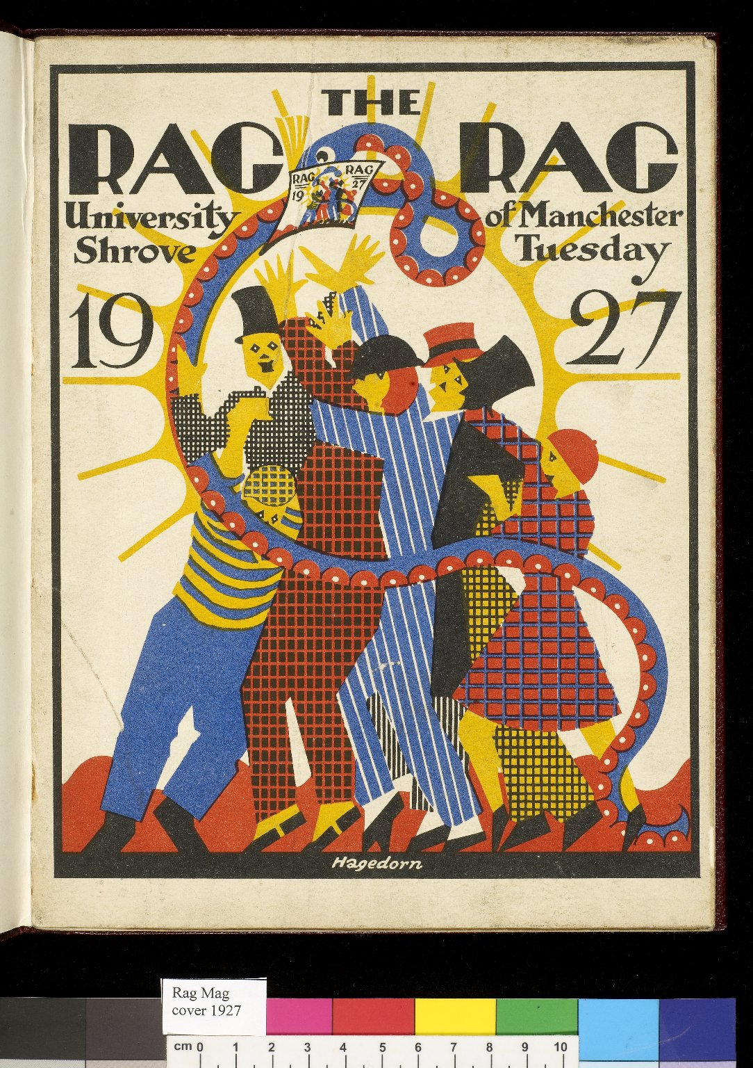
-------------
Image1
-------------
Field Data
Image Number JRL0806550dc
Reference Number SUA/7
Link to Catalogue <a href="http://www.librarysearch.manchester.ac.uk/MU_VU1:BLENDED:44MAN_ELGAR_DSgb133ump">University of Manchester Publications Collection: Newspapers, Magazines and Newsletters</a>
Image Title Rag Rag, 1927
Series Title Rag mags (1924-2003)
Parent Work Title The Rag Rag
Creator Hagedorn, K.
Creator Role Artist
Creator Manchester University
Creator Role Author
Date Created 1927
Publication Details Manchester
Page/Sheet Front cover
Description Cover of the University Rag Mag for 1927. Shrove Tuesday edition 1927. The snake and sun emblems from the Manchester University coat of arms are represented along with a group of brightly-coloured figures.
Language English
Language Code eng-GB
Subject University of Manchester
Category of Material Archives
Sub-Category Periodicals
Technique Used Printing (process)
Support Paper
Time Period Covered 20th Century CE
Places Covered England: Greater Manchester: Manchester
Item Height 245 mm
Item Width 185 mm
Rights Holder - Image The University of Manchester Library
Rights holder - Work The University of Manchester Library
Access Rights <a rel="license" href="http://creativecommons.org/licenses/by-nc-sa/4.0/"><img alt="Creative Commons License" style="border-width:0" src="https://i.creativecommons.org/l/by-nc-sa/4.0/88x31.png"></a>
Image Creation Technique Digital capture by Gten

