Slide 1
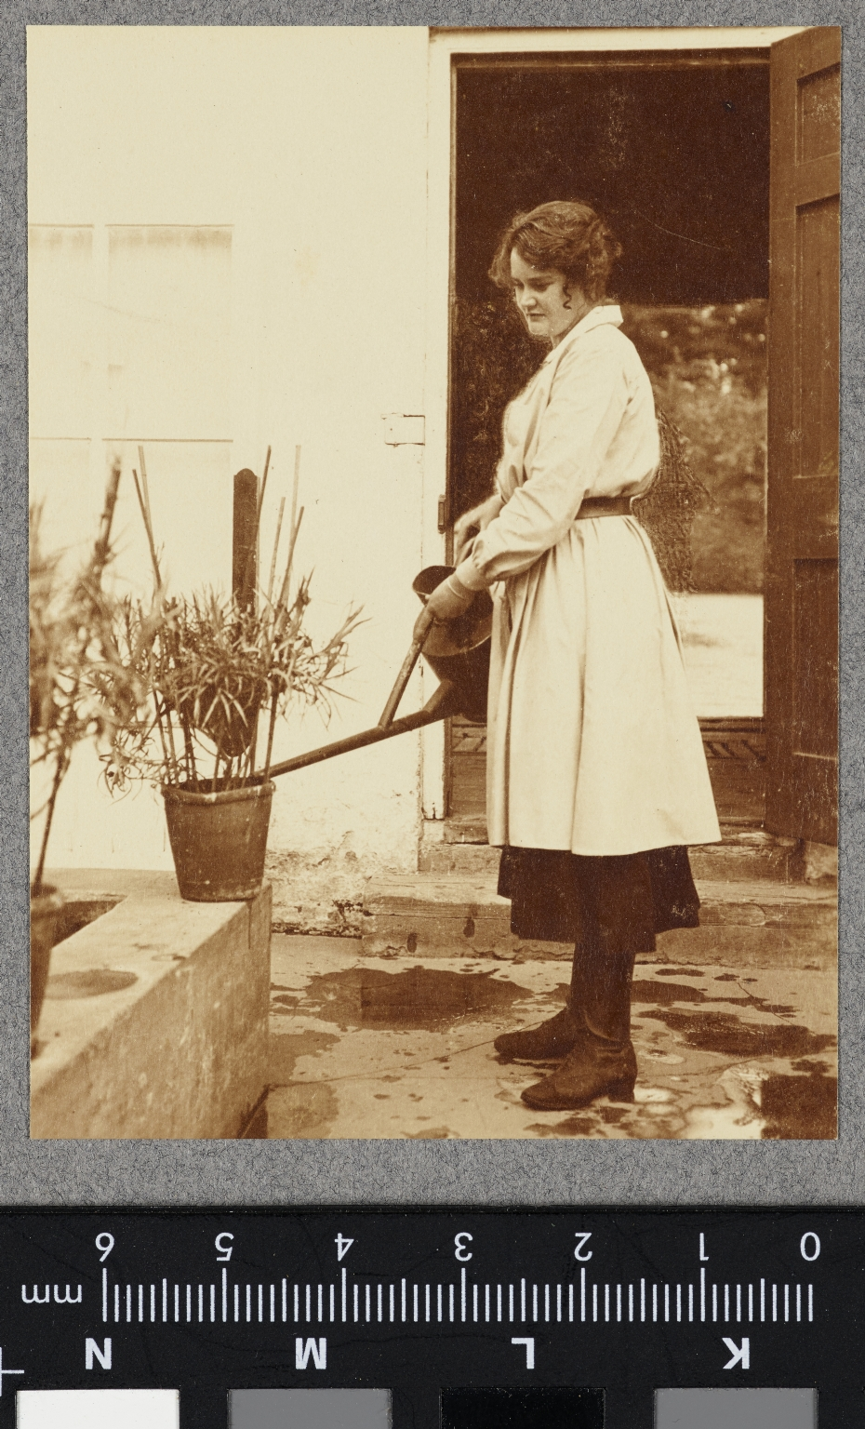
-------------
Image1
-------------
Field Data
Image Number JRL17110467
Reference Number VPH.5.67
Image Title Lady Gardeners, Marquis of Downshire's Estate
Parent Work Title Album of women's work in wartime
Creator Reavil, Mr Arthur
Creator Role Photographer
Date Created 1914-1919
Description Woman wearing an overall over her clothes holding a watering can and watering a pot plant.
Keyword World War; First World War; Homefront; Gardening; Farming.
Subject World War, 1914-1918
Subject Photography--History--20th century
Subject World War, 1914-1918--Photographs
Category of Material Photography
Sub-Category Analogue photography
Technique Used Gelatin silver prints
Support Paper
Time Period Covered 20th Century CE
Item Height 94 mm
Item Width 68 mm
Current Repository The University of Manchester Library, U.K.
Provenance Mr & Mrs Burleigh, former owners
Rights Holder - Image The University of Manchester Library
Rights Holder - Work The University of Manchester Library
Access Rights <a rel="license" href="http://creativecommons.org/licenses/by-nc-sa/4.0/"><img alt="Creative Commons License" style="border-width:0" src="https://i.creativecommons.org/l/by-nc-sa/4.0/88x31.png"></a>
Bibliography <A href="https://luna.manchester.ac.uk/luna/servlet/s/61020q">Album of Women's Work in Wartime.</a>
Image Creation Technique Digital capture by Heritage Imaging, The University of Manchester Library
Date Image Added (yyyy-mm) 2017-11
Metadata Language eng-GB

Slide 2
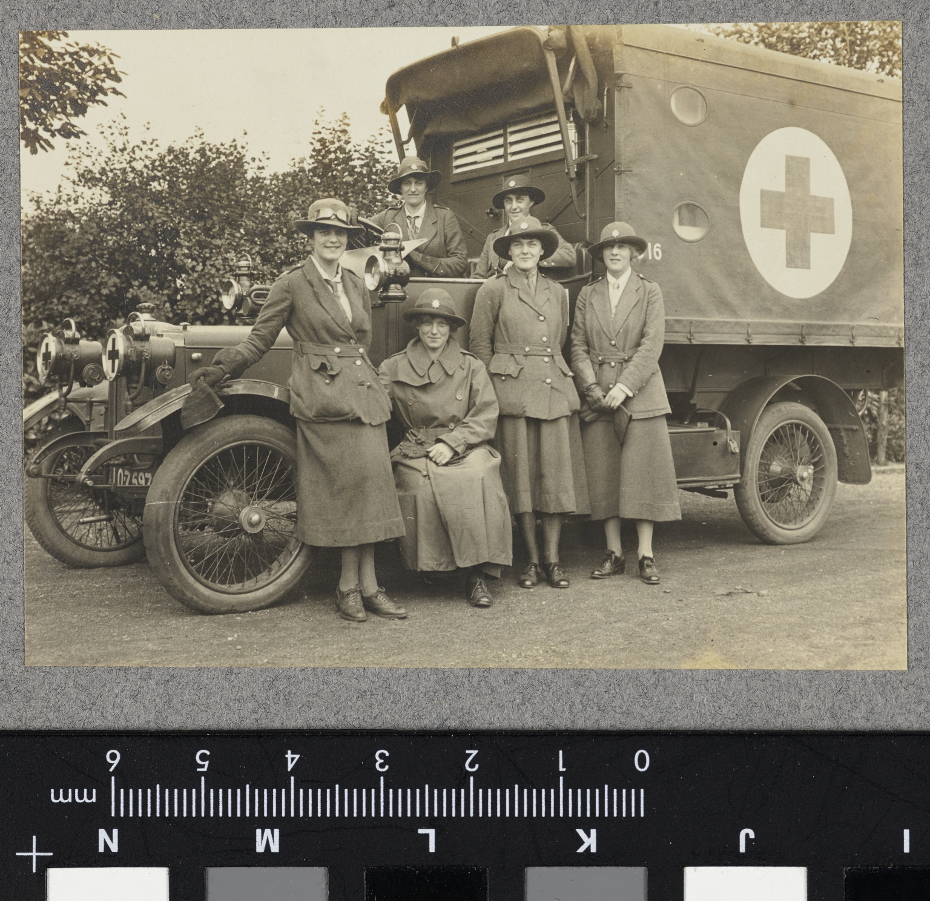
-------------
Image1
-------------
Field Data
Image Number JRL17110491
Reference Number VPH.5.91
Image Title A.S.C. Drivers, Fulham Depot
Parent Work Title Album of women's work in wartime
Creator Reavil, Mr Arthur
Creator Role Photographer
Date Created 1914-1919
Description Six women dressed in unifrom sit and stand around the front of a vehicle. The vehicle has a large white cirle paited on its side with a cross in the middle. The A.S.C. (Army Service Corps.) supplied food, eqipment, ammunition, horses and vehicles to the military. In 1918 it had become the Royal Army Service Corps, laterly known as the Royal Logistics Corps.
Keyword World War; First World War; Homefront.
Subject World War, 1914-1918
Subject Photography--History--20th century
Subject World War, 1914-1918--Photographs
Category of Material Photography
Sub-Category Analogue photography
Technique Used Gelatin silver prints
Support Paper
Creation Site England: London: Fulham
Time Period Covered 20th Century CE
Places Covered England: London: Fulham
Item Height 72 mm
Item Width 99 mm
Current Repository The University of Manchester Library, U.K.
Provenance Mr & Mrs Burleigh, former owners
Rights Holder - Image The University of Manchester Library
Rights Holder - Work The University of Manchester Library
Access Rights <a rel="license" href="http://creativecommons.org/licenses/by-nc-sa/4.0/"><img alt="Creative Commons License" style="border-width:0" src="https://i.creativecommons.org/l/by-nc-sa/4.0/88x31.png"></a>
Bibliography <A href="https://luna.manchester.ac.uk/luna/servlet/s/61020q">Album of Women's Work in Wartime.</a>
Image Creation Technique Digital capture by Heritage Imaging, The University of Manchester Library
Date Image Added (yyyy-mm) 2017-11
Metadata Language eng-GB

Slide 3
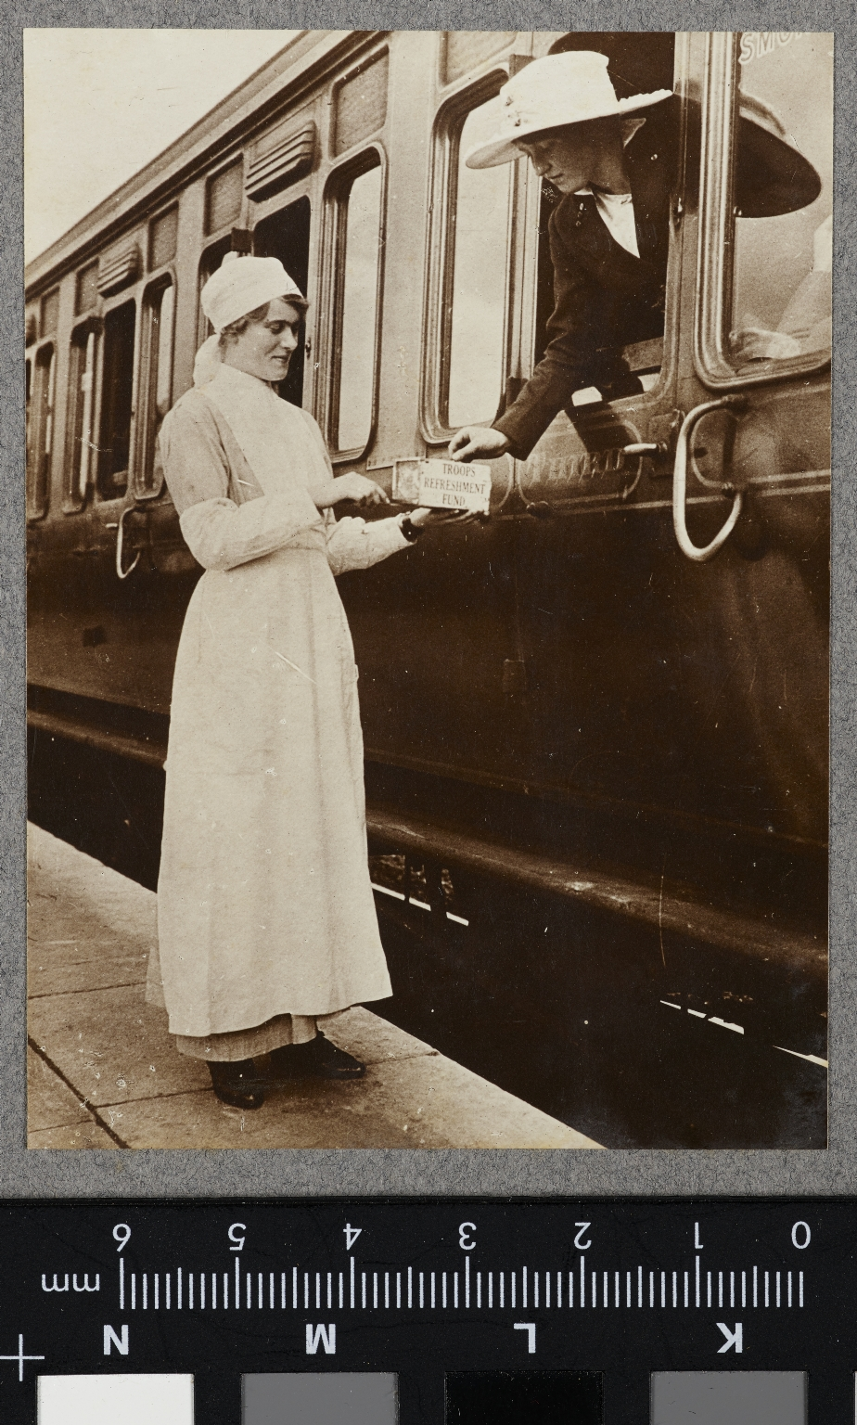
-------------
Image1
-------------
Field Data
Image Number JRL17110494
Reference Number VPH.5.94
Image Title Red Cross, Banbury Station. Sailors and Soldiers Free Buffet
Parent Work Title Album of women's work in wartime
Creator Reavil, Mr Arthur
Creator Role Photographer
Date Created 1914-1919
Description Woman dressed in nurses uniform stands at the side of a train carriage holding a box labelled Troops Refreshment Fund. Leaning out of the third class railway carriage is a woman, wearing a large hat.
Keyword World War; First World War; Homefront; Railways.
Subject World War, 1914-1918
Subject Photography--History--20th century
Subject World War, 1914-1918--Photographs
Category of Material Photography
Sub-Category Analogue photography
Technique Used Gelatin silver prints
Support Paper
Creation Site England: Oxfordshire: Banbury
Time Period Covered 20th Century CE
Places Covered England: Oxfordshire: Banbury
Item Height 98 mm
Item Width 70 mm
Current Repository The University of Manchester Library, U.K.
Provenance Mr & Mrs Burleigh, former owners
Rights Holder - Image The University of Manchester Library
Rights Holder - Work The University of Manchester Library
Access Rights <a rel="license" href="http://creativecommons.org/licenses/by-nc-sa/4.0/"><img alt="Creative Commons License" style="border-width:0" src="https://i.creativecommons.org/l/by-nc-sa/4.0/88x31.png"></a>
Bibliography <A href="https://luna.manchester.ac.uk/luna/servlet/s/61020q">Album of Women's Work in Wartime.</a>
Image Creation Technique Digital capture by Heritage Imaging, The University of Manchester Library
Date Image Added (yyyy-mm) 2017-11
Metadata Language eng-GB

Slide 4
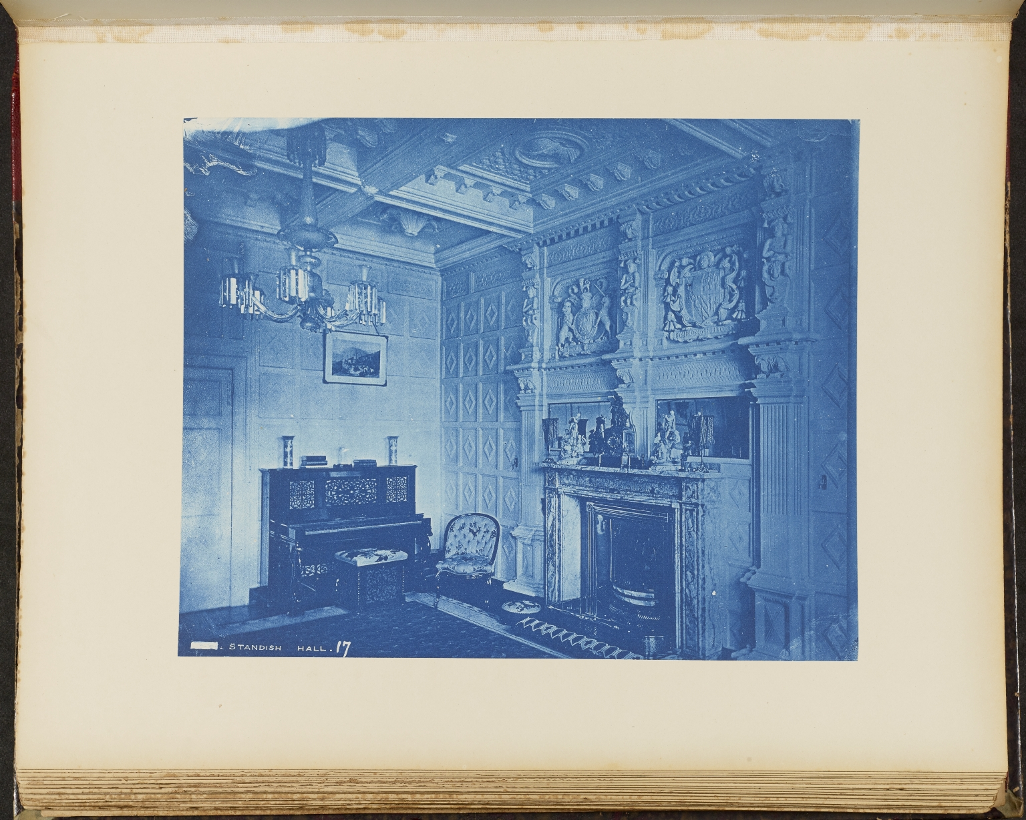
-------------
Image1
-------------
Field Data
Image Number JRL17082743
Reference Number VPH.6.17
Image Title Interior view of the boudoir at Standish Hall, Wigan. By Henry Bedford Lemere.
Parent Work Title Intérieurs Anglais, an album of 50 cyanotypes of British house interiors by Bedford Lemere & Co. 1880’s-1890’s
Creator Lemere, Bedford Henry (Harry), 1865-1944
Creator Role Photographer
Display Creator Bedford Lemere & Co.
Date Created c1900
Page/Sheet 17
Image Sequence Number 17
Description Interior view of the boudoir at Standish Hall, Wigan, looking towards the fireplace. There is an elaborate plasterwork ceiling and ornamented panelling on the walls. The fireplace is as high as the ceiling and bears two coat of arms, one is the Royal Arms of the British monarch, bearing the lion and the unicorn, these arms are framed by three terminal figures (human top half, columnar bottom).The mantelpiece has porcelain figurines and a mantel clock in the centre. To the side of the fireplace is a piano. The Standishes held the manor of Standish and Standish Hall estate from the thirteenth century. Following the extinction of the male line upon the death of Ralph Standish in 1755, the estate passed through female lines until it was sold and broken up after the death of Henry Nouailles Widdrington Standish in 1920. There are some very small flaws in the print itself, likely sustained in the printing process rather than a flaw to the original plate or negative.
Keyword Boudoir; Fireplace.
Subject Architecture
Subject Country homes--Great Britain
Subject Interior decoration -- Great Britain
Subject Photography--History--19th century
Category of Material Photography
Sub-Category Analogue photography
Technique Used Blueprint process
Support Paper
Creation Site England: Greater Manchester: Wigan: Standish
Time Period Covered 19th Century CE
Places Covered England: Greater Manchester: Wigan: Standish
Item Height 221 mm
Item Width 280 mm
Current Repository The University of Manchester Library, U.K.
Provenance Thomas Maileander, Artist.
Rights Holder - Image The University of Manchester Library
Rights Holder - Work The University of Manchester Library
Access Rights <a rel="license" href="http://creativecommons.org/licenses/by-nc-sa/4.0/"><img alt="Creative Commons License" style="border-width:0" src="https://i.creativecommons.org/l/by-nc-sa/4.0/88x31.png"></a>
Bibliography <A href="https://luna.manchester.ac.uk/luna/servlet/s/h8b3g8 ">Intérieurs Anglais, an album of 50 cyanotypes of British house interiors by Bedford Lemere & Co. 1880’s-1890’s.</a>
Notes Worldcat lists one complete set of Intérieurs Anglais, at the Stiftung Bibliothek Werner Oechslin, Switzerland. Another complete set is owned by Yale University, located at the British Art Center, Folio A 2014 71. The Getty Research Institute holds 82 of the set of 86 cyanotypes (lacking nos. 10, 65, 67 and 81). The Royal Institute of British Architects have eight photographs from this series also in cyanotype, with the same numbering 1-68 (nos. 1, 7, 37, 49, 58, 61, 66 and 67).
Date Captured (yyyy-mm-dd) 2017-08-23
Image Creation Technique Digital capture by Heritage Imaging, The University of Manchester Library
Date Image Added (yyyy-mm) 2017-08
Metadata Language eng-GB

Slide 5
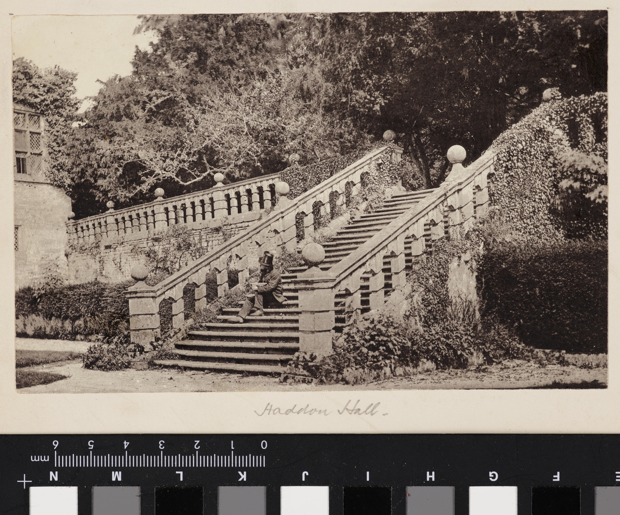
-------------
Image1
-------------
Field Data
Image Number JRL17092411
Reference Number VPH.7.29
Image Title View of Haddon Hall, Derbyshire
Parent Work Title English architecture and landscapes.
Creator Unknown
Creator Role Photographer
Date Created c1850s
Page/Sheet 29
Image Sequence Number 29
Description View of Haddon Hall, Derbyshire. Exterior view of Ivy covered stone steps leading to the lower garden. A gentleman wearing a top hat is seated part way up the staircase, looking towards the Hall. The origins of the hall date to the 11th century with numerous additions through the years.
Keyword Country House; Derbyshire; Duke of Rutland; Gardens.
Subject Landscape photography--19th century
Subject Photography--History--19th century
Subject Landscape gardening
Subject Architecture
Category of Material Photography
Category of Material Printed
Technique Used Photomechanical processes
Support Paper
Creation Site England: Derbyshire: Bakewell
Time Period Covered 20th Century CE
Places Covered England: Derbyshire: Bakewell
Item Height 107 mm
Item Width 168 mm
Current Repository The University of Manchester Library, U.K.
Rights Holder - Image The University of Manchester Library
Rights Holder - Work The University of Manchester Library
Access Rights <a rel="license" href="http://creativecommons.org/licenses/by-nc-sa/4.0/"><img alt="Creative Commons License" style="border-width:0" src="https://i.creativecommons.org/l/by-nc-sa/4.0/88x31.png"></a>
Bibliography <A href="https://luna.manchester.ac.uk/luna/servlet/s/w39w18">English architecture and landscapes.</a>
Notes Underneath the print in pencil "Haddon Hall"
Date Captured (yyyy-mm-dd) 2017-09-18
Image Creation Technique Digital capture by Heritage Imaging, The University of Manchester Library
Date Image Added (yyyy-mm) 2017-09
Metadata Language eng-GB

Slide 6
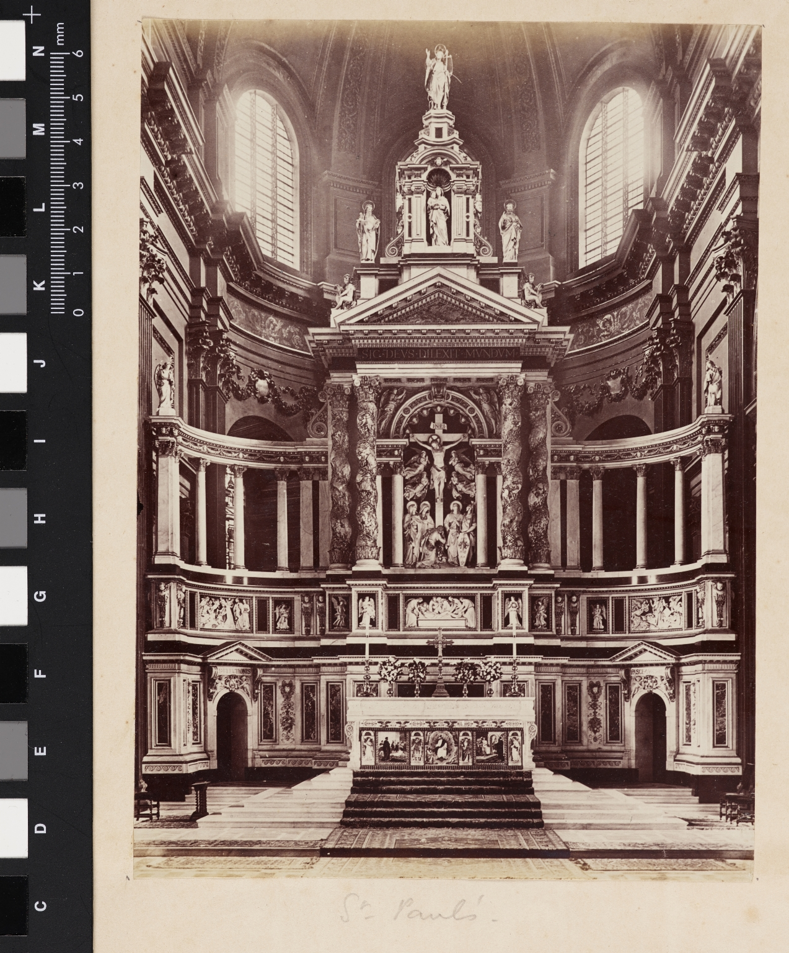
-------------
Image1
-------------
Field Data
Image Number JRL17092386
Reference Number VPH.7.4
Image Title View of the reredos and high altar at St Paul's Cathedral, London.
Parent Work Title English architecture and landscapes.
Creator Unknown
Creator Role Photographer
Date Created 1888
Page/Sheet 4
Image Sequence Number 4
Description View of the reredos and high altar at St Paul's Cathedral, London. The elaborate reredos (decorated screen) stood behind the Cathedral high altar. It depicts in sculptures the Crucifixion, Christ on the cross is surrounded by mourning angels and there is a gathering of five figures at the foot of the cross: The Three Marys; St John and a Roman soldier, Stephaton. The architects were George Frederick Bodley and Thomas Garner and it was carved for Farmer and Brindley Ltd. by E Guillemin. The piece was dedicated on St Paul's Day, 29 June, 1888. On the 10th December 1940 most of the reredos was destroyed by a bomb, although several of the pieces, including that of the central sculpture of the Crucified Christ were salvaged and remain in the Cathedral Collection.
Keyword Church; Churches; Cathedrals; Blitz; Bomb damage.
Subject Photography--History--19th century
Subject Cathedrals
Subject Crucifixion
Subject Architecture
Category of Material Photography
Sub-Category Analogue photography
Technique Used Albumen prints
Support Paper
Creation Site England: Greater London: London: City of London: Ludgate Hill
Time Period Covered 20th Century CE
Places Covered England: Greater London: London: City of London: Ludgate Hill
Item Height 197 mm
Item Width 142 mm
Current Repository The University of Manchester Library, U.K.
Rights Holder - Image The University of Manchester Library
Rights Holder - Work The University of Manchester Library
Access Rights <a rel="license" href="http://creativecommons.org/licenses/by-nc-sa/4.0/"><img alt="Creative Commons License" style="border-width:0" src="https://i.creativecommons.org/l/by-nc-sa/4.0/88x31.png"></a>
Bibliography <A href="https://luna.manchester.ac.uk/luna/servlet/s/w39w18">English architecture and landscapes.</a>
Notes Bottom centre, underneath the print "St Paul's" in pencil.
Date Captured (yyyy-mm-dd) 2017-09-18
Image Creation Technique Digital capture by Heritage Imaging, The University of Manchester Library
Date Image Added (yyyy-mm) 2017-09
Metadata Language eng-GB

Slide 7
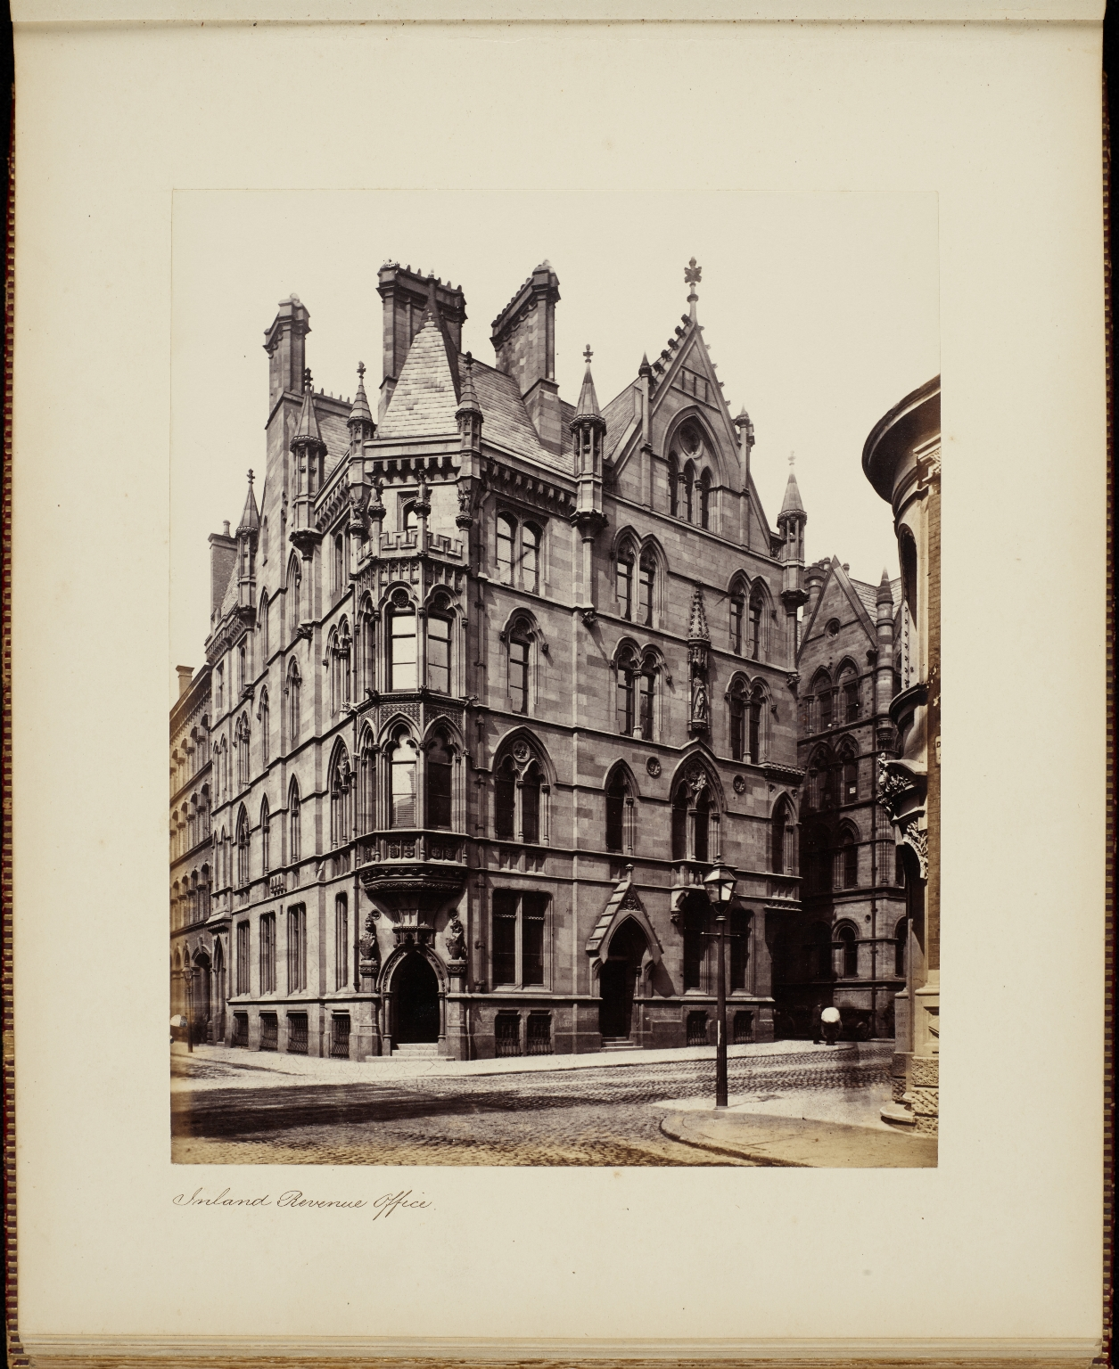
-------------
Image1
-------------
Field Data
Image Number JRL17101885
Reference Number VPH.9.5
Image Title View of the Inland Revenue Office, Manchester
Parent Work Title Manchester
Creator Francis Frith & Co.
Creator Role Photographer
Date Created c1870
Image Sequence Number 5
Description View of the Inland Revenue Office, on Mount Street, Manchester; now known as the Lawrence Buildings. The building which is of sandstone ashlar with a slate roof, was constructed for the Inland Revenue in 1874-6 by Pennington and Bridgen in the Gothic Revival style. It has distinctive arched windows and tall crocketed gables. The corner doorway is decorated by a lion on one side and a unicorn on the other, each stood on pedestals. An elaborate two-storey oriel window sits directly above the entrance.
Keyword Manchester; Architecture; Inland Revenue; Gothic.
Language English
Language Code eng-GB
Subject Photography--History--19th century
Subject Architecture
Category of Material Photography
Sub-Category Analogue photography
Technique Used Albumen prints
Support Paper
Creation Site England: Greater Manchester: Manchester
Time Period Covered 19th Century CE
Places Covered England: Greater Manchester: Manchester
Item Height 209 mm
Item Width 164 mm
Current Repository The University of Manchester Library, U.K.
Rights Holder - Image The University of Manchester Library
Rights Holder - Work The University of Manchester Library
Access Rights <a rel="license" href="http://creativecommons.org/licenses/by-nc-sa/4.0/"><img alt="Creative Commons License" style="border-width:0" src="https://i.creativecommons.org/l/by-nc-sa/4.0/88x31.png"></a>
Bibliography <A href="https://luna.manchester.ac.uk/luna/servlet/s/q7pr7q">Manchester.</a>
Date Captured (yyyy-mm-dd) 2017-10-12
Image Creation Technique Digital capture by Heritage Imaging, The University of Manchester Library
Date Image Added (yyyy-mm) 2017-11
Metadata Language eng-GB

Slide 8
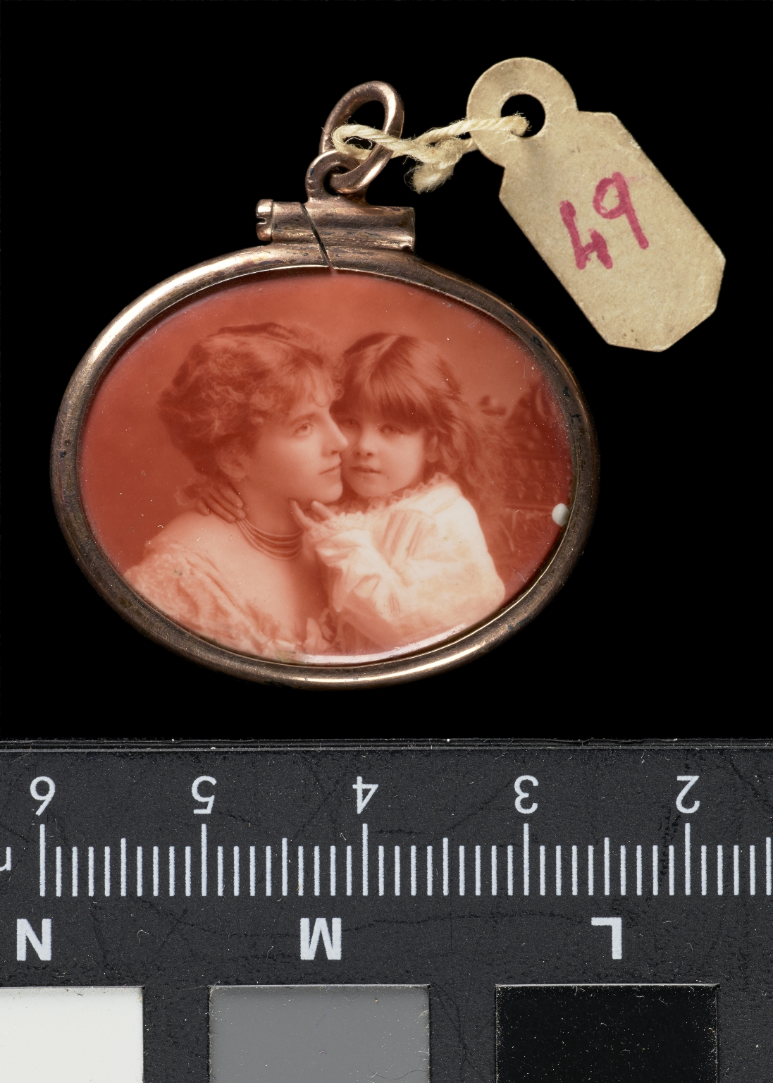
-------------
Image1
-------------
Field Data
Image Number JRL17114903
Reference Number VPH.35
Image Title Portrait of a mother and daughter
Alternative Image Title Photo Jewellery
Creator Unknown
Creator Role Photographer
Date Created c1900s
Description A portrait on enamel of a mother and daughter, sat with their cheeks touching but looking off in different directions. The child is touching the mother's face, both are wearing white or light coloured clothing and the mother has many strings of pearls around her neck. The image has a reddish tone and is set into a gold frame with a hanging ring.
Keyword Photography; Enamel; Portraits.
Subject Photography--History--19th century
Category of Material Photography
Sub-Category Analogue photography
Sub-Category Portraits
Support Enamel
Time Period Covered 19th Century CE
Item Height 24 mm
Item Width 26 mm
Current Repository The University of Manchester Library, U.K.
Rights Holder - Image The University of Manchester Library
Rights Holder - Work The University of Manchester Library
Access Rights <a rel="license" href="http://creativecommons.org/licenses/by-nc-sa/4.0/"><img alt="Creative Commons License" style="border-width:0" src="https://i.creativecommons.org/l/by-nc-sa/4.0/88x31.png"></a>
Date Captured (yyyy-mm-dd) 2017-11-29
Image Creation Technique Digital capture by Heritage Imaging, The University of Manchester Library
Date Image Added (yyyy-mm) 2017-12
Metadata Language eng-GB

Slide 9
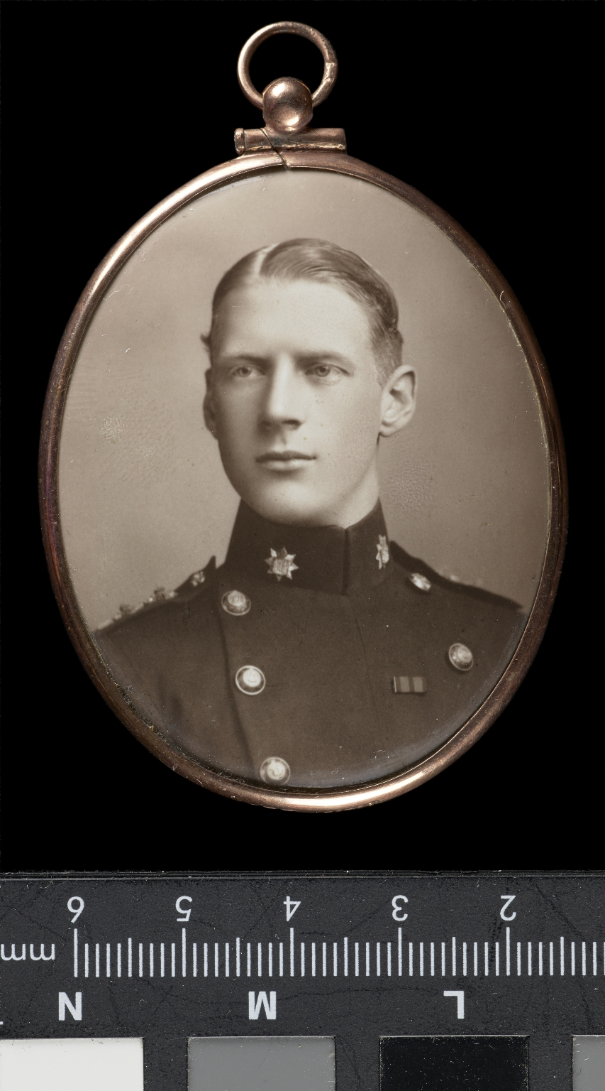
-------------
Image1
-------------
Field Data
Image Number JRL17114904
Reference Number VPH.36
Image Title Portrait of a fair-haired young man in uniform
Alternative Image Title Photo Jewellery
Creator Unknown
Creator Role Photographer
Date Created c1900s
Description A portrait on enamel of a fair-haired young man in a uniform. The tunic he is wearing has a high collar and is decorated with buttons and also what appears to be some military decoration. The image is set into a gold oval frame with a hanging ring.
Keyword Photography; Enamel; Portraits.
Subject Photography--History--19th century
Category of Material Photography
Sub-Category Analogue photography
Sub-Category Portraits
Support Enamel
Time Period Covered 19th Century CE
Item Height 57 mm
Item Width 45 mm
Current Repository The University of Manchester Library, U.K.
Rights Holder - Image The University of Manchester Library
Rights Holder - Work The University of Manchester Library
Access Rights <a rel="license" href="http://creativecommons.org/licenses/by-nc-sa/4.0/"><img alt="Creative Commons License" style="border-width:0" src="https://i.creativecommons.org/l/by-nc-sa/4.0/88x31.png"></a>
Date Captured (yyyy-mm-dd) 2017-11-29
Image Creation Technique Digital capture by Heritage Imaging, The University of Manchester Library
Date Image Added (yyyy-mm) 2017-12
Metadata Language eng-GB

Slide 10
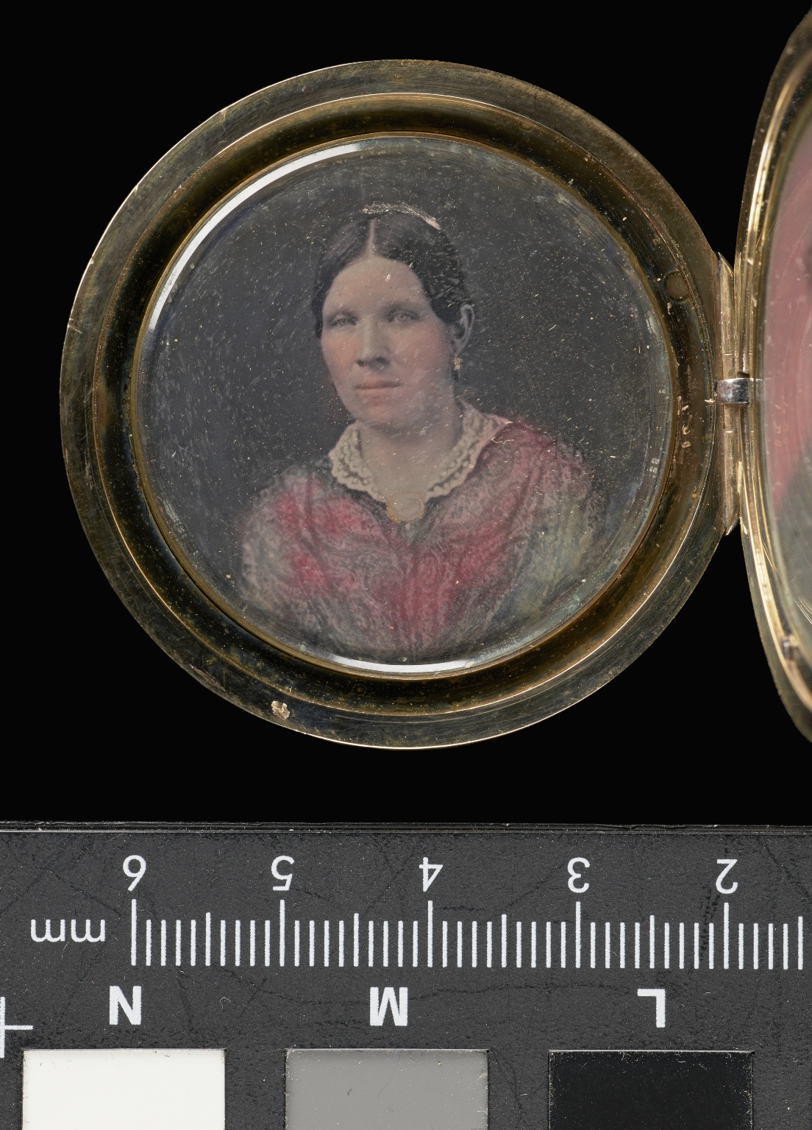
-------------
Image1
-------------
Field Data
Image Number JRL17114912
Reference Number VPH.41.1
Image Title Portrait of a Victorian lady
Alternative Image Title Photo Jewellery
Creator Unknown
Creator Role Photographer
Date Created c1850s
Description A hand-coloured daguerreotype portrait of a Victorian lady. The lady wears a dress with a lace collar and a brooch pinned at the collar, her hair is parted in the centre and pulled back from her face. The image is one of two (presumably a husband and wife) set into a round gilt locket with a hanging ring. The locket engraved on each side with decorative patterns, a foliage design on one side and the initials 'AEW' within the design on the other.
Keyword Photography; Daguerreotypes; Portraits; Locket; keepsake; Love token.
Subject Photography--History--19th century
Category of Material Photography
Sub-Category Analogue photography
Sub-Category Portraits
Technique Used Daguerreotype (process)
Support Copper sheet plated with silver
Time Period Covered 19th Century CE
Item Height 36 mm
Item Width 36 mm
Current Repository The University of Manchester Library, U.K.
Rights Holder - Image The University of Manchester Library
Rights Holder - Work The University of Manchester Library
Access Rights <a rel="license" href="http://creativecommons.org/licenses/by-nc-sa/4.0/"><img alt="Creative Commons License" style="border-width:0" src="https://i.creativecommons.org/l/by-nc-sa/4.0/88x31.png"></a>
Date Captured (yyyy-mm-dd) 2017-11-29
Image Creation Technique Digital capture by Heritage Imaging, The University of Manchester Library
Date Image Added (yyyy-mm) 2017-12
Metadata Language eng-GB

Slide 11
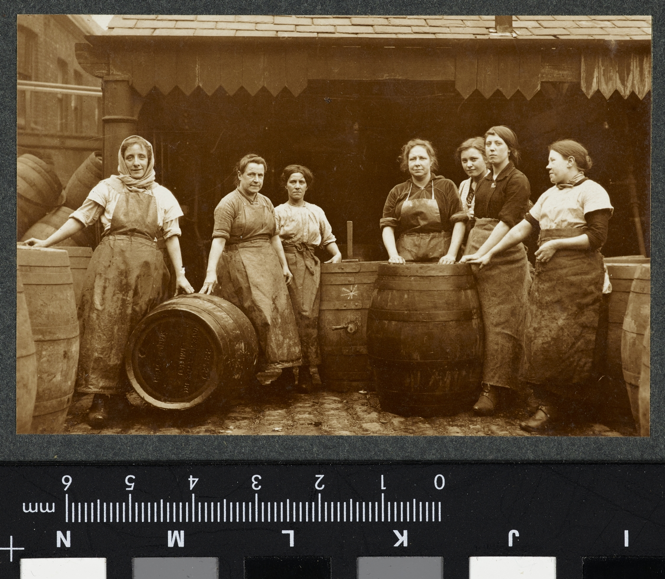
-------------
Image1
-------------
Field Data
Image Number JRL17110565
Reference Number VPH.5.164
Image Title Brewery Women, Coopers and Cask Cleaners, Manchester
Parent Work Title Album of women's work in wartime
Creator Reavil, Mr Arthur
Creator Role Photographer
Date Created 1914-1919
Description A group of seven women stand in a semi circle around beer barrels. They are all wearing aprons and clogs.
Keyword World War; First World War; Homefront.
Subject World War, 1914-1918
Subject Photography--History--20th century
Subject World War, 1914-1918--Photographs
Category of Material Photography
Sub-Category Analogue photography
Technique Used Gelatin silver prints
Support Paper
Creation Site England: Manchester
Time Period Covered 20th Century CE
Places Covered England: Manchester
Item Height 67 mm
Item Width 101 mm
Current Repository The University of Manchester Library, U.K.
Provenance Mr & Mrs Burleigh, former owners
Rights Holder - Image The University of Manchester Library
Rights Holder - Work The University of Manchester Library
Access Rights <a rel="license" href="http://creativecommons.org/licenses/by-nc-sa/4.0/"><img alt="Creative Commons License" style="border-width:0" src="https://i.creativecommons.org/l/by-nc-sa/4.0/88x31.png"></a>
Bibliography <A href="https://luna.manchester.ac.uk/luna/servlet/s/61020q">Album of Women's Work in Wartime.</a>
Image Creation Technique Digital capture by Heritage Imaging, The University of Manchester Library
Date Image Added (yyyy-mm) 2017-11
Metadata Language eng-GB

