Slide 1
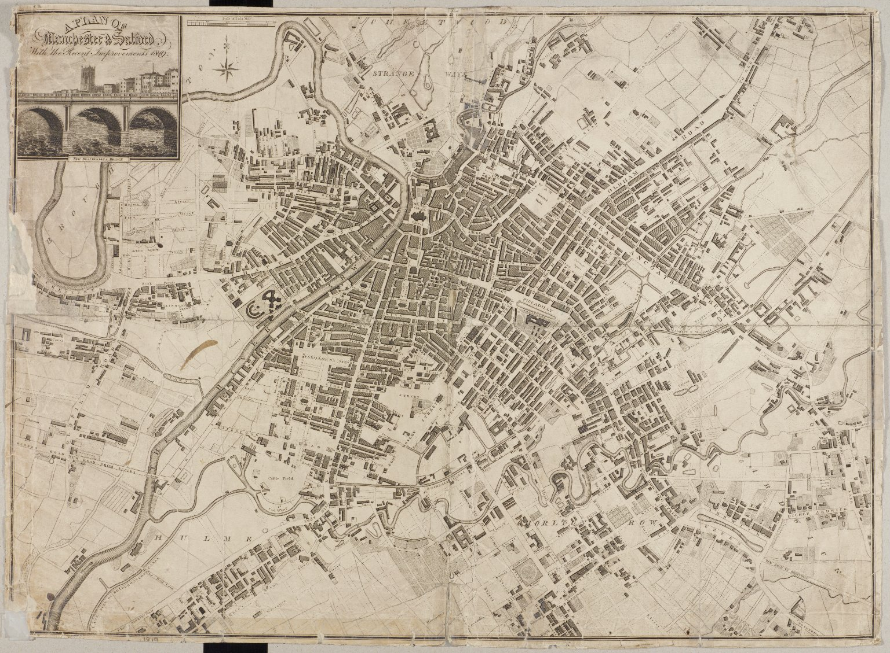
-------------
Image1
-------------
Field Data
Image Number 1819 A Plan of Manc & Salf
Reference Number GB127.Local Studies Street Map Collection/1819 Pigot with new Blackfriars bridge
Image Title Manchester and Salford
Parent Work Title A Plan of Manchester and Salford
Creator Pigot, James
Creator Role Publisher
Date Created 1819
Description Plan of Manchester and Salford. Inset (top left) illustration of the 'New Blackfriars Bridge'. Shows parts of Broughton, Castlefield, Hulme, Chorlton Row, Cheetwood, Strangeways and River Irwell. Scale of 1/4 of a mile.
Language Code eng-GB
Language Name English
Category of Material Printed
Support Paper
Time Period Covered 19th Century CE
Places Covered England: Greater Manchester: Salford
Places Covered England: Greater Manchester: Manchester
Item Height 500 mm
Item Width 680 mm
Current Repository Manchester Archives and Local Studies
Rights Holder - Image Manchester Libraries, Information and Archives, Manchester City Council
Rights holder - Work Manchester Libraries, Information and Archives, Manchester City Council
Notes All image requests to be directed to <a href="http://www.manchester.gov.uk/info/448/archives_and_local_history/7378/access_our_archives_rare_books_and_collections/3">Manchester Archives and Local Studies</a>
Date Captured (yyyy-mm-dd) 2010-04-15
Image Creation Technique Digital capture by Heritage Imaging, The University of Manchester Library
Date Image Added (yyyy-mm) 2012-11
Metadata Language eng-GB

Slide 2
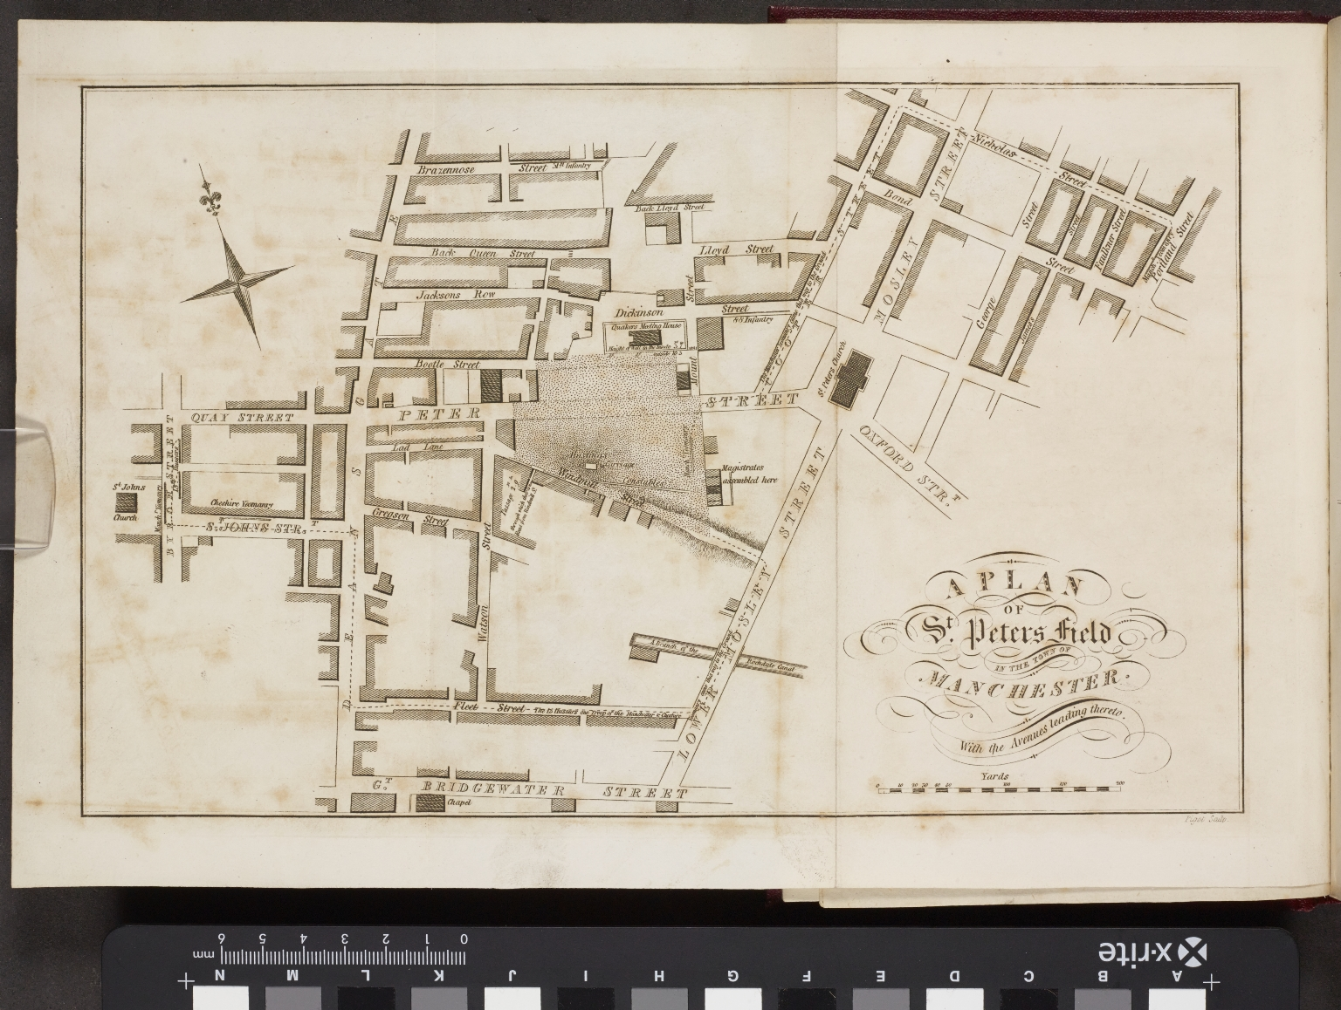
-------------
Image1
-------------
Field Data
Image Number JRL1412576
Reference Number R64191
Link to Catalogue <A href="http://www.librarysearch.manchester.ac.uk/MU_VU1:BLENDED:44MAN_ALMA_DS21133040050001631">UOM online catalogue.</a>
Image Title Plan of St. Peter's field
Parent Work Title In the King's Bench : Between Thomas Redford, plaintiff; and Hugh Hornby Birley, Alexander Oliver, Richard Withington, and Edward Meagher, defendants. For an assault on the 16th. of August, 1819. Report of the proceedings on the trial of this cause at Lancaster ... before Mr.Justice Holroyd and a special jury; and the judgment of the Court of King's Bench in Easter term following
Date Created [1823]
Publication Details Manchester : Printed by C. Wheeler and Son; sold by Messrs. Clarke... and others; England Manchester.
Description Plan of St Peter's field.
Language Code eng-GB
Language Name English
Category of Material Printed
Sub-Category Maps
Support Paper
Time Period Covered 19th Century CE
Places Covered England: Greater Manchester: Manchester
Current Repository The University of Manchester Library, U.K.
Provenance Birmingham Law Society, former owner
Rights Holder - Image The University of Manchester Library
Rights holder - Work The University of Manchester Library
Date Captured (yyyy-mm-dd) 2014-05-13
Image Creation Technique Digital capture by Heritage Imaging, The University of Manchester Library
Date Image Added (yyyy-mm) 2016-11
Metadata Language eng-GB

