Slide 1
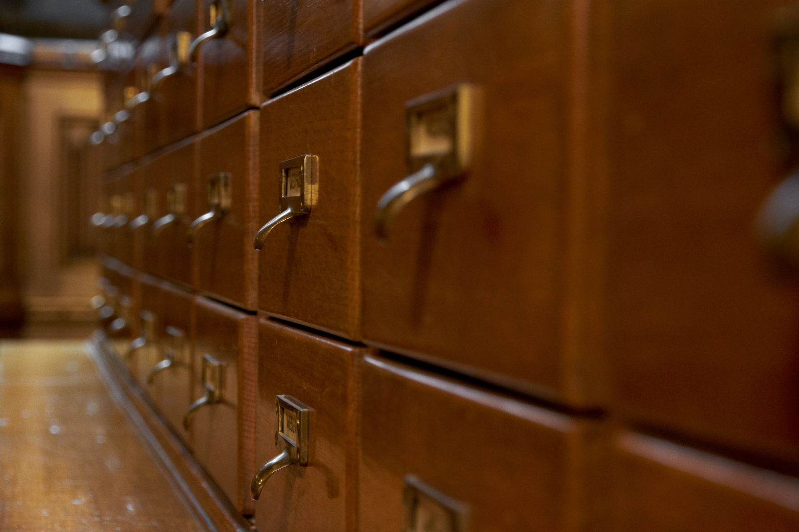
-------------
Image1
-------------
Field Data
Image Number JRL1212368
Image Title Card Catalogue
Description Card Catalogue in the Historic Reading Room. In a physical catalogue the information about an item is on a separate card, which is placed in alphabetical order in the catalogue drawer depending on the type of record.
Subject Architecture
Subject Library buildings
Subject Interior decoration
Creation Site England: Manchester
Time Period Covered 21st Century CE
Places Covered England: Greater Manchester: Manchester
Current Site The John Rylands Library, Deansgate, Manchester, U.K.
Rights Holder - Image The University of Manchester Library
Rights holder - Work The University of Manchester Library
Access Rights <a rel="license" href="http://creativecommons.org/licenses/by-nc-sa/4.0/"><img alt="Creative Commons License" style="border-width:0" src="https://i.creativecommons.org/l/by-nc-sa/4.0/88x31.png"></a>
Date Captured (yyyy-mm-dd) 2012-02-13
Image Creation Technique Digital capture by Heritage Imaging, The University of Manchester Library
Metadata Language eng-GB

Slide 2
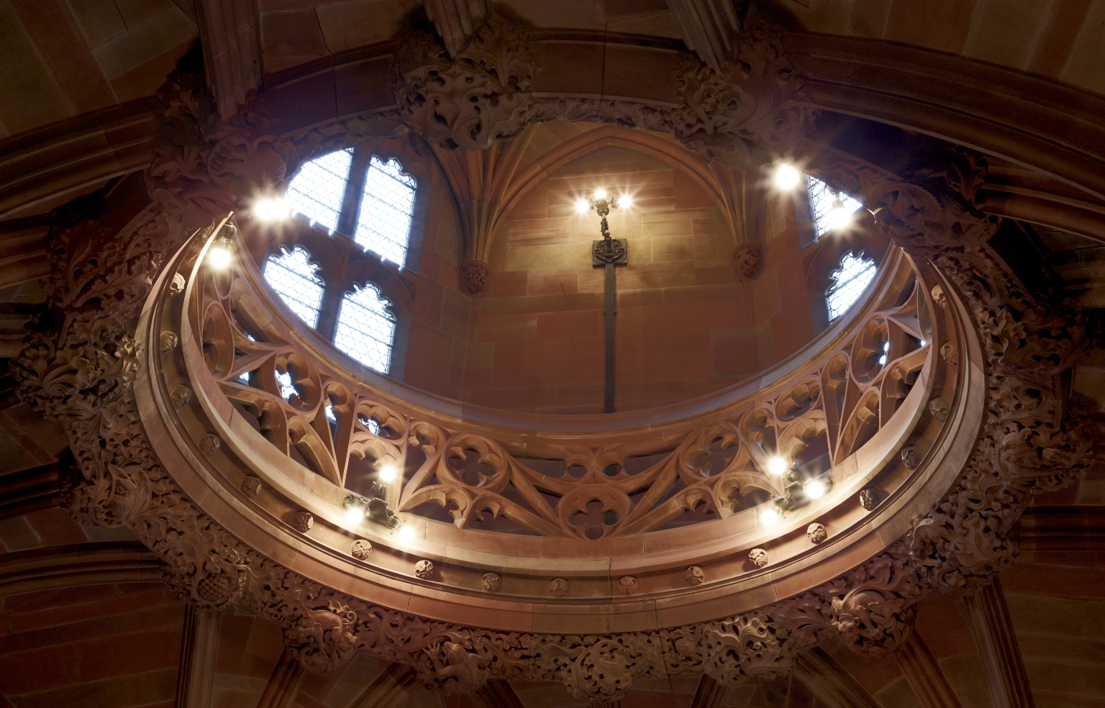
-------------
Image1
-------------
Field Data
Image Number JRL1212309
Image Title Lantern Gallery
Date Created 2012
Subject Architecture
Subject Library buildings
Subject John Rylands Library
Category of Material Photography
Sub-Category Digital photography
Creation Site England: Manchester
Time Period Covered 21st Century CE
Places Covered England: Greater Manchester: Manchester
Current Site The John Rylands Library, Deansgate, Manchester, U.K.
Rights Holder - Image The University of Manchester Library
Rights holder - Work The University of Manchester Library
Access Rights <a rel="license" href="http://creativecommons.org/licenses/by-nc-sa/4.0/"><img alt="Creative Commons License" style="border-width:0" src="https://i.creativecommons.org/l/by-nc-sa/4.0/88x31.png"></a>
Date Captured (yyyy-mm-dd) 2012-02-13
Image Creation Technique Digital capture by Heritage Imaging, The University of Manchester Library
Metadata Language eng-GB

Slide 3
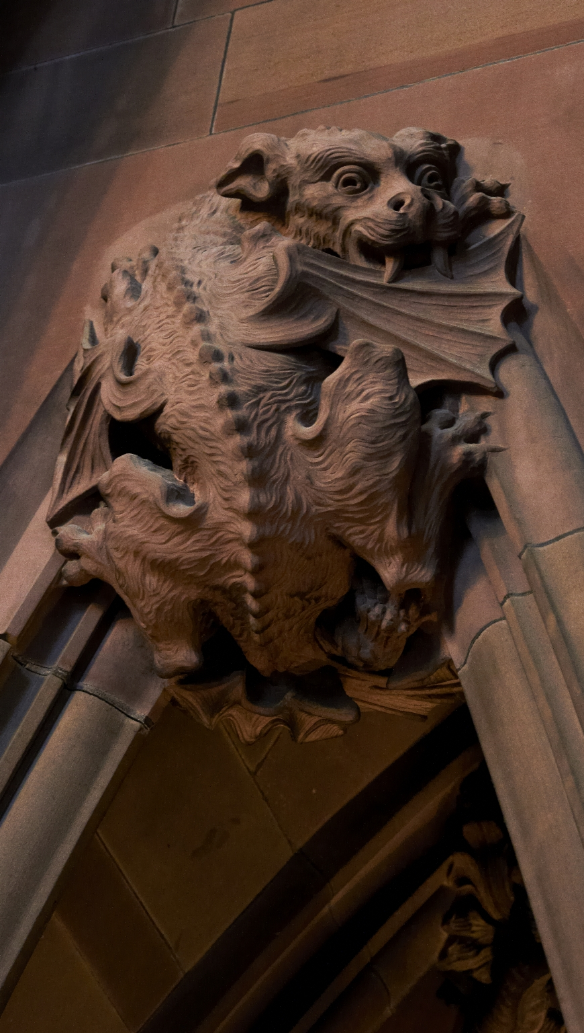
-------------
Image1
-------------
Field Data
Image Number JRL1212374
Image Title Main Staircase: a dragon
Creator Champneys, Basil, 1842-1935
Creator Role Architect
Creator Robert Bridgeman & Sons Ltd
Creator Role Sculptor
Date Created 1895-1897
Description Stone carving of a dragon (mythological creature); main staircase leading to the Historic Reading Room in the John Rylands Library.
Subject Architecture
Subject Library buildings
Subject John Rylands Library
Sub-Category Sculpture
Technique Used Carving (processes)
Technique Used Sculpting
Creation Site England: Manchester
Places Covered England: Greater Manchester: Manchester
Current Site The John Rylands Library, Deansgate, Manchester, U.K.
Rights Holder - Image The University of Manchester Library
Rights holder - Work The University of Manchester Library
Access Rights <a rel="license" href="http://creativecommons.org/licenses/by-nc-sa/4.0/"><img alt="Creative Commons License" style="border-width:0" src="https://i.creativecommons.org/l/by-nc-sa/4.0/88x31.png"></a>
Date Captured (yyyy-mm-dd) 2012-02-13
Image Creation Technique Digital capture by Heritage Imaging, The University of Manchester Library
Metadata Language eng-GB

Slide 4
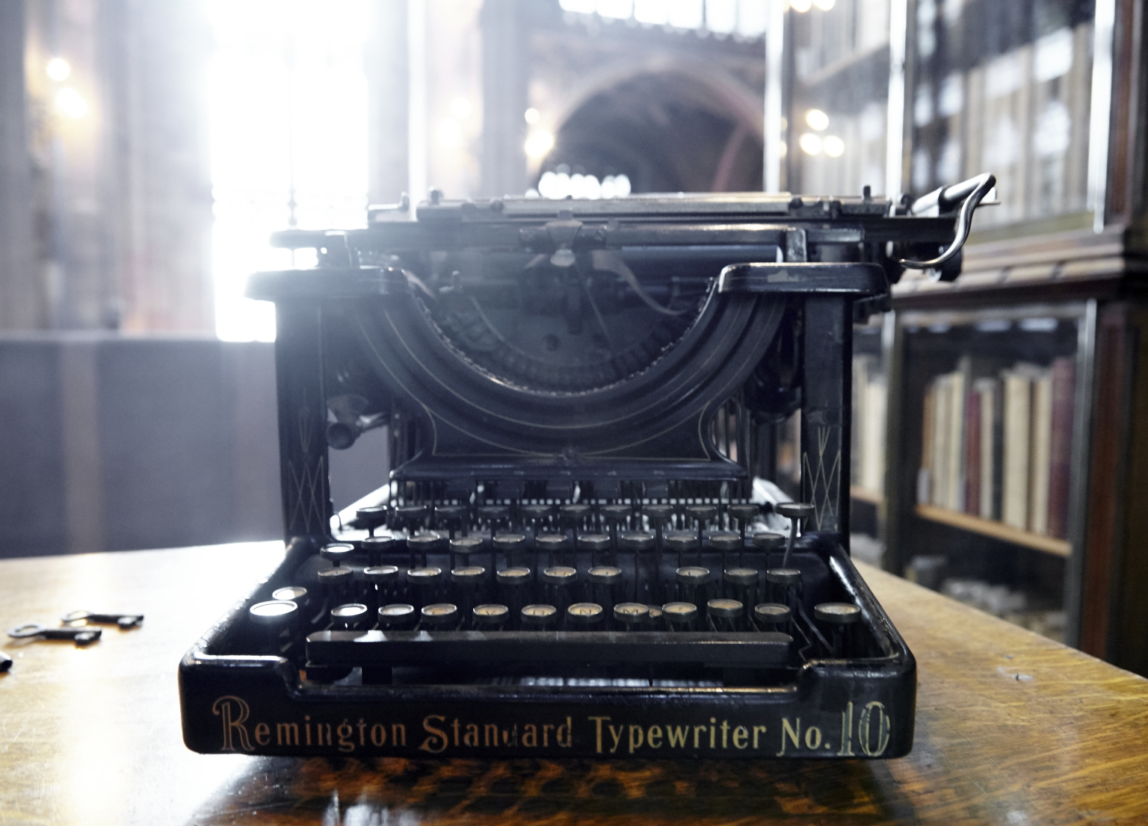
-------------
Image1
-------------
Field Data
Image Number JRL15120000
Image Title Remington Typewriter, Standard no.10
Description Typewriter on Historic Reading Room Gallery.
Subject Typewriters
Subject Typewriters--History
Subject Library buildings
Current Repository The University of Manchester Library, U.K.
Rights Holder - Image The University of Manchester Library
Rights holder - Work The University of Manchester Library
Access Rights <a rel="license" href="http://creativecommons.org/licenses/by-nc-sa/4.0/"><img alt="Creative Commons License" style="border-width:0" src="https://i.creativecommons.org/l/by-nc-sa/4.0/88x31.png"></a>
Image Creation Technique Digital capture by Heritage Imaging, The University of Manchester Library
Date Captured (yyyy-mm-dd) 2015-12-07
Date Image Added (yyyy-mm) 2016-01
Metadata Language eng-GB

Slide 5
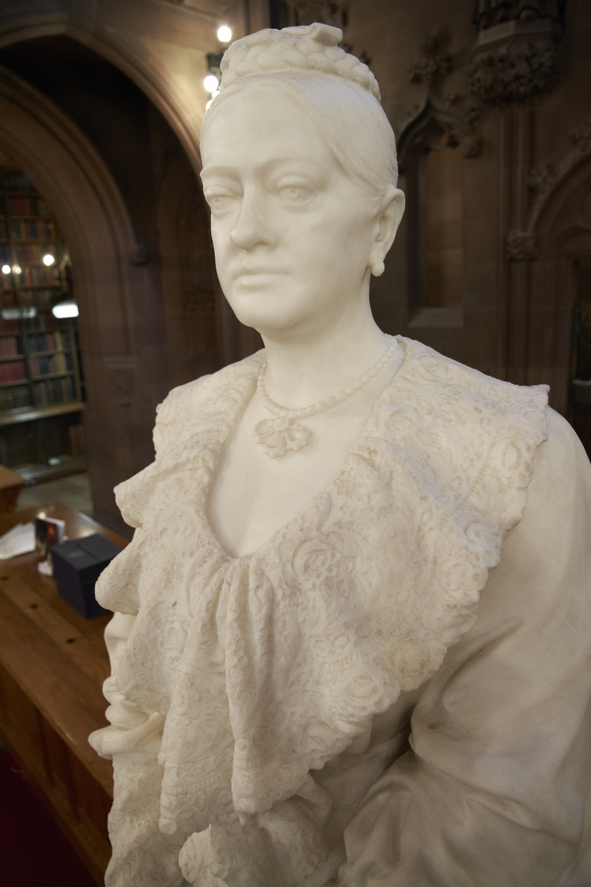
-------------
Image1
-------------
Field Data
Image Number JRL1212247
Image Title Mrs Rylands
Alternative Image Title Enriqueta Rylands
Creator Cassidy, John, 1860-1939
Creator Role Sculptor
Date Created 1907
Description Close-up, life-size marble statue of Enriqueta Rylands in the Historic Reading Room of the John Rylands Library.
Subject Architecture
Subject Library buildings
Subject John Rylands Library
Sub-Category Sculpture
Technique Used Sculpting
Support Saravezza marble
Creation Site England: Manchester
Time Period Covered 20th Century CE
Places Covered England: Greater Manchester: Manchester
People Covered Rylands, Enriqueta Augustina, 1843-1908
Current Site The John Rylands Library, Deansgate, Manchester, U.K.
Rights Holder - Image The University of Manchester Library
Rights holder - Work The University of Manchester Library
Access Rights <a rel="license" href="http://creativecommons.org/licenses/by-nc-sa/4.0/"><img alt="Creative Commons License" style="border-width:0" src="https://i.creativecommons.org/l/by-nc-sa/4.0/88x31.png"></a>
Date Captured (yyyy-mm-dd) 2012-02-13
Image Creation Technique Digital capture by Heritage Imaging, The University of Manchester Library
Metadata Language eng-GB
Date Image Added (yyyy-mm) 2015-11

Slide 6
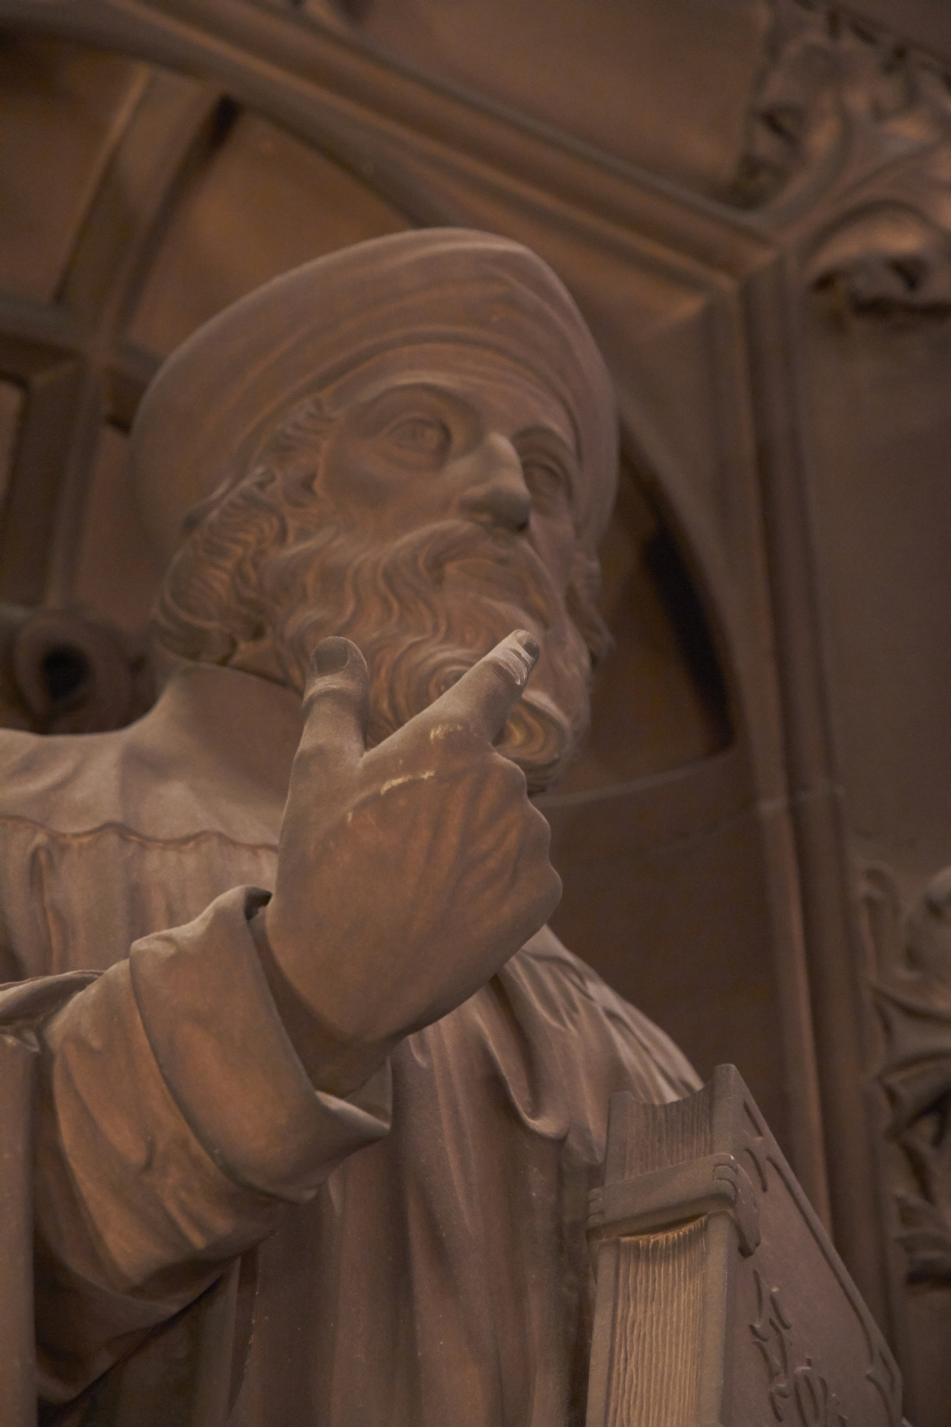
-------------
Image1
-------------
Field Data
Image Number JRL1212286
Image Title Historic Reading Room: Wycliffe
Alternative Image Title John Wycliffe
Alternative Image Title Wycliff
Creator Champneys, Basil, 1842-1935
Creator Role Architect
Creator Robert Bridgeman & Sons Ltd
Creator Role Sculptor
Date Created 1895-1897
Description Statue of Wycliffe in close-up view.
Subject Architecture
Subject Library buildings
Subject John Rylands Library
Sub-Category Sculpture
Technique Used Sculpting
Support Shawk stone
Creation Site England: Manchester
Time Period Covered 19th Century CE
Places Covered England: Greater Manchester: Manchester
People Covered Wycliffe, John, -1384
Current Site The John Rylands Library, Deansgate, Manchester, U.K.
Rights Holder - Image The University of Manchester Library
Rights holder - Work The University of Manchester Library
Access Rights <a rel="license" href="http://creativecommons.org/licenses/by-nc-sa/4.0/"><img alt="Creative Commons License" style="border-width:0" src="https://i.creativecommons.org/l/by-nc-sa/4.0/88x31.png"></a>
Date Captured (yyyy-mm-dd) 2012-02-13
Image Creation Technique Digital capture by Heritage Imaging, The University of Manchester Library
Metadata Language eng-GB
Date Image Added (yyyy-mm) 2015-11

Slide 7
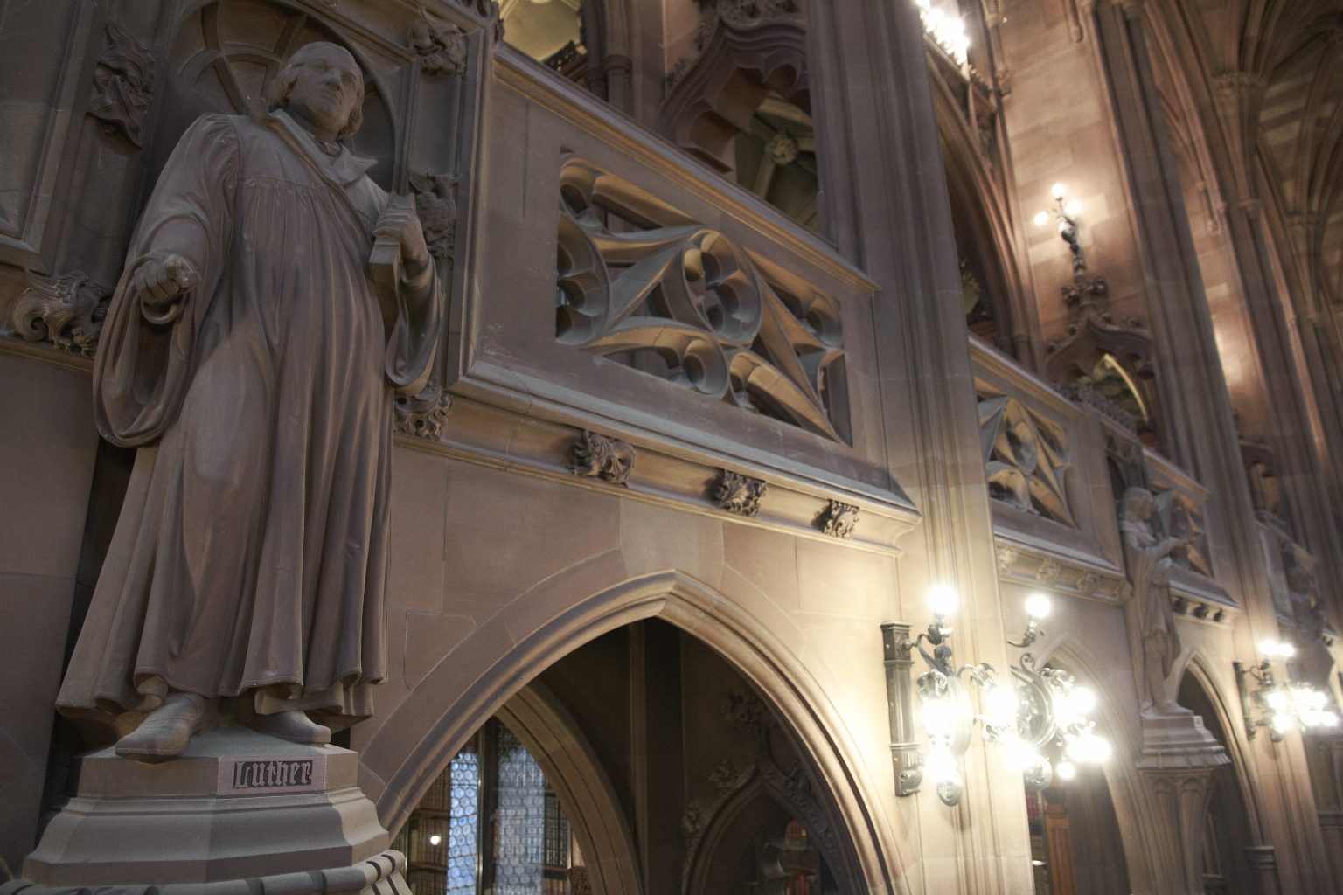
-------------
Image1
-------------
Field Data
Image Number JRL1212256
Image Title Historic Reading Room: Luther
Alternative Image Title Martin Luther
Date Created 2012
Description Section of the Historic Reading Room featuring Martin Luther's statue. architect: Basil Champneys 1842-1935, architect; Robert Bridgeman 1844-1918, sculptor.
Subject Sculpture
Subject Architecture
Subject Library buildings
Category of Material Photography
Sub-Category Digital photography
Creation Site England: Manchester
Time Period Covered 21st Century CE
Places Covered England: Greater Manchester: Manchester
People Covered Luther, Martin, 1483-1546
Current Site The John Rylands Library, Deansgate, Manchester, U.K.
Rights Holder - Image The University of Manchester Library
Rights holder - Work The University of Manchester Library
Access Rights <a rel="license" href="http://creativecommons.org/licenses/by-nc-sa/4.0/"><img alt="Creative Commons License" style="border-width:0" src="https://i.creativecommons.org/l/by-nc-sa/4.0/88x31.png"></a>
Date Captured (yyyy-mm-dd) 2012-02-13
Image Creation Technique Digital capture by Heritage Imaging, The University of Manchester Library
Metadata Language eng-GB
Date Image Added (yyyy-mm) 2015-11

Slide 8
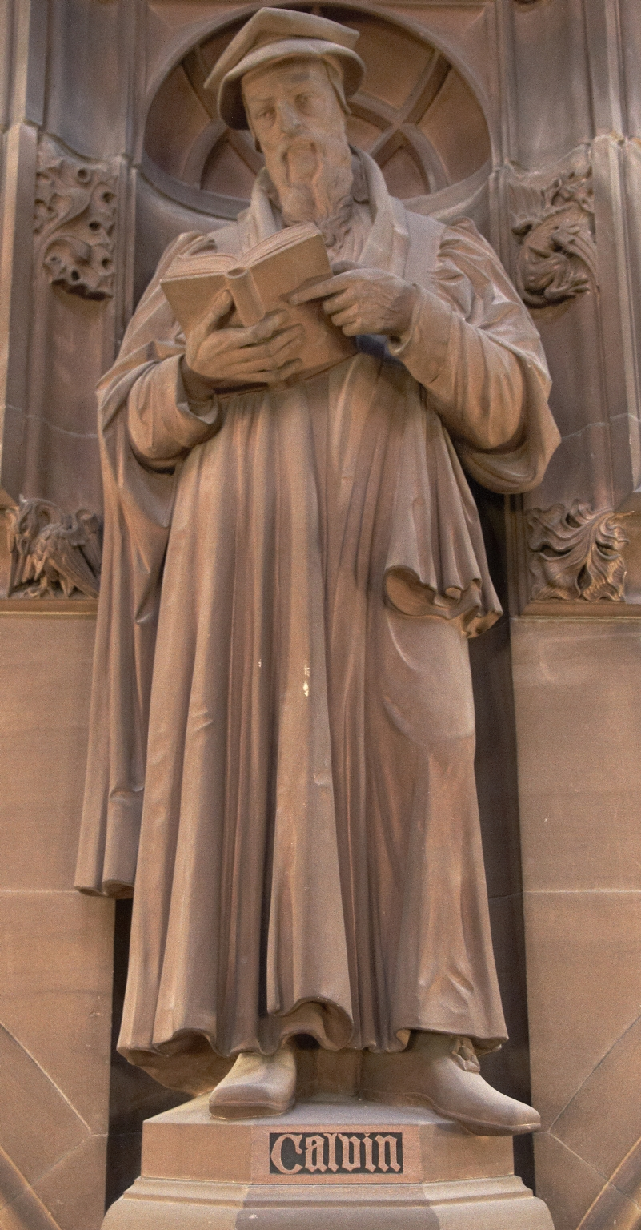
-------------
Image1
-------------
Field Data
Image Number JRL1212212
Image Title Jean Calvin
Creator Champneys, Basil, 1842-1935
Creator Role Architect
Creator Robert Bridgeman & Sons Ltd
Creator Role Sculptor
Date Created 1895-1897
Description Statue of John Calvin, in the Historic Reading Room of the John Rylands Library. John Calvin was an influential French theologian and pastor during the Protestant Reformation. He was a principal figure in the development of the system of Christian theology later called Calvinism.
Subject Architecture
Subject Library buildings
Subject John Rylands Library
Sub-Category Sculpture
Technique Used Sculpting
Support Shawk stone
Creation Site England: Manchester
Time Period Covered 19th Century CE
Places Covered England: Greater Manchester: Manchester
People Covered Calvin, Jean, 1509-1564
Current Site The John Rylands Library, Deansgate, Manchester, U.K.
Rights Holder - Image The University of Manchester Library
Rights holder - Work The University of Manchester Library
Access Rights <a rel="license" href="http://creativecommons.org/licenses/by-nc-sa/4.0/"><img alt="Creative Commons License" style="border-width:0" src="https://i.creativecommons.org/l/by-nc-sa/4.0/88x31.png"></a>
Date Captured (yyyy-mm-dd) 2012-02-13
Image Creation Technique Digital capture by Heritage Imaging, The University of Manchester Library
Metadata Language eng-GB
Date Image Added (yyyy-mm) 2015-11

Slide 9
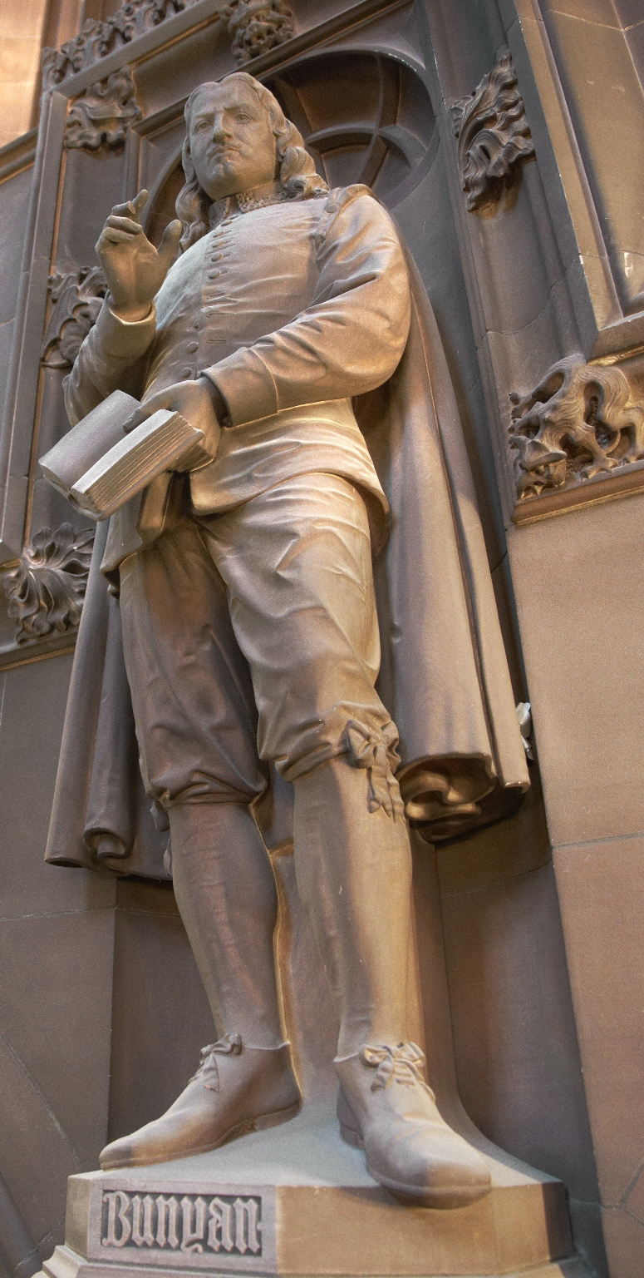
-------------
Image1
-------------
Field Data
Image Number JRL1212216
Image Title John Bunyan
Creator Champneys, Basil, 1842-1935
Creator Role Architect
Creator Robert Bridgeman & Sons Ltd
Creator Role Sculptor
Date Created 1895-1897
Description Statue of John Bunyan in the Historic Reading Room of the John Rylands Library. John Bunyan was an English writer and Baptist preacher best remembered as the author of the religious allegory The Pilgrim's Progress.
Subject Architecture
Subject Library buildings
Subject John Rylands Library
Sub-Category Sculpture
Technique Used Sculpting
Support Shawk stone
Creation Site England: Manchester
Time Period Covered 19th Century CE
Places Covered England: Greater Manchester: Manchester
People Covered Bunyan, John, 1628-1688
Current Site The John Rylands Library, Deansgate, Manchester, U.K.
Rights Holder - Image The University of Manchester Library
Rights holder - Work The University of Manchester Library
Access Rights <a rel="license" href="http://creativecommons.org/licenses/by-nc-sa/4.0/"><img alt="Creative Commons License" style="border-width:0" src="https://i.creativecommons.org/l/by-nc-sa/4.0/88x31.png"></a>
Date Captured (yyyy-mm-dd) 2012-02-13
Image Creation Technique Digital capture by Heritage Imaging, The University of Manchester Library
Metadata Language eng-GB
Date Image Added (yyyy-mm) 2015-11

Slide 10
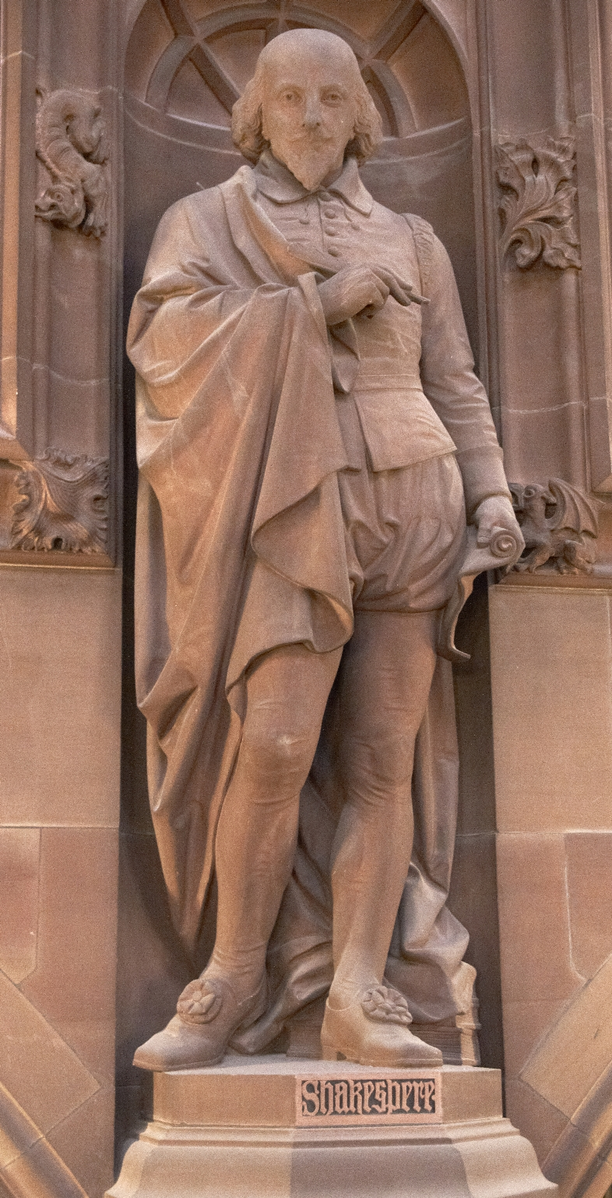
-------------
Image1
-------------
Field Data
Image Number JRL1212210
Image Title William Shakespeare
Creator Champneys, Basil, 1842-1935
Creator Role Architect
Creator Robert Bridgeman & Sons Ltd
Creator Role Sculptor
Date Created 1895-1897
Description Statue of William Shakespeare in the Historic Reading Room, John Rylands Library. William Shakespeare was an English poet, playwright, and actor, widely regarded as the greatest writer in the English language and the world's pre-eminent dramatist. He is often called England's national poet, and the "Bard of Avon".
Subject Architecture
Subject Library buildings
Subject John Rylands Library
Sub-Category Sculpture
Technique Used Sculpting
Support Shawk stone
Creation Site England: Manchester
Time Period Covered 19th Century CE
Places Covered England: Greater Manchester: Manchester
Current Site The John Rylands Library, Deansgate, Manchester, U.K.
Rights Holder - Image The University of Manchester Library
Rights holder - Work The University of Manchester Library
Access Rights <a rel="license" href="http://creativecommons.org/licenses/by-nc-sa/4.0/"><img alt="Creative Commons License" style="border-width:0" src="https://i.creativecommons.org/l/by-nc-sa/4.0/88x31.png"></a>
Date Captured (yyyy-mm-dd) 2012-02-13
Image Creation Technique Digital capture by Heritage Imaging, The University of Manchester Library
Metadata Language eng-GB
Date Image Added (yyyy-mm) 2015-11

