Slide 1
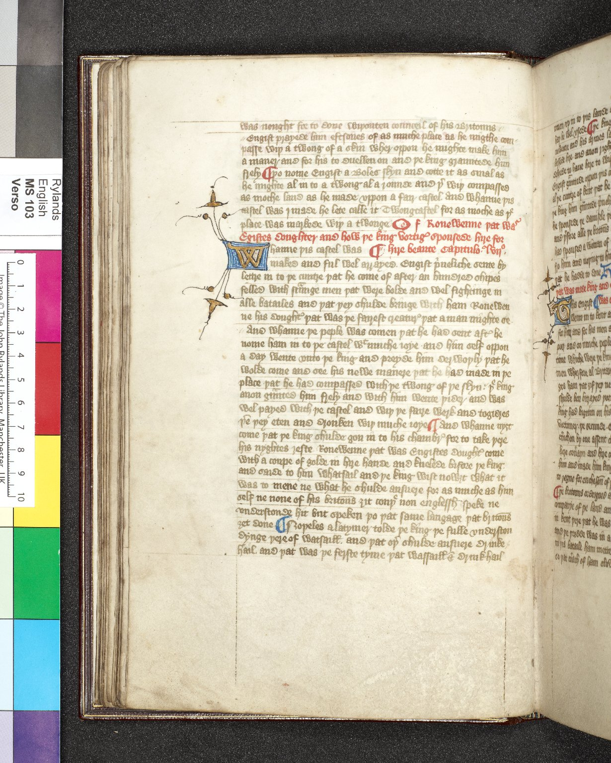
-------------
Image1
-------------
Field Data
Image Number JRL0925070dc
Reference Number English MS 103
Link to Catalogue <A href=https://www.librarysearch.manchester.ac.uk/primo-explore/fulldisplay?docid=44MAN_ELGAR_DSgb133engms103&context=L&vid=MU_NUI&search_scope=BLENDED&tab=local&lang=en_US>UoM online catalogue.</a>
Image Title King Vortiger
Parent Work Title Brut Chronicle (1347 Continuation)
Alternative Parent Work Title Brute or the Chronicles of England
Date Created 14th century [mid]
Page 19v
Image Sequence Number 019v
Description How Engist built Twongcastel. Red rubrication and an illuminated initial ' W ' introduce the tale of how Vortiger married Ronewenne, Engist's daughter. The written space is c.182 x 112 mm and the script is anglicana formata.
Transcription was nought for to done wiþouten counceil of his Britouns // // Engist prayede him eftsones of as muche place as he migthe com- pass wiþ a twong of a skin wher oppon he mighte make him a maner and for his to duellen on and þe king grauntede him frely // þo nome Engist a Boles skyn and cotte it as smal as he mighte al in to a twong al a rounde and þ(er) wiþ compassed as moche land as he made vppon a fair castel . And whanne þis castel was j made he lete calle it Twongcastel for as moche as þe place was markede wiþ a twong Of Ronewenne þat wa(s) Egistes doughter and how þe king Vortig(er) spousede hire for [...] hire beaute Capitulo. lvijo. Whanne þis castel was [...] maked and ful wel arrayed . Engist p(ri)ueliche sente by lettre in to þe cuntre þat he come of after an hundred shipes felled with str(ra)unge men were bolde and wel fightinge in alle batailes and þat þey shulde bringe with ham Ronewen ne his dought(er) þat was þe fairest creatur(e) þat a man mighte se // And whanne þe peple was comen þat he had sent aft(er) he nome ham in to þe castel wt muche ioye and him self oppon a day wente vnto þe king and preyde him derwoþly þat he wolde come and see his newe manere þat he had made in þe place þat he had compassed with þe twong of þe skyn : þe king anon g(ra)unted him frely and with him wente þider and was wel payed with þe castel and wiþ þe faire werk and togidres þe(~) þey eten and dronken wiþ muche ioye // And whanne nyȝt come þat þe king shulde gon in to his chambr(e) for to take þere his nyghtes reste Ronewenne þat was Engistes dought(er) come with a coupe of golde in hire hande and knelede bifore þe king. and saide to him whatsail and þe king wist nowȝt what it was to mene ne what he shulde ansuere for as muche as him self ne none of his britou(~)s ȝit couþe non englessh speke ne vnderstonde hit but speken þo þat same langage þat britou(~)s ȝet done // Noþeles alatymer tolde þe king þe fulle vnderston dynge þere of watsaill . and þat oþ(er) shulde ansuere drink hail . and þat was þe ferste tyme þat wassaill & drinkhail
Language Code enm-GB
Subject Chronicles of England
Subject Chronicles of England--Manuscripts
Subject Great Britain--History
Category of Material Manuscripts
Sub-Category Codex
Technique Used Illumination (image-making process)
Medium Ink
Support Vellum
Time Period Covered 1 BCE - 500 CE
Places Covered England
People Covered Vortigern, active 450
Item Height 278 mm
Item Width 183 mm
Current Repository The University of Manchester Library, U.K.
Rights Holder - Image The University of Manchester Library
Rights holder - Work The University of Manchester Library
Access Rights <a rel="license" href="http://creativecommons.org/licenses/by-nc-sa/4.0/"><img alt="Creative Commons License" style="border-width:0" src="https://i.creativecommons.org/l/by-nc-sa/4.0/88x31.png" /></a>
References Parts of this catalogue have been reproduced from Ker, N.R., 'Medieval manuscripts in British libraries, vol. III, Lampeter-Oxford' (Oxford: Clarendon Press, 1983), p. 417. By kind permission of Oxford University Press.
References Tyson, Moses, 'Hand-List of the Collection of English Manuscripts in the John Rylands Library' (1928), p.23.
Bibliographic Citation Brie, Friedrich W. D., 'The Brut, or, the Chronicles of England / edited from Ms. Rawl. B 171, Bodleian Library &c.', (London: Kegan Paul, Trench, Trübner for the Early English Text Society, 1906-1908)
Cost Purchased by the John Rylands Library from the London booksellers J. & J. Leighton for £36.00 on 18 June 1908.
Date Captured (yyyy-mm-dd) 2009-07-22
Multi Page Number 240
Image Creation Technique Digital capture by Heritage Imaging, The University of Manchester Library
Date Image Added (yyyy-mm) 2010-06
Metadata Language eng-GB

Slide 3
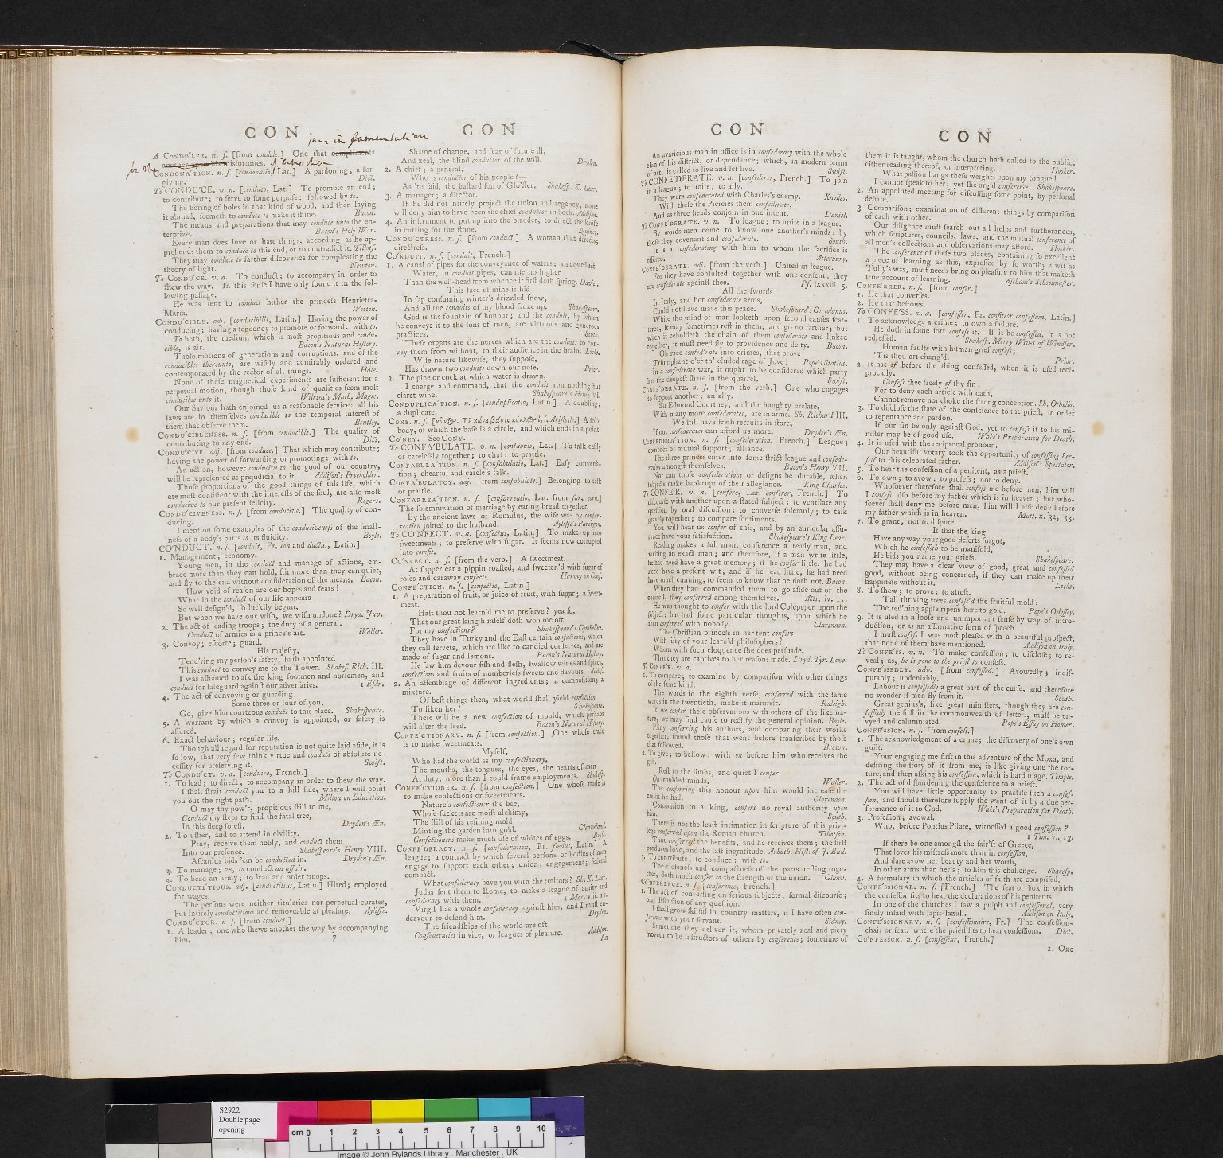
-------------
Image1
-------------
Field Data
Image Number JRL0701499dc
Reference Number Spencer 2922
Link to Catalogue <A href=http://man-fe.hosted.exlibrisgroup.com/MU_VU1:BLENDED:44MAN_ALMA_DS21151726900001631>UoM online catalogue</a>
Image Title Samuel Johnson's Dictionary
Parent Work Title A dictionary of the English language: : in which the words are deduced from their originals, and illustrated in their different significations by examples from the best writers
Creator Johnson, Samuel, 1709-1784
Creator Role Author
Date Created 1773
Publication Details London: printed by W. Strahan, for W. Strahan, J. & F. Rivington, T. Davies, J. Hinton, L. Davis [and 21 others in London]
Volume 1
Page/Sheet CON
Description Double page opening from the fourth edition of Samuel Johnson's Dictionary: Condoler - Confessor.
Language Code eng-GB
Subject Language and languages
Subject English literature
Category of Material Printed
Support Paper
Time Period Covered 18th Century CE
People Covered Johnson, Samuel, 1709-1784
Current Repository The University of Manchester Library, U.K.
Provenance Spencer, George John Spencer, Earl, 1758-1834, former owner
Rights Holder - Image The University of Manchester Library
Rights holder - Work The University of Manchester Library
Access Rights <a rel="license" href="http://creativecommons.org/licenses/by-nc-sa/4.0/"><img alt="Creative Commons License" style="border-width:0" src="https://i.creativecommons.org/l/by-nc-sa/4.0/88x31.png" /></a>
Notes The titlepages in red and black
Date Captured (yyyy-mm-dd) 2006-12-19
Image Creation Technique Digital capture by Gten
Date Image Added (yyyy-mm) 2007-04
Metadata Language eng-GB

Slide 4
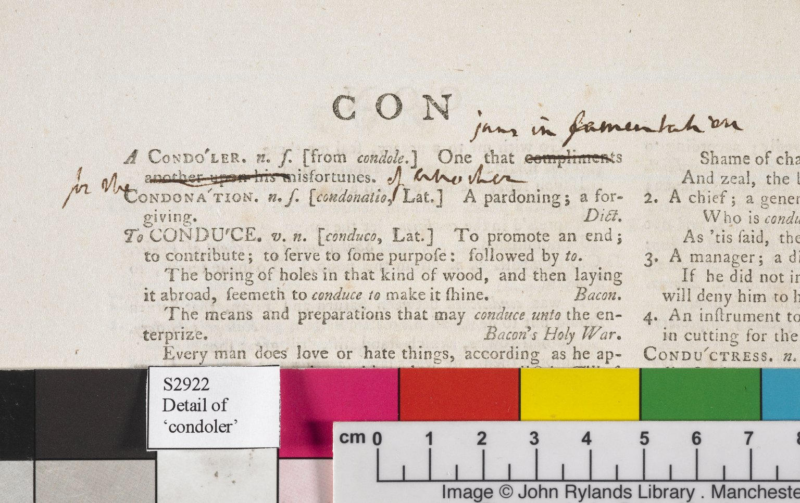
-------------
Image1
-------------
Field Data
Image Number JRL0701500dc
Reference Number Spencer 2922
Link to Catalogue <A href=http://man-fe.hosted.exlibrisgroup.com/MU_VU1:BLENDED:44MAN_ALMA_DS21151726900001631>UoM online catalogue</a>
Image Title Detail of annotation
Parent Work Title A dictionary of the English language: : in which the words are deduced from their originals, and illustrated in their different significations by examples from the best writers
Creator Johnson, Samuel, 1709-1784
Creator Role Author
Date Created 1773
Publication Details London: printed by W. Strahan, for W. Strahan, J. & F. Rivington, T. Davies, J. Hinton, L. Davis [and 21 others in London]
Volume 1
Page/Sheet CON
Description Detail of Johnson's annotation to the entry for 'Condoler' in the fourth edition of Samuel Johnson's Dictionary.
Language Code eng-GB
Subject Language and languages
Subject English literature
Category of Material Printed
Technique Used Handwriting
Support Paper
Time Period Covered 18th Century CE
People Covered Johnson, Samuel, 1709-1784
Current Repository The University of Manchester Library, U.K.
Provenance Spencer, George John Spencer, Earl, 1758-1834, former owner
Rights Holder - Image The University of Manchester Library
Rights holder - Work The University of Manchester Library
Access Rights <a rel="license" href="http://creativecommons.org/licenses/by-nc-sa/4.0/"><img alt="Creative Commons License" style="border-width:0" src="https://i.creativecommons.org/l/by-nc-sa/4.0/88x31.png" /></a>
Notes The titlepages in red and black
Date Captured (yyyy-mm-dd) 2006-12-19
Image Creation Technique Digital capture by Gten
Date Image Added (yyyy-mm) 2007-04
Metadata Language eng-GB

Slide 5
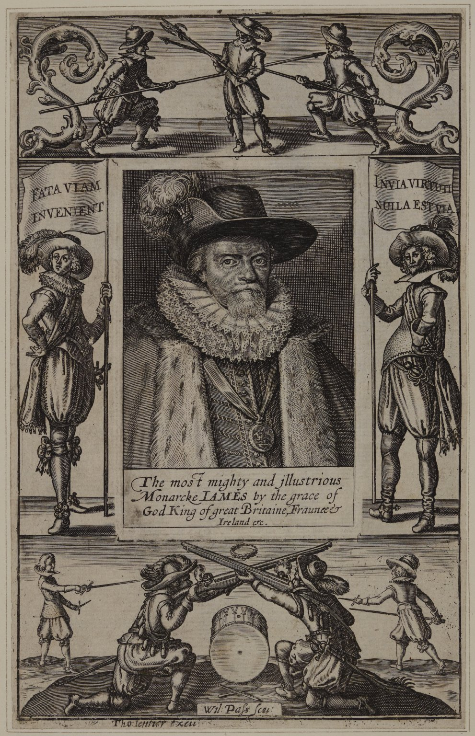
-------------
Image1
-------------
Field Data
Image Number JRL1201536
Reference Number Spencer 22348
Link to Catalogue <A href=http://man-fe.hosted.exlibrisgroup.com/MU_VU1:BLENDED:44MAN_ALMA_DS21209817250001631>UoM online catalogue.</a>
Image Title Civil war figures against a backdrop portrait of James I
Parent Work Title The history of the rebellion and civil wars in England
Creator Passe, Willem van de, 1598-approximately 1637
Creator Role Engraver
Creator Jenner, Thomas, -1673
Creator Role Author
Creator Clarendon, Edward Hyde, Earl of, 1609-1674
Creator Role Author
Date Created 1807
Publication Details Oxford
Volume Vol. I: part I
Page/Sheet 22
Description Images of civil war figures against a backdrop portrait of James I.
Language Code eng-GB
Subject Great Britain--History
Category of Material Printed
Sub-Category Illustrated works
Sub-Category Portraits
Technique Used Engraving (printing process)
Medium Ink
Support Paper
Time Period Covered 17th Century CE
People Covered James I, King of England, 1566-1625
Current Repository The University of Manchester Library, U.K.
Rights Holder - Image The University of Manchester Library
Rights holder - Work The University of Manchester Library
Access Rights <a rel="license" href="http://creativecommons.org/licenses/by-nc-sa/4.0/"><img alt="Creative Commons License" style="border-width:0" src="https://i.creativecommons.org/l/by-nc-sa/4.0/88x31.png" /></a>
Notes New edition [with extra illustrations].
Date Captured (yyyy-mm-dd) 2011-09-23
Image Creation Technique Digital capture by Heritage Imaging, The University of Manchester Library
Date Image Added (yyyy-mm) 2011-10
Metadata Language eng-GB

