Slide 1
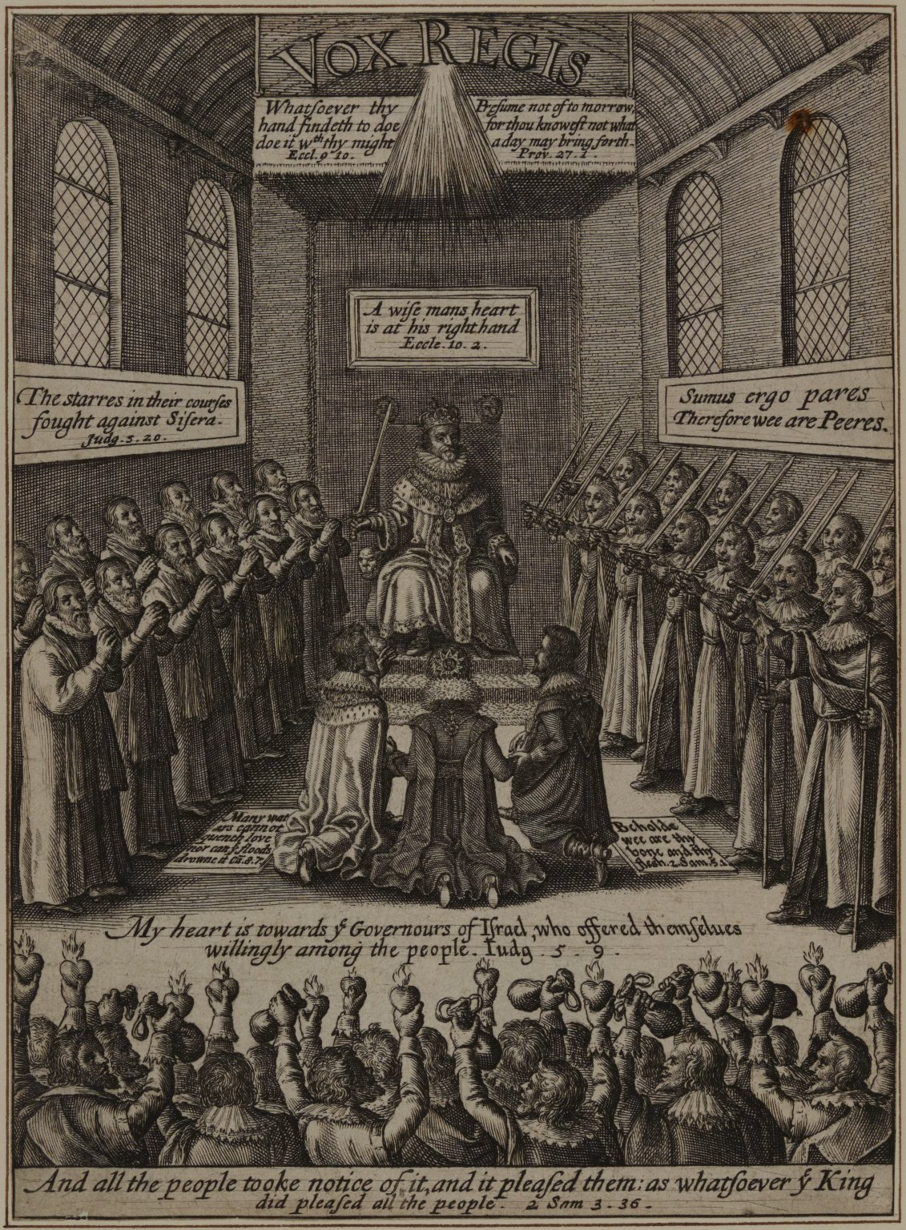
-------------
Image1
-------------
Field Data
Image Number JRL1201537
Reference Number Spencer 22348
Link to Catalogue <A href=http://man-fe.hosted.exlibrisgroup.com/MU_VU1:BLENDED:44MAN_ALMA_DS21209817250001631>UoM online catalogue.</a>
Image Title Vox Regis
Parent Work Title The history of the rebellion and civil wars in England
Creator Clarendon, Edward Hyde, Earl of, 1609-1674
Creator Role Author
Date Created 1807
Publication Details Oxford
Volume Vol. I: part I
Page/Sheet 29
Description Vox Regis - King and Parliament.
Language Code lat-GB
Language Code eng-GB
Subject Great Britain--History
Category of Material Printed
Sub-Category Illustrated works
Technique Used Engraving (printing process)
Medium Ink
Support Paper
Time Period Covered 17th Century CE
Current Repository The University of Manchester Library, U.K.
Rights Holder - Image The University of Manchester Library
Rights holder - Work The University of Manchester Library
Access Rights <a rel="license" href="http://creativecommons.org/licenses/by-nc-sa/4.0/"><img alt="Creative Commons License" style="border-width:0" src="https://i.creativecommons.org/l/by-nc-sa/4.0/88x31.png" /></a>
Notes New edition [with extra illustrations].
Date Captured (yyyy-mm-dd) 2011-09-23
Image Creation Technique Digital capture by Heritage Imaging, The University of Manchester Library
Date Image Added (yyyy-mm) 2011-10
Metadata Language eng-GB

Slide 2
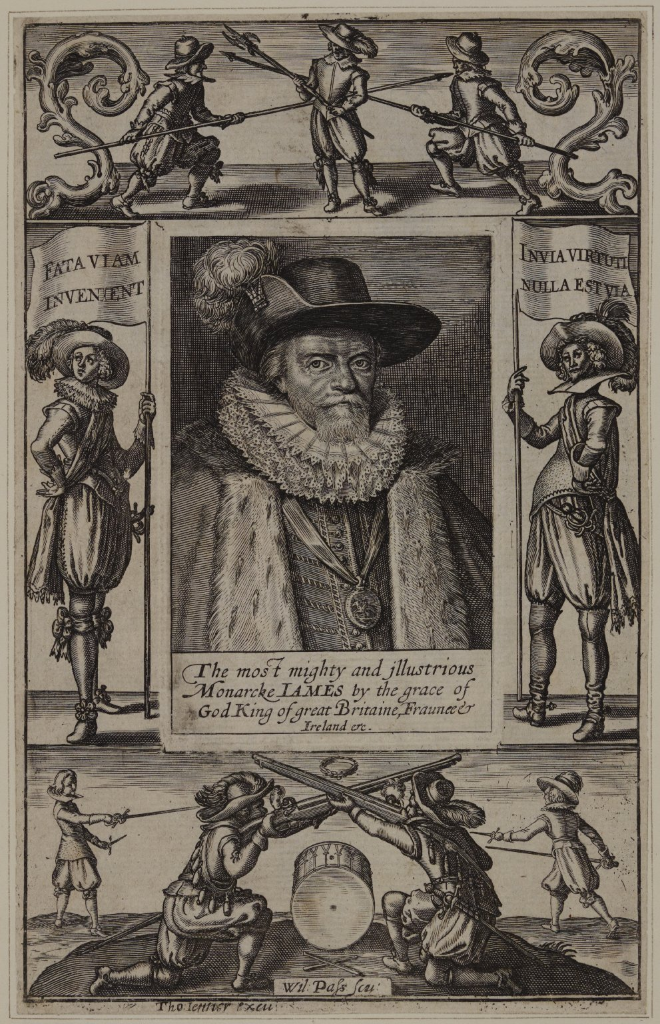
-------------
Image1
-------------
Field Data
Image Number JRL1201536
Reference Number Spencer 22348
Link to Catalogue <A href=http://man-fe.hosted.exlibrisgroup.com/MU_VU1:BLENDED:44MAN_ALMA_DS21209817250001631>UoM online catalogue.</a>
Image Title Civil war figures against a backdrop portrait of James I
Parent Work Title The history of the rebellion and civil wars in England
Creator Passe, Willem van de, 1598-approximately 1637
Creator Role Engraver
Creator Jenner, Thomas, -1673
Creator Role Author
Creator Clarendon, Edward Hyde, Earl of, 1609-1674
Creator Role Author
Date Created 1807
Publication Details Oxford
Volume Vol. I: part I
Page/Sheet 22
Description Images of civil war figures against a backdrop portrait of James I.
Language Code eng-GB
Subject Great Britain--History
Category of Material Printed
Sub-Category Illustrated works
Sub-Category Portraits
Technique Used Engraving (printing process)
Medium Ink
Support Paper
Time Period Covered 17th Century CE
People Covered James I, King of England, 1566-1625
Current Repository The University of Manchester Library, U.K.
Rights Holder - Image The University of Manchester Library
Rights holder - Work The University of Manchester Library
Access Rights <a rel="license" href="http://creativecommons.org/licenses/by-nc-sa/4.0/"><img alt="Creative Commons License" style="border-width:0" src="https://i.creativecommons.org/l/by-nc-sa/4.0/88x31.png" /></a>
Notes New edition [with extra illustrations].
Date Captured (yyyy-mm-dd) 2011-09-23
Image Creation Technique Digital capture by Heritage Imaging, The University of Manchester Library
Date Image Added (yyyy-mm) 2011-10
Metadata Language eng-GB

Slide 3
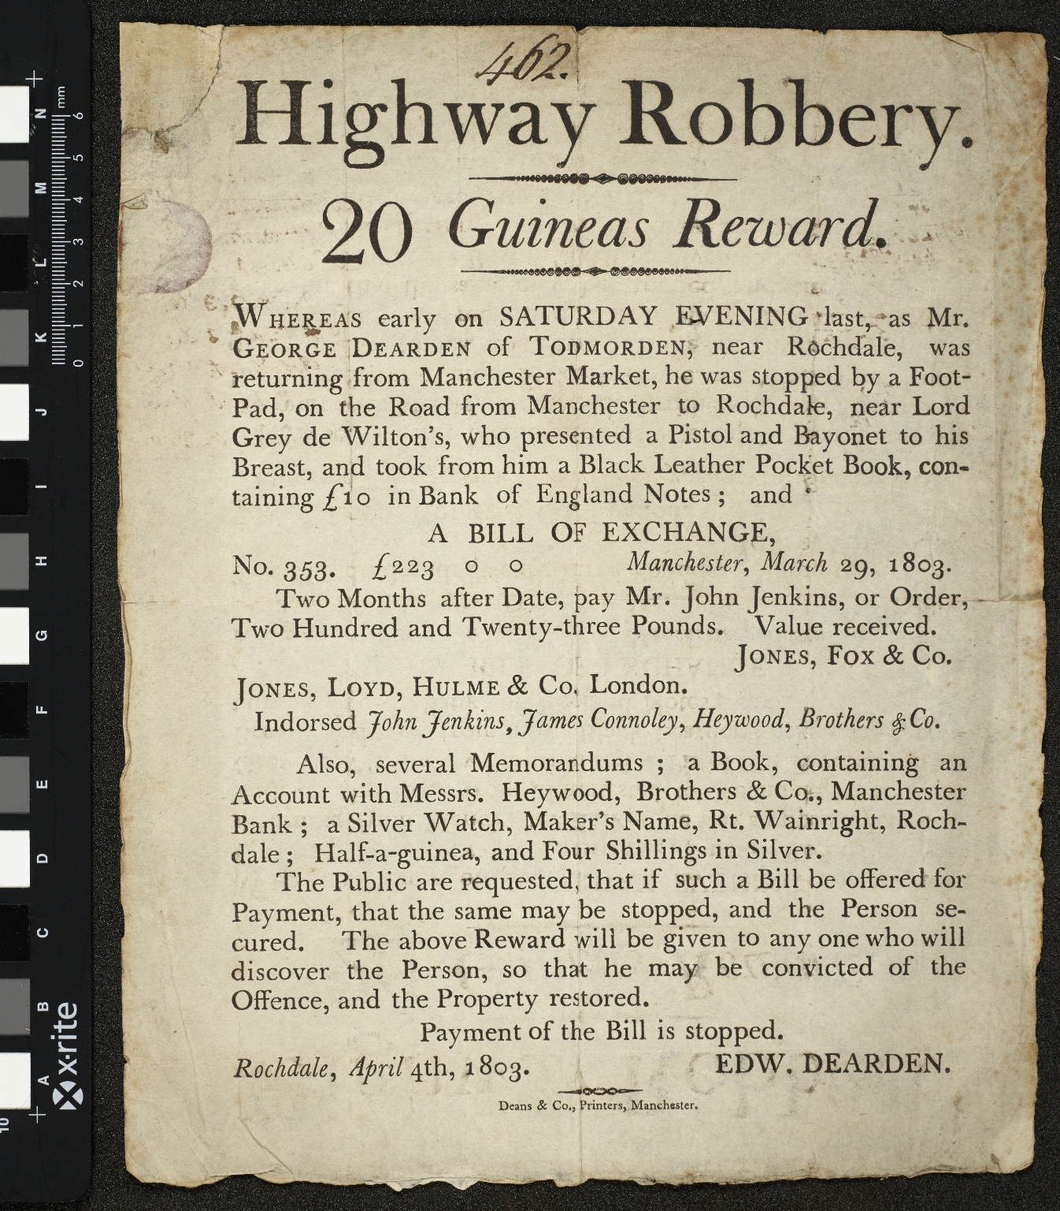
-------------
Image1
-------------
Field Data
Image Number JRL15110598
Reference Number R224483
Link to Catalogue <A href="http://man-fe.hosted.exlibrisgroup.com/MU_VU1:LSCOP_ALMA:44MAN_ALMA_DS21251935570001631">UOM online catalogue.</a>
Image Title Highway Robbery
Parent Work Title Highway robbery: 20 guineas reward.
Creator Dean & Co.
Creator Role Printer
Creator Dearden, Edward
Creator Role Author
Date Created 1803-04-04
Publication Details Manchester: Dean & Co., Printers
Description Broadside: A broadside reward notice relating to the robbery of George Dearden of Todmorden, near Rochdale in 1803. Issued by Edw. Dearden, signed and dated at foot: Rochdale, April 4th, 1803.
Language Code eng-GB
Language English
Subject Robbery -- England -- Manchester -- Posters
Subject Brigands and robbers -- England -- Manchester -- 19th century
Subject Wanted posters -- 19th century
Category of Material Printed
Sub-Category Broadsides
Medium Ink
Support Paper
Time Period Covered 19th Century CE
Places Covered England: Greater Manchester: Rochdale
Current Repository The University of Manchester Library, U.K.
Rights Holder - Image The University of Manchester Library
Rights holder - Work The University of Manchester Library
Access Rights <a rel="license" href="http://creativecommons.org/licenses/by-nc-sa/4.0/"><img alt="Creative Commons License" style="border-width:0" src="https://i.creativecommons.org/l/by-nc-sa/4.0/88x31.png" /></a><br />This work is licensed under a <a rel="license" href="http://creativecommons.org/licenses/by-nc-sa/4.0/">Creative Commons Attribution-NonCommercial-ShareAlike 4.0 International License.</a> Copyright of The University of Manchester
Date Captured (yyyy-mm-dd) 2015-11-10
Image Creation Technique Digital capture by Heritage Imaging, The University of Manchester Library
Date Image Added (yyyy-mm) 2015-11

Slide 4
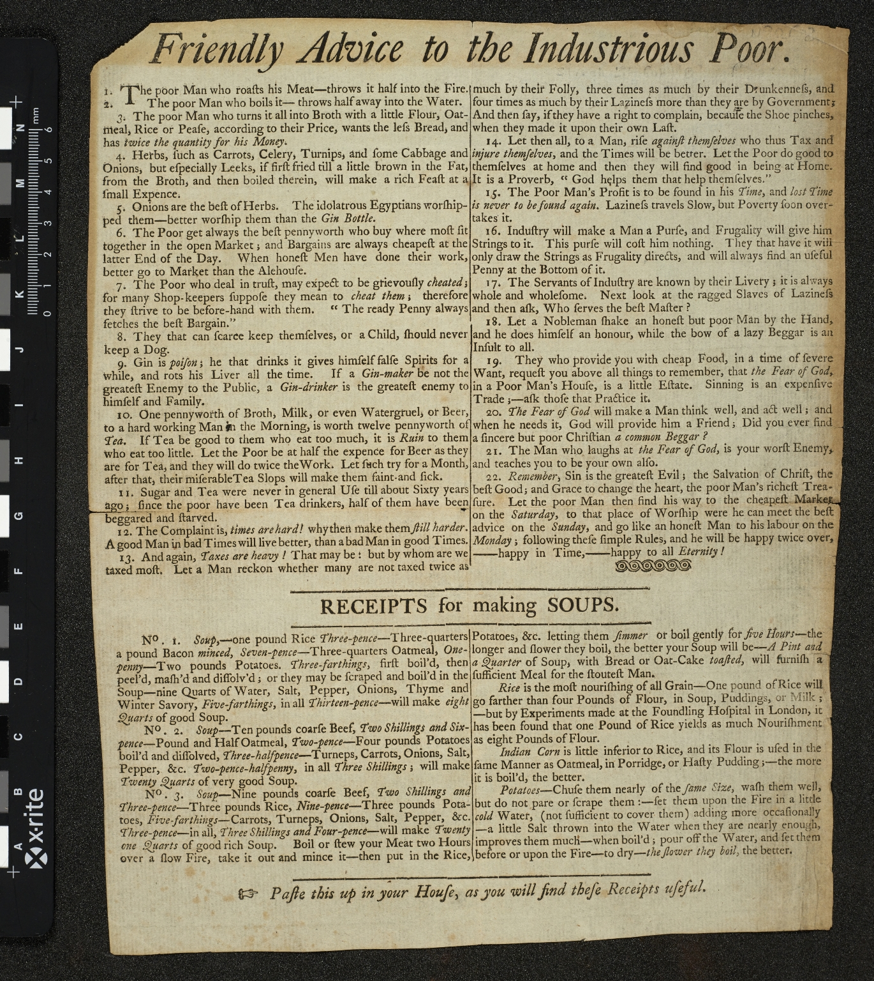
-------------
Image1
-------------
Field Data
Image Number JRL15110593
Reference Number R147001
Link to Catalogue <A href="http://man-fe.hosted.exlibrisgroup.com/MU_VU1:44MAN_ALMA_DS21158216240001631">UOM online catalogue.</a>
Image Title Friendly advice to the industrious poor
Parent Work Title Friendly advice to the industrious poor: Receipts for making soups
Date Created 179-?]
Publication Details England? : s.n.
Description Twenty-two items of advice, followed by three soup recipes, and notes on rice, Indian corn and potatoes. Note at foot of sheet: Paste this up in your house, as you will find these receipts useful.
Keyword Poor; Cooking.
Language Code eng-GB
Language English
Subject Cooking -- Great Britain -- History
Subject Poor -- Great Britain -- History
Category of Material Printed
Medium Ink
Support Paper
Time Period Covered 18th Century CE
Current Repository The University of Manchester Library, U.K.
Rights Holder - Image The University of Manchester Library
Rights holder - Work The University of Manchester Library
Access Rights <a rel="license" href="http://creativecommons.org/licenses/by-nc-sa/4.0/"><img alt="Creative Commons License" style="border-width:0" src="https://i.creativecommons.org/l/by-nc-sa/4.0/88x31.png" /></a><br />This work is licensed under a <a rel="license" href="http://creativecommons.org/licenses/by-nc-sa/4.0/">Creative Commons Attribution-NonCommercial-ShareAlike 4.0 International License.</a> Copyright of The University of Manchester
Date Captured (yyyy-mm-dd) 2015-11-10
Image Creation Technique Digital capture by Heritage Imaging, The University of Manchester Library
Date Image Added (yyyy-mm) 2015-11

Slide 5
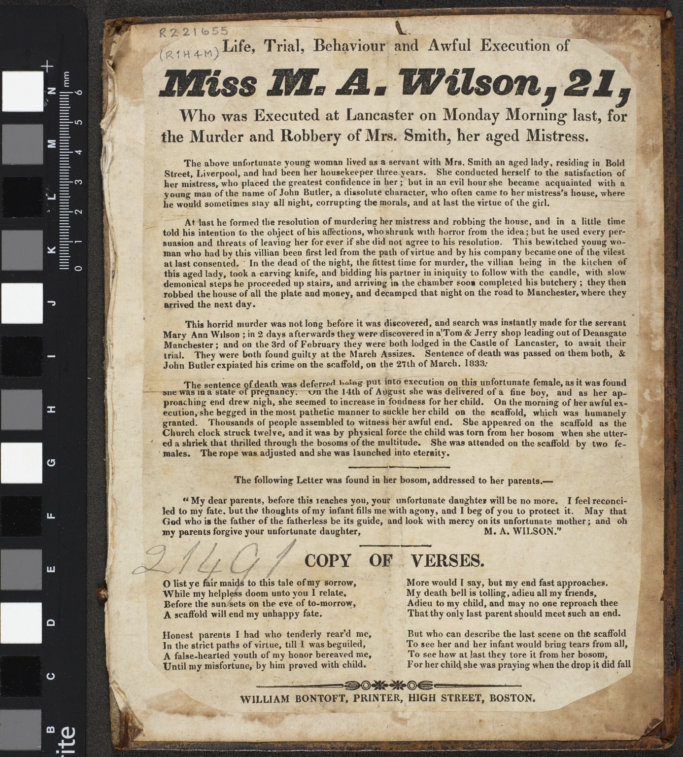
-------------
Image1
-------------
Field Data
Image Number JRL15100529
Reference Number R221655
Link to Catalogue <A href="http://man-fe.hosted.exlibrisgroup.com/MU_VU1:LSCOP_ALMA:44MAN_ALMA_DS21255026230001631">UOM online catalogue.</a>
Image Title Life, Trial, Behaviour and Awful Execution of Miss M.A.Wilson
Parent Work Title Life, trial, behaviour and awful execution of Miss M.A.Wilson, 21, who was executed at Lancaster on Monday morning last, for the murder and robbery of Mrs Smith, her aged mistress.
Creator Bontoft, William, active 1828-1841
Creator Role Printer
Date Created 1833
Publication Details Boston: William Bontoft, High Street.
Description An account of the murder of an elderly lady, Mrs. Smith, living in Bold Street, Liverpool, by John Butler and Smith's servant girl, Mary Ann Wilson, early in 1833. Butler was hanged for the crime on 27th March, 1833, but since Wilson was found to be pregnant, her execution was postponed until after she had given birth in August. Includes the text of Wilson's final letter, addressed to her parents, asking their protection for her new born child. Sheet cropped on all sides; attached to the paste-down of a board detached from an earlier book binding (blind-rolled and tooled panel design on sheepskin[?]).
Keyword Murders; Women Murderers; Liverpool; Execution.
Language Code eng-GB
Language English
Subject Murderers--England--19th century
Subject Women murderers--England--19th century
Subject Public executions--England--19th century
Category of Material Printed
Sub-Category Broadsides
Medium Ink
Support Paper
Time Period Covered 19th Century CE
Places Covered England: Merseyside: Liverpool
Current Repository The University of Manchester Library, U.K.
Rights Holder - Image The University of Manchester Library
Rights holder - Work The University of Manchester Library
Date Captured (yyyy-mm-dd) 2015-10-13
Image Creation Technique Digital capture by Heritage Imaging, The University of Manchester Library
Date Image Added (yyyy-mm) 2015-10

Slide 7
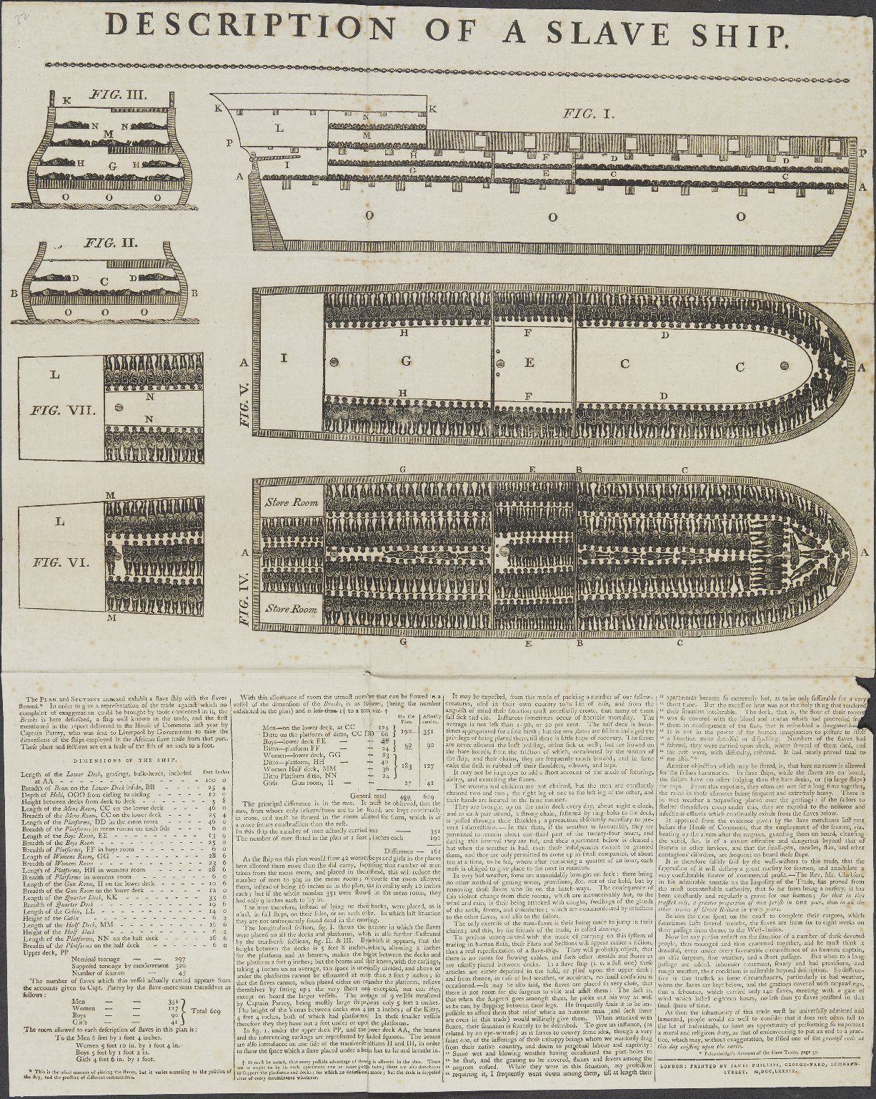
-------------
Image1
-------------
Field Data
Image Number JRL1301003
Reference Number English MS 343/22
Image Title Description of a slave ship
Parent Work Title Miscellaneous Autograph Collection
Creator Phillips, James
Creator Role Printer
Date Created 1789
Publication Details London: Printed by James Phillips, George-Yard, Lombard Street
Description Illustrated: plan and sections of the Brooks slave ship, depicting the ship at full capacity. The text describes the conditions aboard the ship. This image was widely used by abolitionist campaigners.
Language Code eng-GB
Language English
Subject Ships
Subject Slavery
Category of Material Manuscripts
Sub-Category Broadsides
Technique Used Printing (process)
Support Paper
Time Period Covered 18th Century CE
Current Repository The University of Manchester Library, U.K.
Rights Holder - Image The University of Manchester Library
Rights holder - Work The University of Manchester Library
Access Rights <a rel="license" href="http://creativecommons.org/licenses/by-nc-sa/4.0/"><img alt="Creative Commons License" style="border-width:0" src="https://i.creativecommons.org/l/by-nc-sa/4.0/88x31.png" /></a>
Date Captured (yyyy-mm-dd) 2012-11-28
Image Creation Technique Digital capture by Heritage Imaging, The University of Manchester Library
Date Image Added (yyyy-mm) 2013-01
Metadata Language eng-GB

Slide 9
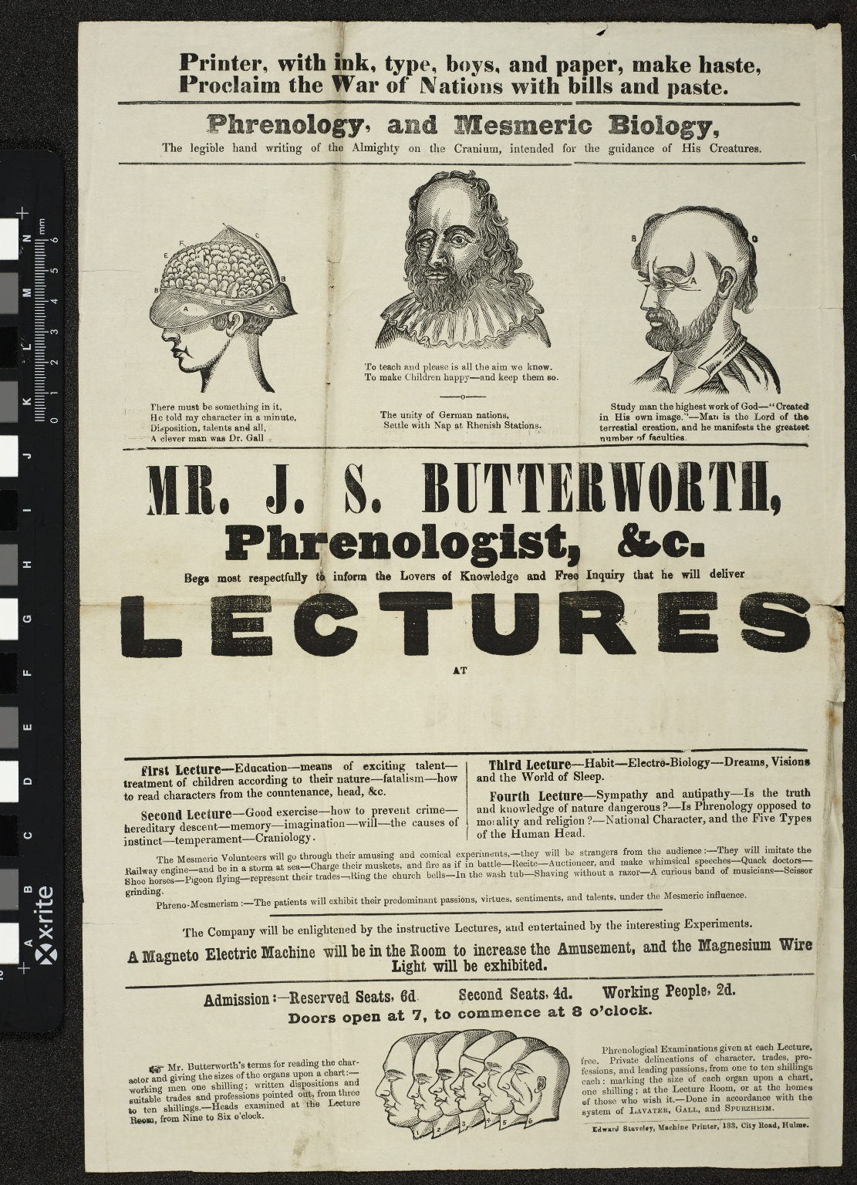
-------------
Image1
-------------
Field Data
Image Number JRL15110597
Reference Number R219339
Link to Catalogue <A href="http://man-fe.hosted.exlibrisgroup.com/MU_VU1:LSCOP_ALMA:44MAN_ALMA_DS21169330200001631">UOM online catalogue.</a>
Image Title Phrenology and mesmeric biology
Parent Work Title Phrenology, and mesmeric biology, the legible hand writing of the Almighty on the cranium, intended for the guidance of his creatures : Mr. J. S. Butterwoth, phrenologist, &c. begs msot respectfully to inform the lovers of knowledge and free inquiry that he will deilver lectures at [blank] First lecture ... Second lecture ... Third lecture ... Fourth lecture ... The company will be enlightened by the instructive lectures, and entertained by the interesting experiments. A magneto electric machine will be in the room to increase the amusement, and the magnesium wire light will be exhibited.
Creator Butterworth, Joseph Edward Staveley
Creator Role Printer
Date Created c1855
Publication Details Hulme : Edward Staveley, machine printer, 133, City Road, Hulme; Great Britain England Hulme.
Description Broadside: At head of sheet: Printer, with ink, type, boys, and paper, make haste, proclaim the War of Nations with bills and paste. Illustrations: four woodcuts of heads. Blank space for location of lectures to be added by hand. Prices for tickets together with details of private examinations are given at the foot of the sheet. The broadside is not dated.
Keyword Phrenology
Language Code eng-GB
Language English
Subject Phrenology
Subject Physiognomy
Category of Material Printed
Sub-Category Broadsides
Medium Ink
Support Paper
Time Period Covered 19th Century CE
Places Covered England: Greater Manchester: Manchester: Hulme
Current Repository The University of Manchester Library, U.K.
Rights Holder - Image The University of Manchester Library
Rights holder - Work The University of Manchester Library
Access Rights <a rel="license" href="http://creativecommons.org/licenses/by-nc-sa/4.0/"><img alt="Creative Commons License" style="border-width:0" src="https://i.creativecommons.org/l/by-nc-sa/4.0/88x31.png" /></a><br />This work is licensed under a <a rel="license" href="http://creativecommons.org/licenses/by-nc-sa/4.0/">Creative Commons Attribution-NonCommercial-ShareAlike 4.0 International License.</a> Copyright of The University of Manchester
Notes Butterworth started out as a factory worker and then worked as a school teacher at Moss Field, Heywood.
Date Captured (yyyy-mm-dd) 2015-11-10
Image Creation Technique Digital capture by Heritage Imaging, The University of Manchester Library
Date Image Added (yyyy-mm) 2015-11

Slide 10
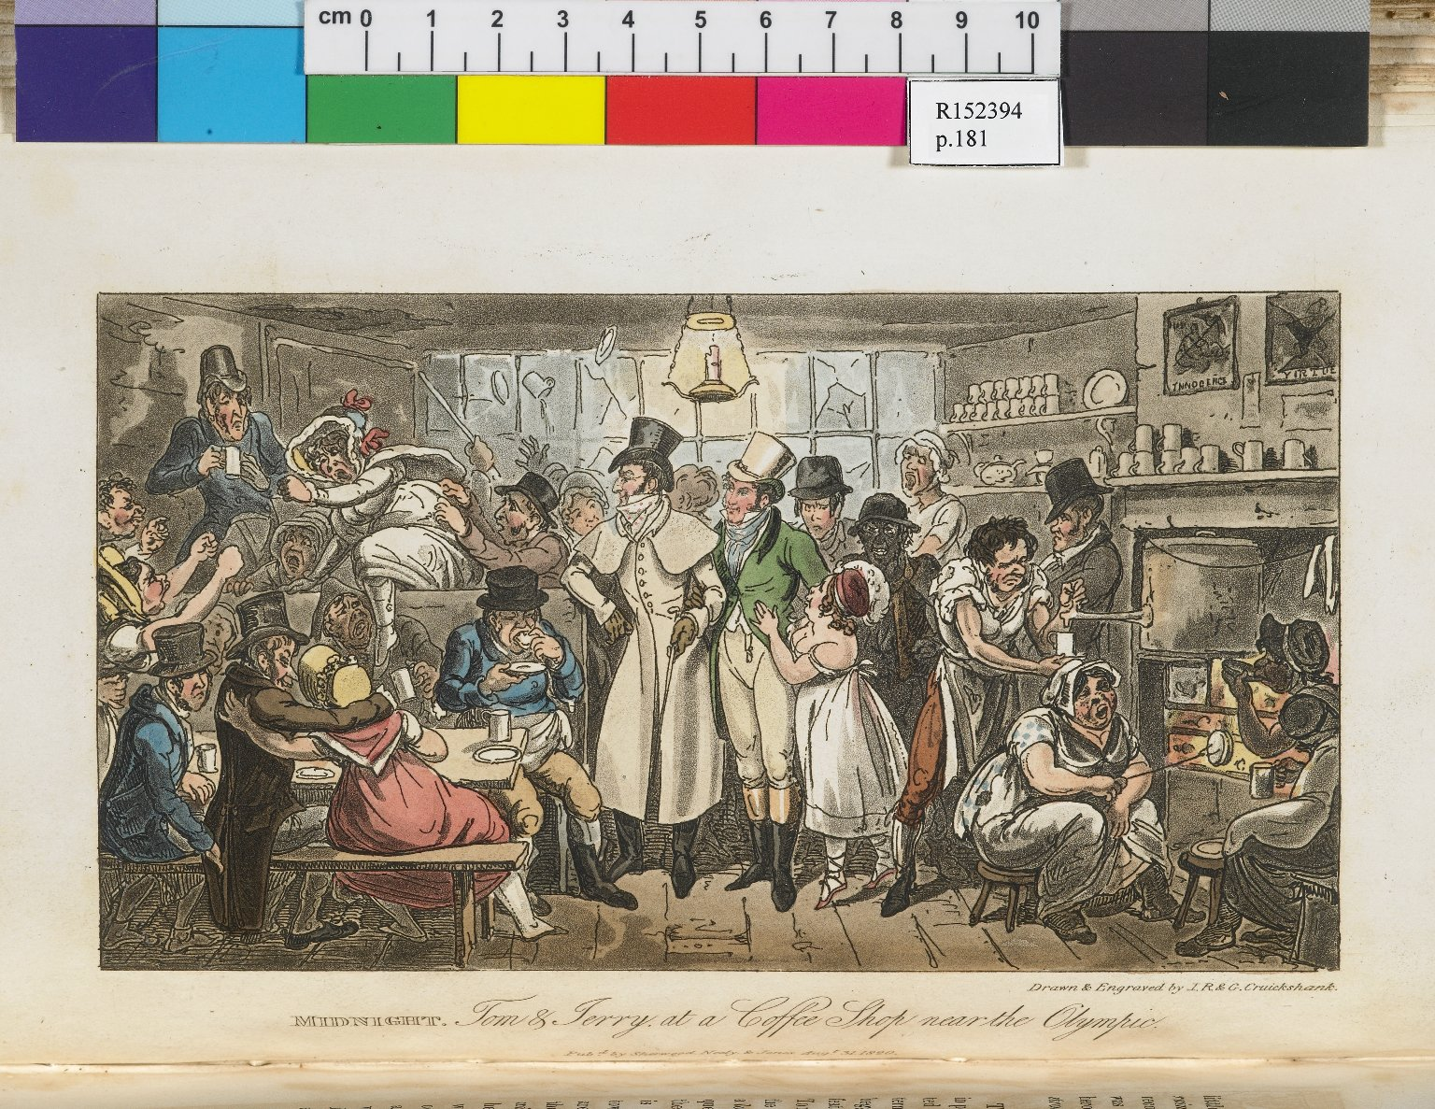
-------------
Image1
-------------
Field Data
Image Number JRL0803311dc
Reference Number R152394
Link to Catalogue <A href=http://man-fe.hosted.exlibrisgroup.com/MU_VU1:BLENDED:44MAN_ALMA_DS21174265940001631>UoM online catalogue.</a>
Image Title Midnight. Tom and Jerry at a coffee shop near the Olympic
Parent Work Title Life in London: or,The day and night scenes of Jerry Hawthorne, esq., and his elegant friend Corinthia Tom, accompanied by Bob Logic, the Oxonian, in their rambles and sprees through the metropolis.
Creator Cruishank, Isaac Robert, 1789-1856
Creator Role Artist
Creator Role Engraver
Creator Cruikshank, George, 1792-1878
Creator Role Artist
Creator Role Engraver
Creator Egan, Pierce, 1772-1849
Creator Role Author
Date Created 1821
Publication Details London : Sherwood, Neely and Jones
Page/Sheet 181
Image Sequence Number 181
Description Colour Illustration: Showing Tom and Jerry at the centre of a riotous scene in a London Coffee shop.
Language Code eng-GB
Subject Great Britain--Social life and customs
Subject Great Britain--Social history
Category of Material Printed
Sub-Category Illustrated works
Technique Used Drawing (image-making)
Technique Used Engraving (printing process)
Support Paper
Time Period Covered 19th Century CE
Item Height 252 mm
Item Width 155 mm
Current Repository The University of Manchester Library, U.K.
Rights Holder - Image The University of Manchester Library
Rights holder - Work The University of Manchester Library
Date Captured (yyyy-mm-dd) 2007-11-23
Image Creation Technique Digital capture by Gten
Date Image Added (yyyy-mm) 2008-03
Metadata Language eng-GB

Slide 11
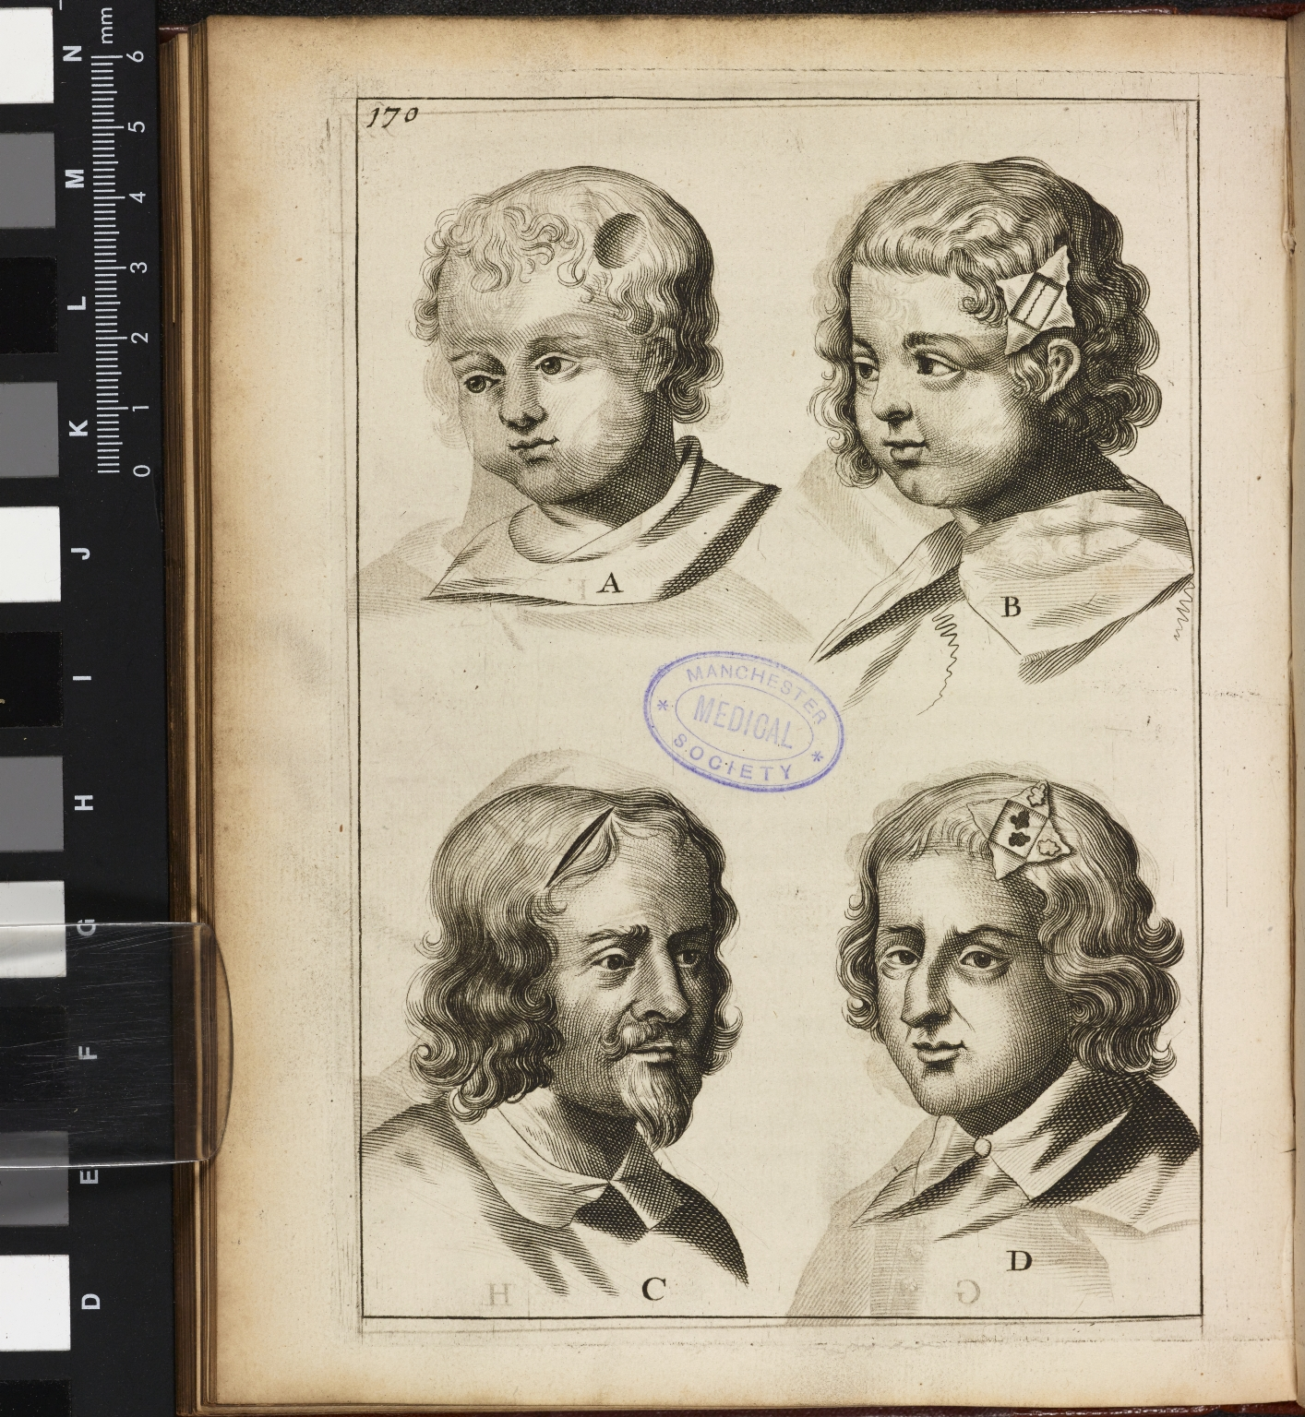
-------------
Image1
-------------
Field Data
Image Number JRL15050837
Reference Number Medical (pre-1701) 377
Image Title Illustration of head wounds
Parent Work Title A compleat discourse of wounds both in general and particular: whereunto are added the severall fractures of the skull, with their variety of figures. As also a treatise of gunshot-wounds in general. Collected and reduced into a new method by John Brown, and approved and allowed by his Majestie’s chief chirurgeons; and may be of singular use to all practitioners in the art of chirurgery.
Creator Browne, John, 1642-approximately 1700
Creator Role Author
Creator Flesher, E. (Elizabeth), active 1670-1678?
Creator Role Printer
Date Created 1678
Publication Details London: printed by E. Flesher, for William Jacob
Page/Sheet 170
Description Plate illustrating various head wounds and fractures of the skull, in an English guide to surgery.
Keyword Medical Illustration; Surgery; Surgical Instruments.
Language Code eng-GB
Language English
Subject Medicine--History
Subject Medicine
Subject Surgery
Category of Material Printed
Sub-Category Illustrated works
Technique Used Engraving (printing process)
Medium Ink
Support Paper
Current Repository The University of Manchester Library, UK
Rights Holder - Image The University of Manchester Library
Rights holder - Work The University of Manchester Library
Access Rights <a rel="license" href="http://creativecommons.org/licenses/by-nc-sa/4.0/"><img alt="Creative Commons License" style="border-width:0" src="https://i.creativecommons.org/l/by-nc-sa/4.0/88x31.png" /></a><br />This work is licensed under a <a rel="license" href="http://creativecommons.org/licenses/by-nc-sa/4.0/">Creative Commons Attribution-NonCommercial-ShareAlike 4.0 International License.</a> Copyright of The University of Manchester
Date Captured (yyyy-mm-dd) 2015-05-28
Image Creation Technique Digital capture by Heritage Imaging, The University of Manchester Library
Date Image Added (yyyy-mm) 2015-09
Metadata Language eng-GB
Educational Notes Early Medical Illustration Project
Academic Project Lead Hannah Priest
Academic Project Lead Cordelia Warr

Slide 12
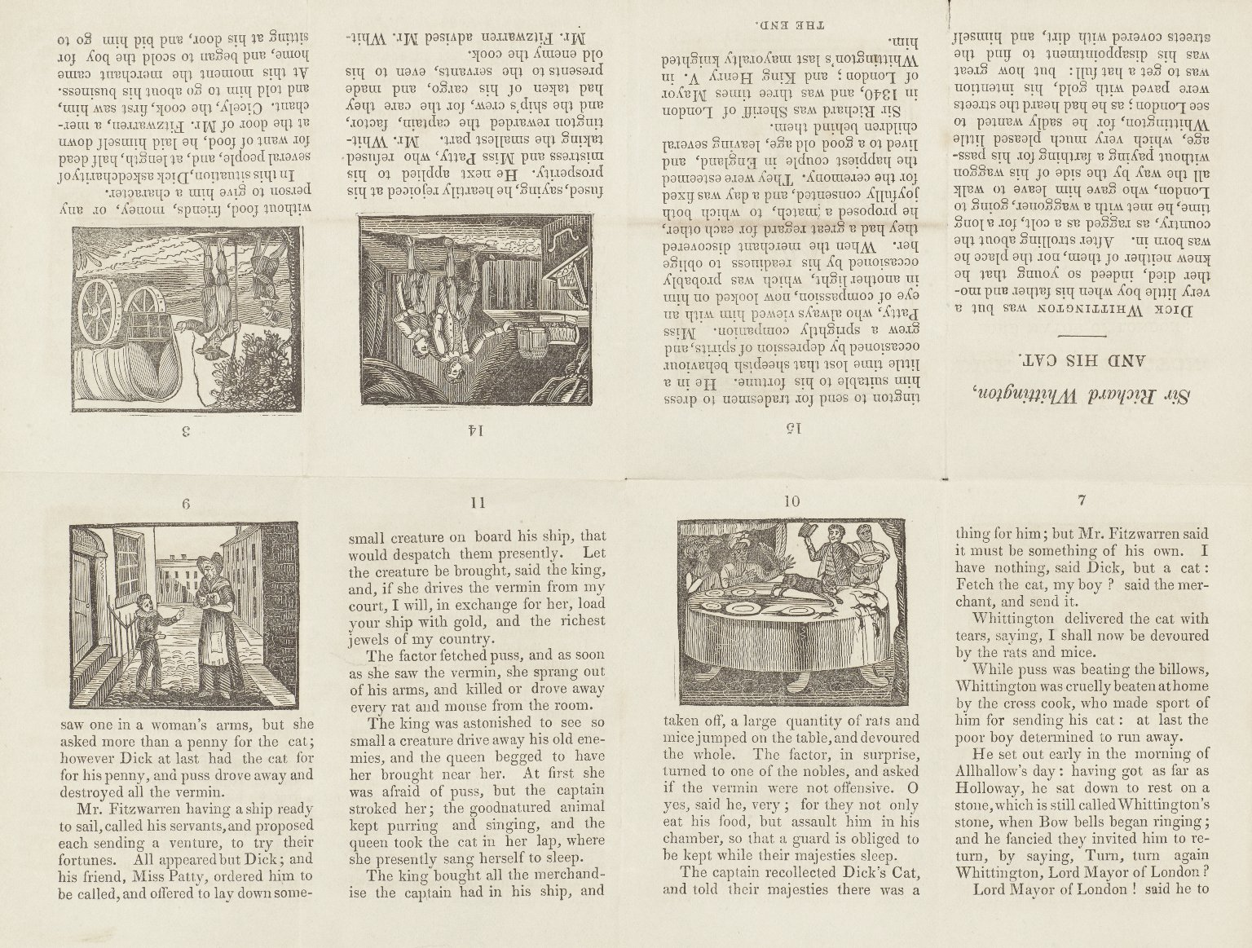
-------------
Image1
-------------
Field Data
Image Number JRL1001771dc
Reference Number R133767.4
Link to Catalogue <A href=http://man-fe.hosted.exlibrisgroup.com/MU_VU1:BLENDED:44MAN_ALMA_DS71182146260001631>UoM online catalogue.</a>
Image Title Unfolded chapbook
Parent Work Title The history of Dick Whittington, Lord Mayor of London; with the adventures of his cat
Creator Rusher, John Golby, 1784-1877
Creator Role Printer
Date Created c1840
Publication Details Banbury : J. G. Rusher
Image Sequence Number 004-002
Language Code eng-GB
Subject Children's literature
Subject Folklore
Subject Nursery rhymes
Category of Material Printed
Sub-Category Chapbooks
Technique Used Woodcut (process)
Medium Ink
Support Paper
Places Covered England
Item Height 96 mm
Item Width 65 mm
Current Repository The University of Manchester Library, U.K.
Rights Holder - Image The University of Manchester Library
Rights holder - Work The University of Manchester Library
Date Captured (yyyy-mm-dd) 2009-10-21
Image Creation Technique Digital capture by Heritage Imaging, The University of Manchester Library
Date Image Added (yyyy-mm) 2011-04
Metadata Language eng-GB

Slide 13
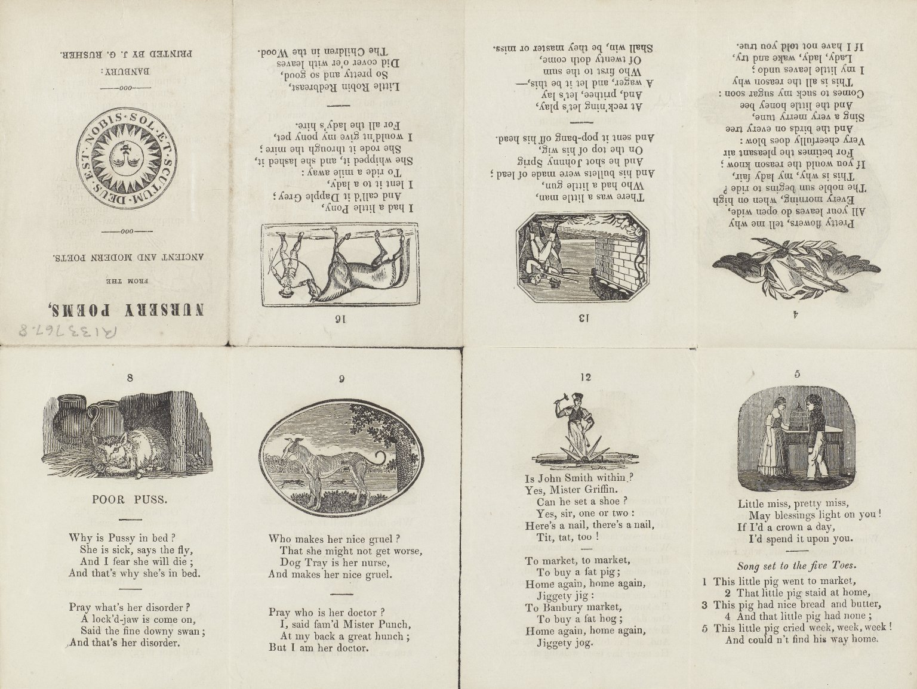
-------------
Image1
-------------
Field Data
Image Number JRL1001772dc
Reference Number R133767
Link to Catalogue <A href=http://man-fe.hosted.exlibrisgroup.com/MU_VU1:BLENDED:44MAN_ALMA_DS71182146260001631>UoM online catalogue.</a>
Image Title Nursery poems from the ancient and modern poets
Series Title Banbury chapbooks for children
Creator Rusher, John Golby, 1784-1877
Creator Role Printer
Date Created 1814
Publication Details Banbury : J. G. Rusher
Volume 8: Nursery poems from the ancient and modern poets
Image Sequence Number 008-001
Description Illustrated: woodcuts. Children's folk stories & nursery rhymes.
Language Code eng-GB
Subject Children's literature
Subject Folklore
Subject Nursery rhymes
Category of Material Printed
Technique Used Woodcut (process)
Support Paper
Item Height 96 mm
Item Width 65 mm
Current Repository The University of Manchester Library, U.K.
Rights Holder - Image The University of Manchester Library
Rights holder - Work The University of Manchester Library
Date Captured (yyyy-mm-dd) 2009-10-21
Image Creation Technique Digital capture by Heritage Imaging, The University of Manchester Library
Date Image Added (yyyy-mm) 2011-04
Metadata Language eng-GB

Slide 14
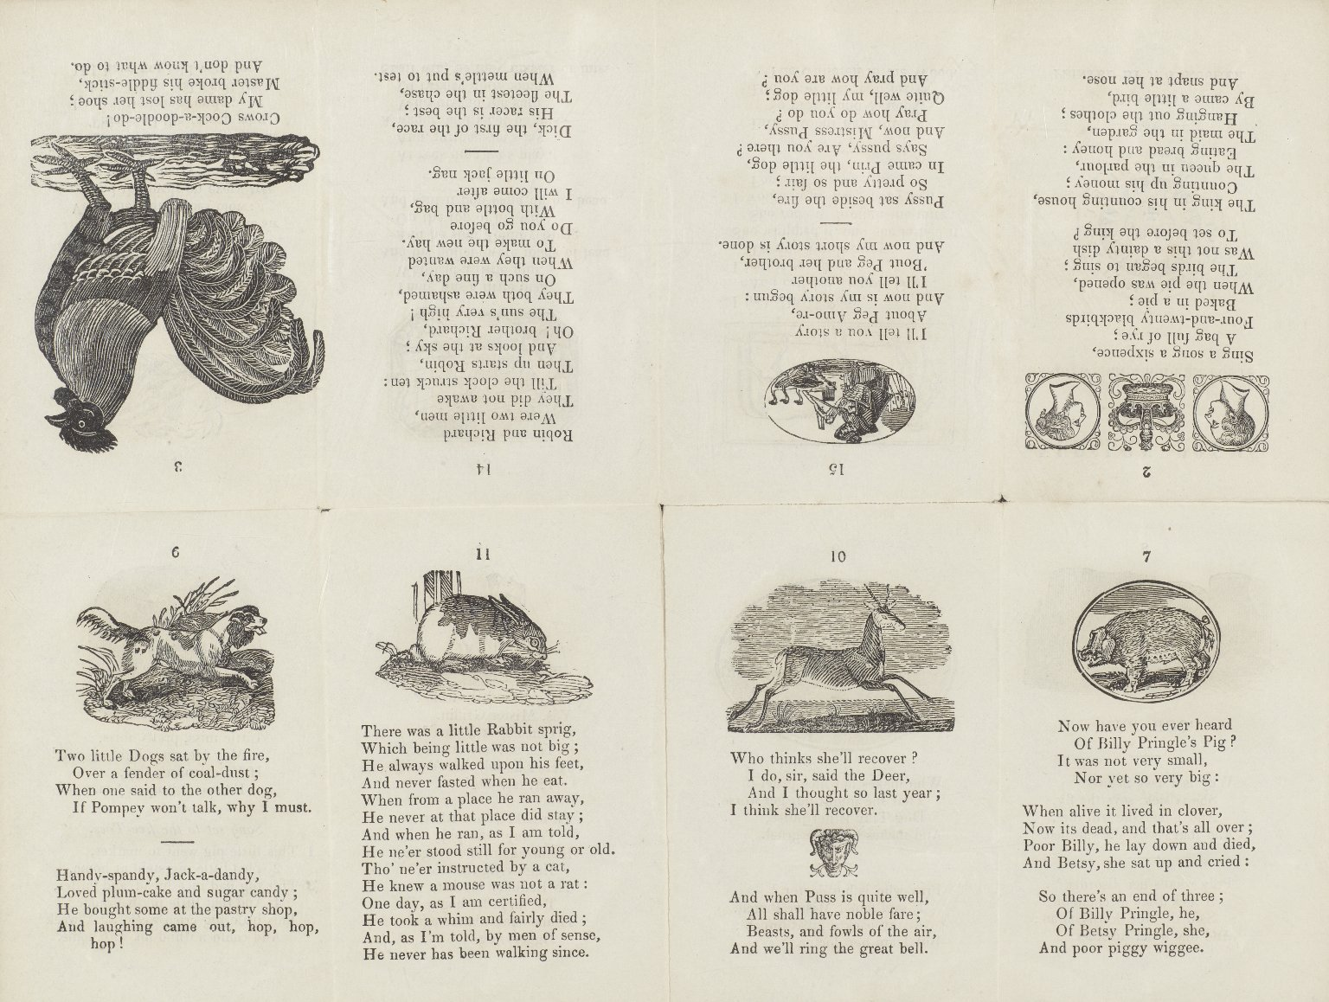
-------------
Image1
-------------
Field Data
Image Number JRL1001773dc
Reference Number R133767
Link to Catalogue <A href=http://man-fe.hosted.exlibrisgroup.com/MU_VU1:BLENDED:44MAN_ALMA_DS71182146260001631>UoM online catalogue.</a>
Image Title Nursery poems from the ancient and modern poets
Series Title Banbury chapbooks for children
Creator Rusher, John Golby, 1784-1877
Creator Role Printer
Date Created 1814
Publication Details Banbury : J. G. Rusher
Volume 8: Nursery poems from the ancient and modern poets
Image Sequence Number 008-002
Description Illustrated: woodcuts. Children's folk stories & nursery rhymes.
Language Code eng-GB
Subject Children's literature
Subject Folklore
Subject Nursery rhymes
Category of Material Printed
Technique Used Woodcut (process)
Support Paper
Item Height 96 mm
Item Width 65 mm
Current Repository The University of Manchester Library, U.K.
Rights Holder - Image The University of Manchester Library
Rights holder - Work The University of Manchester Library
Date Captured (yyyy-mm-dd) 2009-10-21
Image Creation Technique Digital capture by Heritage Imaging, The University of Manchester Library
Date Image Added (yyyy-mm) 2011-04
Metadata Language eng-GB

Slide 15
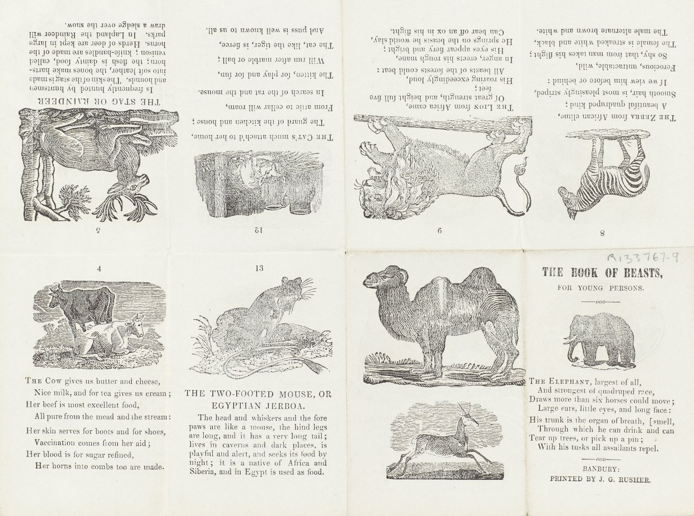
-------------
Image1
-------------
Field Data
Image Number JRL1001774dc
Reference Number R133767.5
Link to Catalogue <A href=https://www.librarysearch.manchester.ac.uk/primo-explore/fulldisplay?docid=44MAN_ALMA_DS21293650070001631&context=L&vid=MU_VU1&search_scope=BLENDED&tab=local&lang=en_US>UoM online catalogue.</a>
Parent Work Title The book of beasts, for young persons
Creator Rusher, John Golby, 1784-1877
Creator Role Printer
Date Created c1840
Publication Details Banbury : J. G. Rusher
Page/Sheet 1
Image Sequence Number 001-001
Description Illustrated: woodcuts. Children's folk stories & nursery rhymes.
Language Code eng-GB
Language English
Subject Children's literature
Subject Folklore
Subject Nursery rhymes
Category of Material Printed
Sub-Category Chapbooks
Technique Used Woodcut (process)
Medium Ink
Support Paper
Item Height 96 mm
Item Width 65 mm
Current Repository The University of Manchester Library, U.K.
Rights Holder - Image The University of Manchester Library
Rights holder - Work The University of Manchester Library
Date Captured (yyyy-mm-dd) 2009-10-21
Image Creation Technique Digital capture by Heritage Imaging, The University of Manchester Library
Date Image Added (yyyy-mm) 2011-04
Metadata Language eng-GB

Slide 16
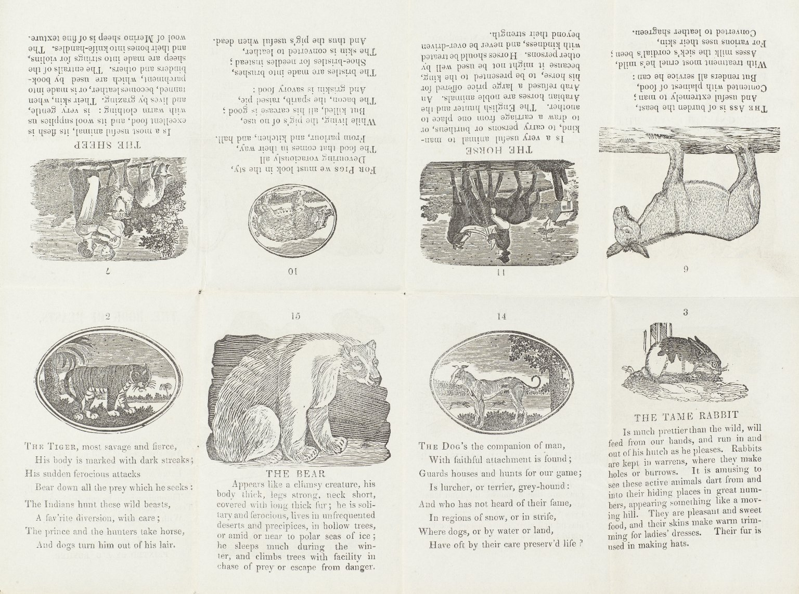
-------------
Image1
-------------
Field Data
Image Number JRL1001775dc
Reference Number R133767.5
Link to Catalogue <A href=https://www.librarysearch.manchester.ac.uk/primo-explore/fulldisplay?docid=44MAN_ALMA_DS21293650070001631&context=L&vid=MU_VU1&search_scope=BLENDED&tab=local&lang=en_US>UoM online catalogue</a>
Image Title Unfolded chapbook
Parent Work Title The book of beasts, for young persons
Creator Rusher, John Golby, 1784-1877
Creator Role Printer
Date Created c1840
Publication Details Banbury : J. G. Rusher
Image Sequence Number 001-002
Language Code eng-GB
Language English
Subject Children's literature
Subject Folklore
Subject Nursery rhymes
Category of Material Printed
Sub-Category Chapbooks
Technique Used Woodcut (process)
Medium Ink
Support Paper
Item Height 96 mm
Item Width 65 mm
Current Repository The University of Manchester Library, U.K.
Rights Holder - Image The University of Manchester Library
Rights holder - Work The University of Manchester Library
Date Captured (yyyy-mm-dd) 2009-10-21
Image Creation Technique Digital capture by Heritage Imaging, The University of Manchester Library
Date Image Added (yyyy-mm) 2011-04
Metadata Language eng-GB

Slide 17
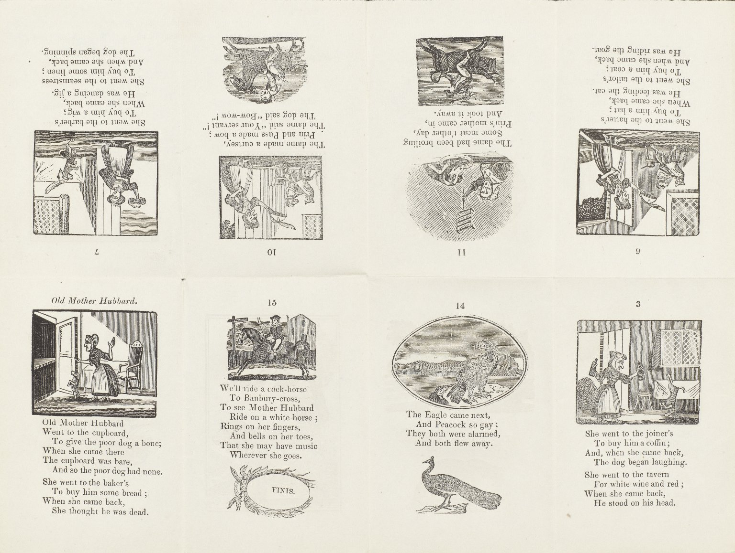
-------------
Image1
-------------
Field Data
Image Number JRL1001777dc
Reference Number R133767.10
Link to Catalogue <A href=https://www.librarysearch.manchester.ac.uk/primo-explore/fulldisplay?docid=44MAN_ALMA_DS21293650160001631&context=L&vid=MU_VU1&search_scope=BLENDED&tab=local&lang=en_US>UoM online catalogue</a>
Image Title Unfolded chapbook
Parent Work Title Old Mother Hubbard and her dog
Creator Rusher, John Golby, 1784-1877
Creator Role Printer
Date Created 1840
Publication Details Banbury: J. G. Rusher
Image Sequence Number 010-002
Description Illustrated: woodcuts. Children's folk stories & nursery rhymes.
Language Code eng-GB
Language English
Subject Children's literature
Subject Folklore
Subject Nursery rhymes
Category of Material Printed
Sub-Category Chapbooks
Technique Used Engraving (printing process)
Medium Ink
Support Paper
Item Height 96 mm
Item Width 65 mm
Current Repository The University of Manchester Library, U.K.
Rights Holder - Image The University of Manchester Library
Rights holder - Work The University of Manchester Library
Date Captured (yyyy-mm-dd) 2009-10-21
Image Creation Technique Digital capture by Heritage Imaging, The University of Manchester Library
Date Image Added (yyyy-mm) 2011-04
Metadata Language eng-GB

Slide 18
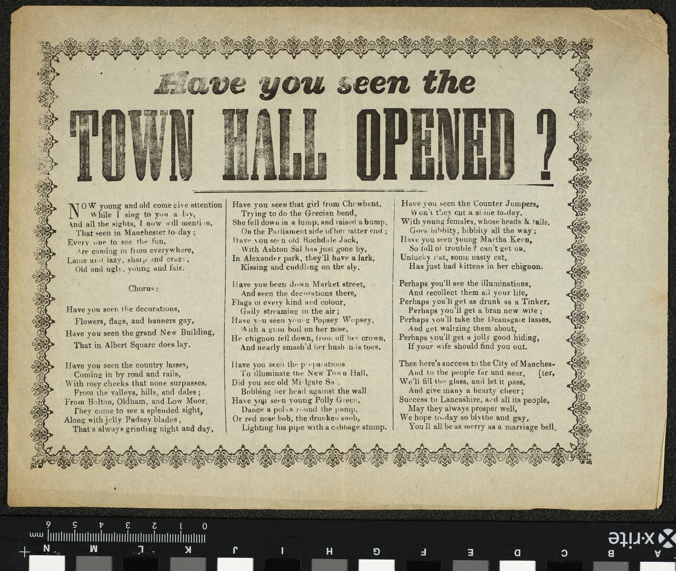
-------------
Image1
-------------
Field Data
Image Number JRL15110599
Reference Number R224508
Link to Catalogue <A href="http://man-fe.hosted.exlibrisgroup.com/MU_VU1:LSCOP_ALMA:44MAN_ALMA_DS21252169840001631">UOM online catalogue.</a>
Image Title Manchester Town Hall
Parent Work Title Have you seen the town hall opened?
Date Created 1877?]
Publication Details S.l.: s.n.
Description A song sheet (no music), on the opening of the new town hall in Albert Square, Manchester. Undated; the formal opening ceremony took place on 13 September 1877. Text in three columns, within a decorative border.
Keyword Manchester; Civic Buildings; Songs; Ballads.
Language Code eng-GB
Language English
Subject Manchester Town Hall (Manchester, England)
Subject Brigands and robbers -- England -- Manchester -- 19th century
Subject City halls -- England
Category of Material Printed
Sub-Category Broadsides
Medium Ink
Support Paper
Time Period Covered 19th Century CE
Places Covered England: Greater Manchester: Manchester
Current Repository The University of Manchester Library, U.K.
Rights Holder - Image The University of Manchester Library
Rights holder - Work The University of Manchester Library
Access Rights <a rel="license" href="http://creativecommons.org/licenses/by-nc-sa/4.0/"><img alt="Creative Commons License" style="border-width:0" src="https://i.creativecommons.org/l/by-nc-sa/4.0/88x31.png" /></a><br />This work is licensed under a <a rel="license" href="http://creativecommons.org/licenses/by-nc-sa/4.0/">Creative Commons Attribution-NonCommercial-ShareAlike 4.0 International License.</a> Copyright of The University of Manchester
Date Captured (yyyy-mm-dd) 2015-11-10
Image Creation Technique Digital capture by Heritage Imaging, The University of Manchester Library
Date Image Added (yyyy-mm) 2015-11

