Slide 2
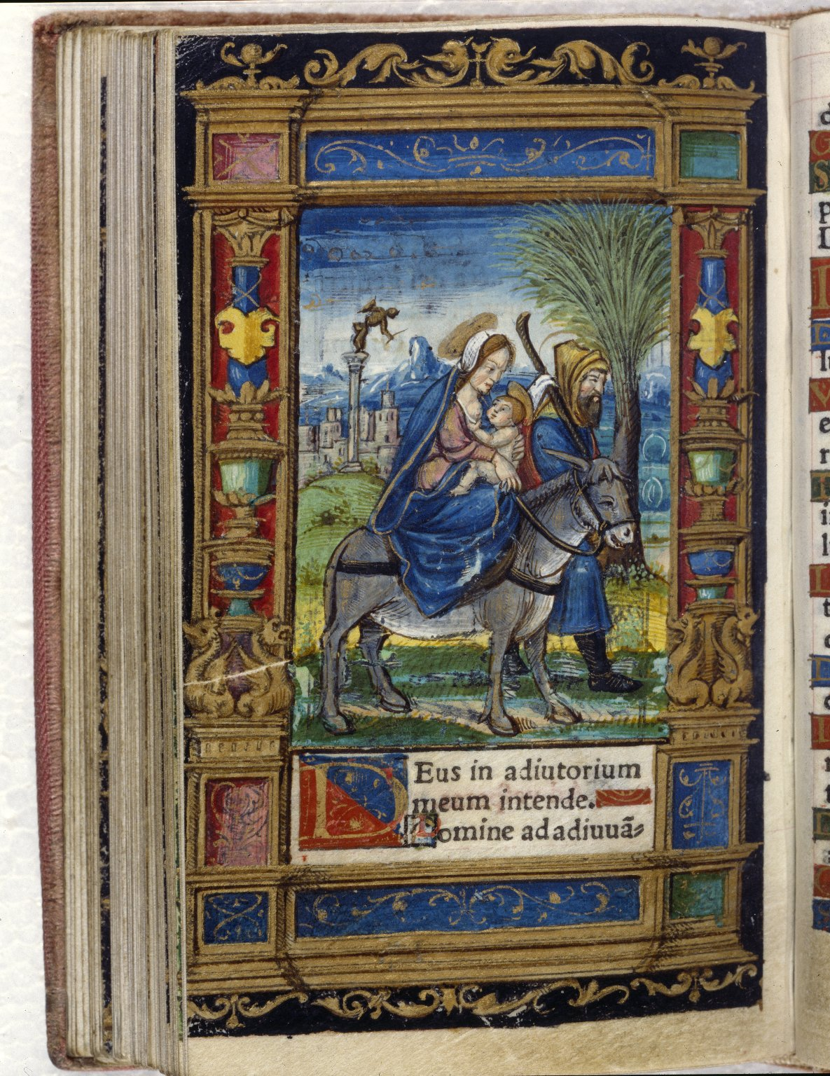
-------------
Image1
-------------
Field Data
Image Number JRL020356tr
Reference Number Aldine R14744
Link to Catalogue <A href=https://man-fe.hosted.exlibrisgroup.com/primo-explore/fulldisplay?docid=44MAN_ALMA_DS21136963760001631&context=L&vid=MU_VU1&search_scope=BLENDED&tab=local&lang=en_US>UoM online catalogue</a>
Image Title Joseph leads the ass
Parent Work Title Horae in lavdem beatissimae virginis Mariae ad vsum Romanum
Translated Parent Work Title Book of Hours
Creator Catholic Church
Creator Role Author
Date Created 1529
Publication Details Venice: Aldus Manutius
Page/Sheet Opposite page 67
Image Sequence Number 067
Description Illustrated: Joseph leads the ass, which carries Mary and the Infant Jesus out of Bethlehem. Full-page illustration, coloured by hand.
Language Code lat
Language Latin
Subject Books of hours
Subject Catholic Church
Subject Religion
Subject Christianity
Category of Material Printed
Support Vellum
Current Repository The University of Manchester Library, U.K.
Rights Holder - Image The University of Manchester Library
Rights holder - Work The University of Manchester Library
Image Creation Technique Scanned from colour transparency by Gten, July 2004
Metadata Language eng-GB

Slide 3
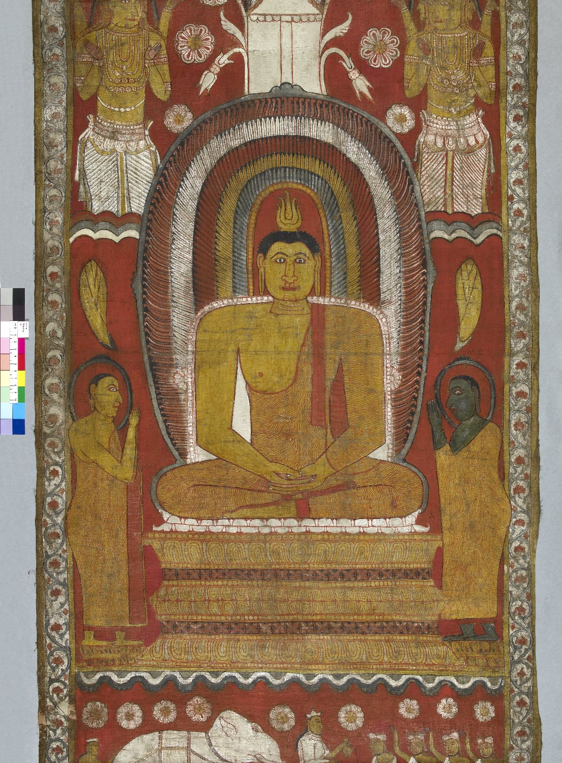
-------------
Image1
-------------
Field Data
Image Number JRL0804456dc
Reference Number Indian Drawings 10
Image Title Buddha
Date Created 18th century
Description Painting of Buddha on canvas. The two monks beside the Buddha are Sāriputta, who is supreme in wisdom, also known as 'the General of the Dhamma' (the Buddha's teaching), and Moggallāna (or Maha-Moggallāna, 'Moggallāna the Great'), supreme in meditation and psychic powers. They are the two much-loved chief Arahats (saints) in the Buddhist tradition, and feature in the Dhammapada. Moggallāna is dark in colour because of his somewhat chequered past in his previous lives. The deity above Moggallāna is Brahmā. Below is a ceremonial presentation of a white elephant.
Subject Buddhism
Subject Religion
Category of Material Manuscripts
Sub-Category Rolls
Technique Used Painting (image-making)
Support Canvas
Creation Site Sri Lanka
People Covered Buddha
People Covered Sāriputta
People Covered Moggallāna
Current Repository The University of Manchester Library, U.K.
Rights Holder - Image The University of Manchester Library
Rights holder - Work The University of Manchester Library
Notes Information about the painting kindly provided by Dr Valerie Roebuck.
Date Captured (yyyy-mm-dd) 2008-02-29
Image Creation Technique Digital capture by Gten
Date Image Added (yyyy-mm) 2008-07
Metadata Language eng-GB

Slide 4
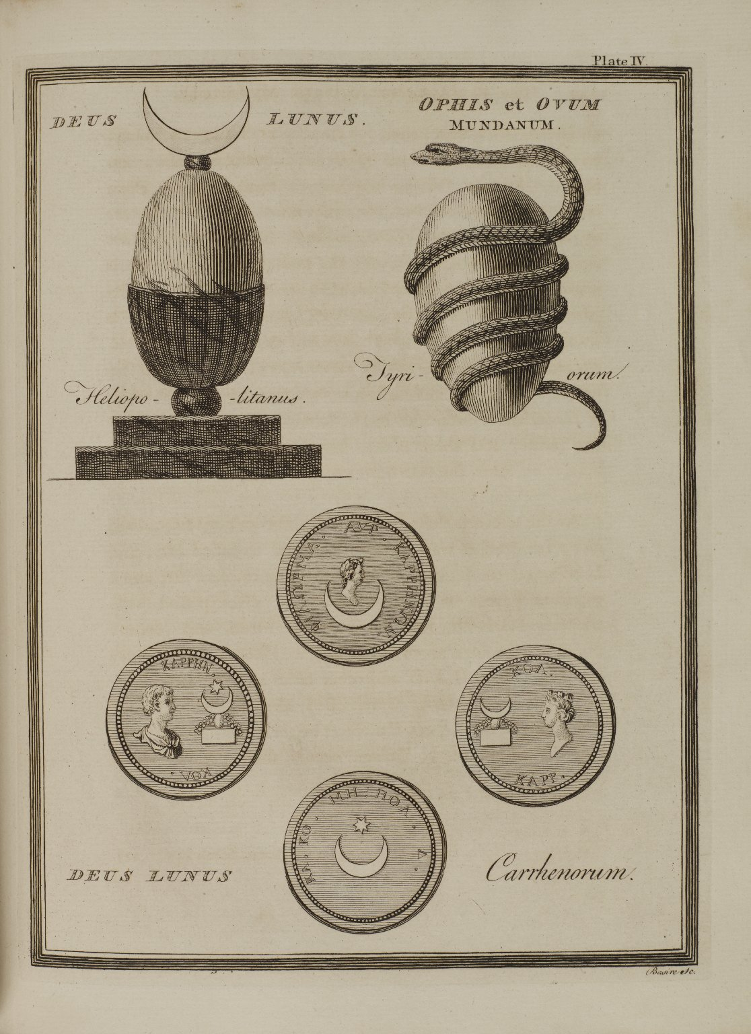
-------------
Image1
-------------
Field Data
Image Number JRL1310905
Reference Number Spencer 4202
Link to Catalogue <A href=http://man-fe.hosted.exlibrisgroup.com/MU_VU1:BLENDED:44MAN_ALMA_DS21187738860001631>UoM online catalogue.</a>
Image Title Deus Lunus
Alternative Image Title Plate 4
Parent Work Title A new system: or, an analysis of ancient mythology: wherein an attempt is made to divest tradition of fable; and to reduce the truth to its original purity
Creator Basire, James, 1730-1802
Creator Role Engraver
Creator Bryant, Jacob, 1715-1804
Creator Role Author
Date Created 1774
Publication Details London: printed for T. Payne; P. Elmsly; B. White; and J. Walter
Volume 2
Page/Sheet Opposite page 242
Description In the Phoenician, Egyptian, Hindu, and Japanese systems, it is represented that the world was hatched from an egg ('The mundane egg'). In some mythologies a bird is represented as laying the mundane egg on the primordial waters. In these six monochrome illustrations the mundane egg is guarded by the moon which rests on top. In the second image it is held and guarded by a snake. Below are four coins featuring the egg, crescent moons, the stars and busts of various men and women. The phrase 'Deus Lunus' is also printed. Below the frame in the bottom right corner is written 'Basire Sc.'.
Subject Mythology
Category of Material Printed
Medium Ink
Support Paper
Item Height 280 mm
Item Width 205 mm
Current Repository The University of Manchester Library, U.K.
Provenance Spencer, George John Spencer, Earl, 1758-1834, former owner
Rights Holder - Image The University of Manchester Library
Rights holder - Work The University of Manchester Library
Access Rights <a rel="license" href="http://creativecommons.org/licenses/by-nc-sa/4.0/"><img alt="Creative Commons License" style="border-width:0" src="https://i.creativecommons.org/l/by-nc-sa/4.0/88x31.png" /></a>
Date Captured (yyyy-mm-dd) 2013-05-20
Image Creation Technique Digital capture by Heritage Imaging, The University of Manchester Library
Date Image Added (yyyy-mm) 2013-06
Metadata Language eng-GB

Slide 5
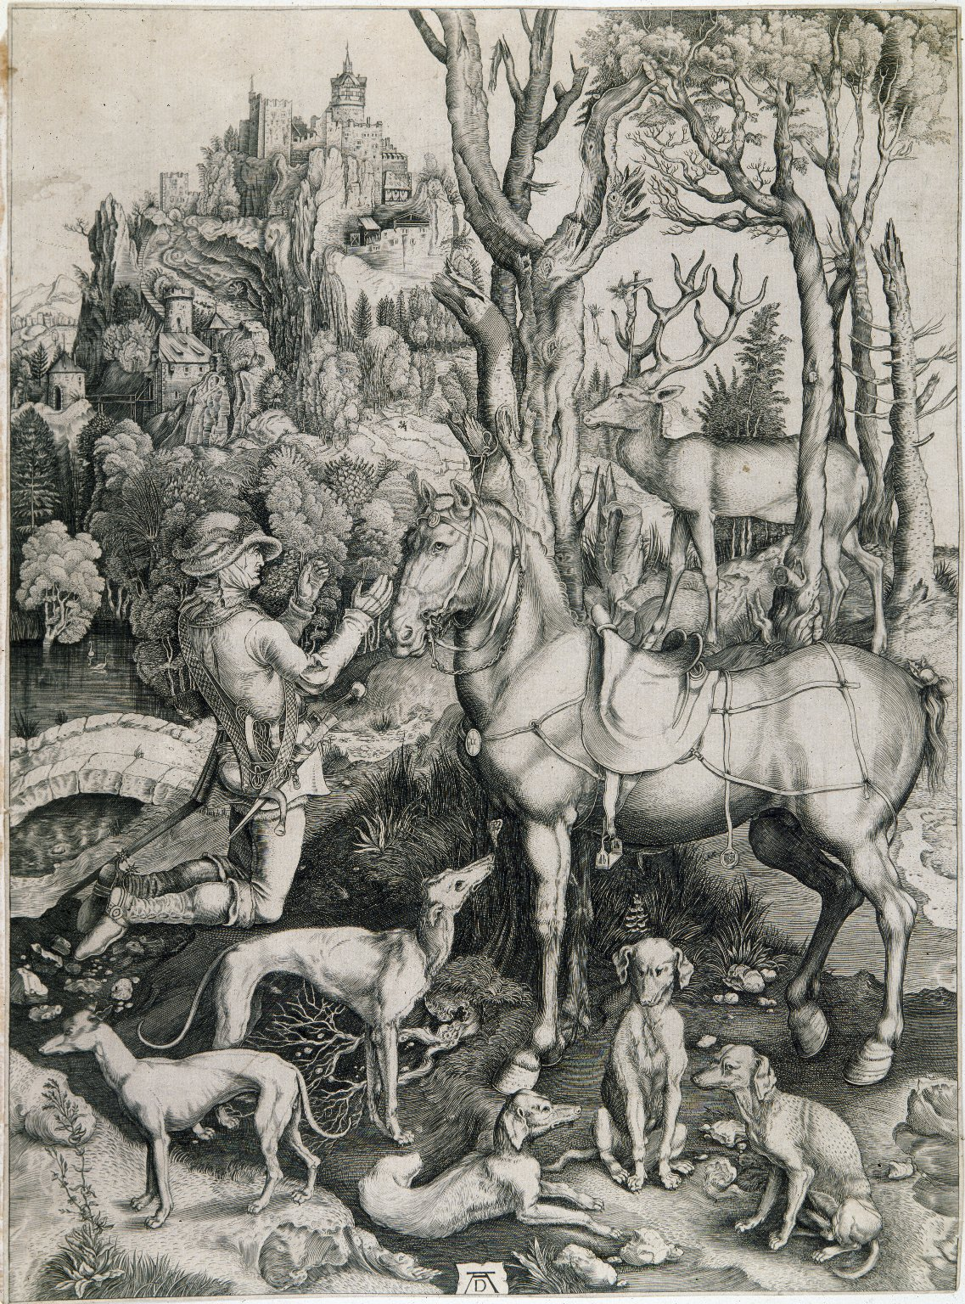
-------------
Image1
-------------
Field Data
Image Number JRL023039tr
Reference Number Holtorp Collection: German Engravings
Image Title St Eustace
Alternative Image Title Vision of St Hubert
Creator Dürer, Albrecht, 1471-1528
Creator Role Artist
Date Created c1501
Description Illustrated: engraving of St Eustace featuring greyhounds & hunting hounds, a horse and a stag with Christ on the cross rising from between his antlers. This print is also erroneously known as St Hubert. The Hiero von Holtorp Collection was purchased at Sotheby's on 29 March 1906.
Subject Christianity
Category of Material Printed
Technique Used Engraving (printing process)
Current Repository The University of Manchester Library, U.K.
Provenance Holtorp Collection
Rights Holder - Image The University of Manchester Library
Rights holder - Work The University of Manchester Library
Image Creation Technique Scanned from colour transparency by Gten, September 2005
Metadata Language eng-GB

Slide 6
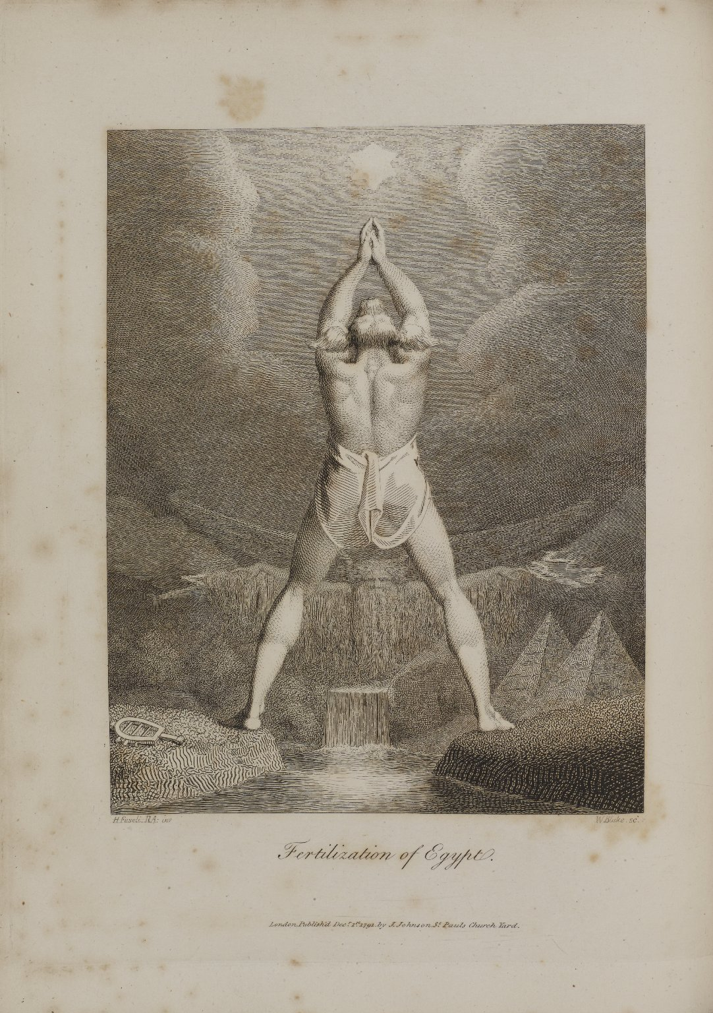
-------------
Image1
-------------
Field Data
Image Number JRL1310908
Reference Number Spencer 7969.1
Link to Catalogue <A href=http://man-fe.hosted.exlibrisgroup.com/MU_VU1:BLENDED:44MAN_ALMA_DS21157794940001631>UoM online catalogue</a>
Image Title Fertilization of Egypt
Parent Work Title The botanic garden: a poem, in two parts
Creator Darwin, Erasmus, 1731-1802
Creator Role Author
Creator Blake, William, 1757-1827
Creator Role Engraver
Creator Fuseli, Henry, 1741-1825
Creator Role Artist
Date Created 1791
Publication Details London: J. Johnson
Page/Sheet 127
Description Monochrome shaded line drawing from 'The Economy of Vegetation' in Darwin's 'Botanic Garden', The figure in the centre is the jackal-headed god Anubis, praying to the dog-star Sirius for rain. In his notes to the poem, Darwin explains that in Egyptian mythology, because the annual 'monsoon' of the Nile coincided with rise of the dog-Star, it was associated with the dog-god Anubis. In the background, above the river, is the figure of Jupitus Pluvius, the rain-giver. He is shown as a bearded old man with his arms outstretched. On the ground near Anubis' left foot is a sistrum, a musical instrument, included from Fuseli's drawing: Anubis has cast aside art to worship the rain-giver. Bottom left says: 'H. Fuseli RA: inv, bottom right says: 'W Blake, SC.' At the foot of the image is printed: 'London, Publish'd Dec.r 1st 1791. by J. Johnson, St Pauls Church .'.
Language Code eng-GB
Language English
Subject Mythology
Category of Material Printed
Sub-Category Bookplates
Medium Ink
Support Paper
Places Covered Egypt
Item Height 290 mm
Item Width 222 mm
Current Repository The University of Manchester Library, U.K.
Provenance Spencer, George John Spencer, Earl, 1758-1834, former owner
Rights Holder - Image The University of Manchester Library
Rights holder - Work The University of Manchester Library
Access Rights <a rel="license" href="http://creativecommons.org/licenses/by-nc-sa/4.0/"><img alt="Creative Commons License" style="border-width:0" src="https://i.creativecommons.org/l/by-nc-sa/4.0/88x31.png" /></a>
Date Captured (yyyy-mm-dd) 2013-05-20
Image Creation Technique Digital capture by Heritage Imaging, The University of Manchester Library
Date Image Added (yyyy-mm) 2013-06
Metadata Language eng-GB

Slide 7
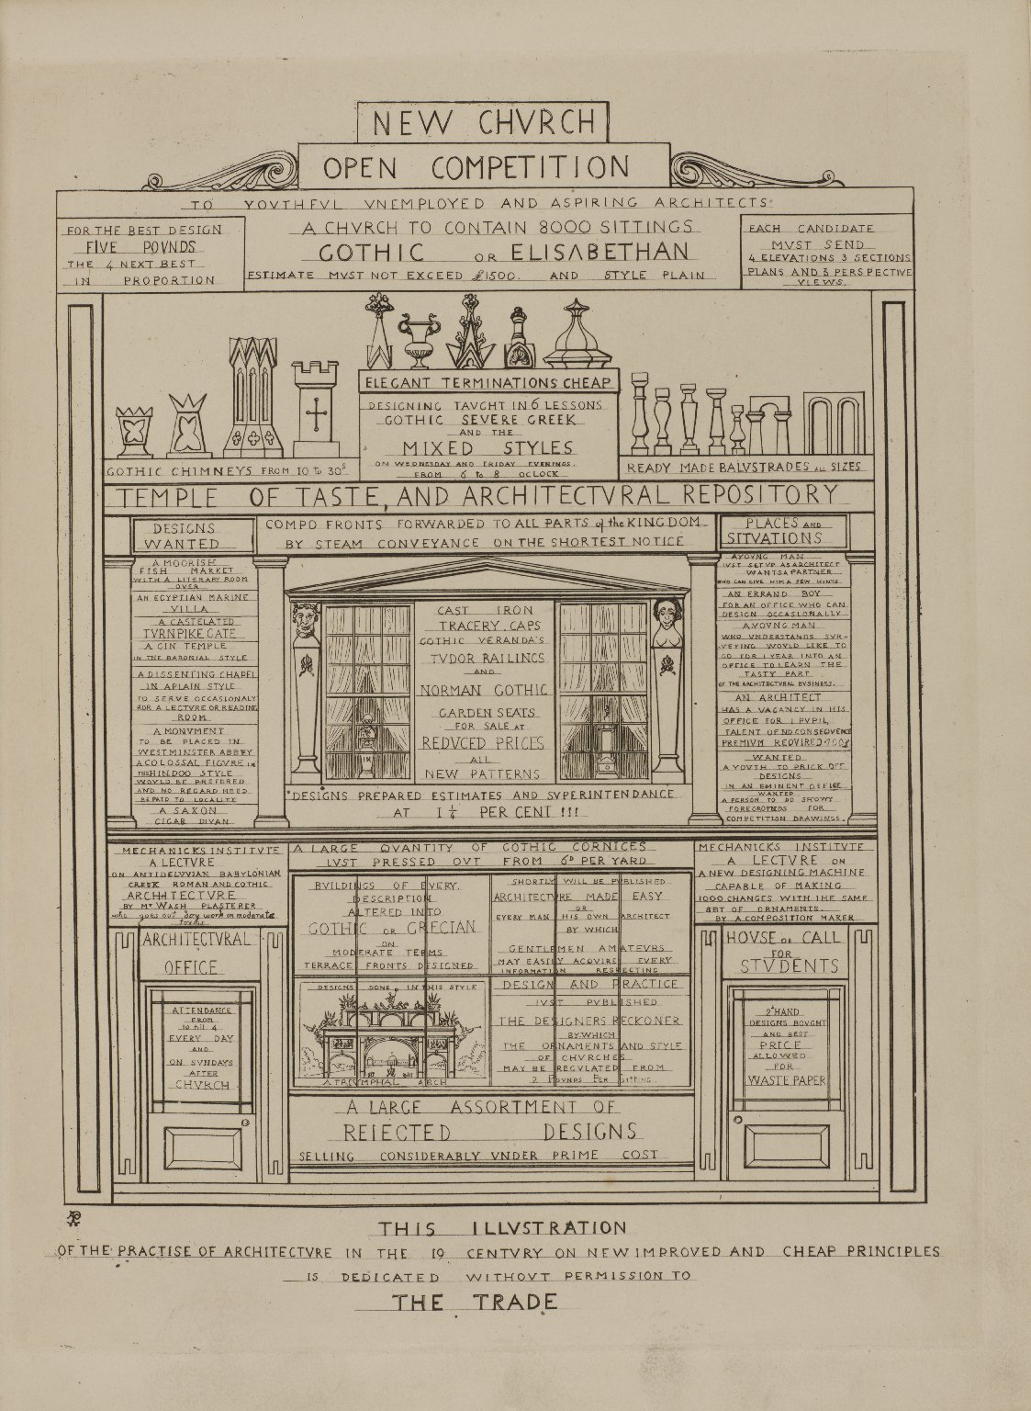
-------------
Image1
-------------
Field Data
Image Number JRL1310929
Reference Number SC9269C
Link to Catalogue <A href=http://man-fe.hosted.exlibrisgroup.com/MU_VU1:BLENDED:44MAN_ALMA_DS21149318250001631>UoM online catalogue.</a>
Image Title New Church Open Competition
Parent Work Title Contrasts: or, A parallel between the noble edifices of the fourteenth and fifteenth centuries and similar buildings of the present day: Shewing the present decay of taste
Creator Pugin, Augustus Welby Northmore, 1812-1852
Creator Role Author
Date Created 1836
Publication Details London : printed for the Author and published by him
Description A square spare drawing of a building with columns, windows and doors. Each section contains a list of commodities such as ' Designs Wanted', 'Places and Situations', advertisements for lectures and books and for offers of work etc. All seeeming to mock current architectural trends. The title at the bottom says: 'This illustration of the practise of architecture in the 19 century on new improved and cheap principles is dedicated without permission to The Trade'.
Language Code eng-GB
Language English
Subject Architecture
Category of Material Printed
Medium Ink
Support Paper
Creation Site England: London
Time Period Covered 19th Century CE
Current Site John Rylands Library, Deansgate, Manchester, U.K.
Current Repository The University of Manchester Library, U.K.
Rights Holder - Image The University of Manchester Library
Rights holder - Work The University of Manchester Library
Date Captured (yyyy-mm-dd) 2013-05-20
Image Creation Technique Digital capture by Heritage Imaging, The University of Manchester Library
Date Image Added (yyyy-mm) 2013-06
Metadata Language eng-GB

