Slide 1
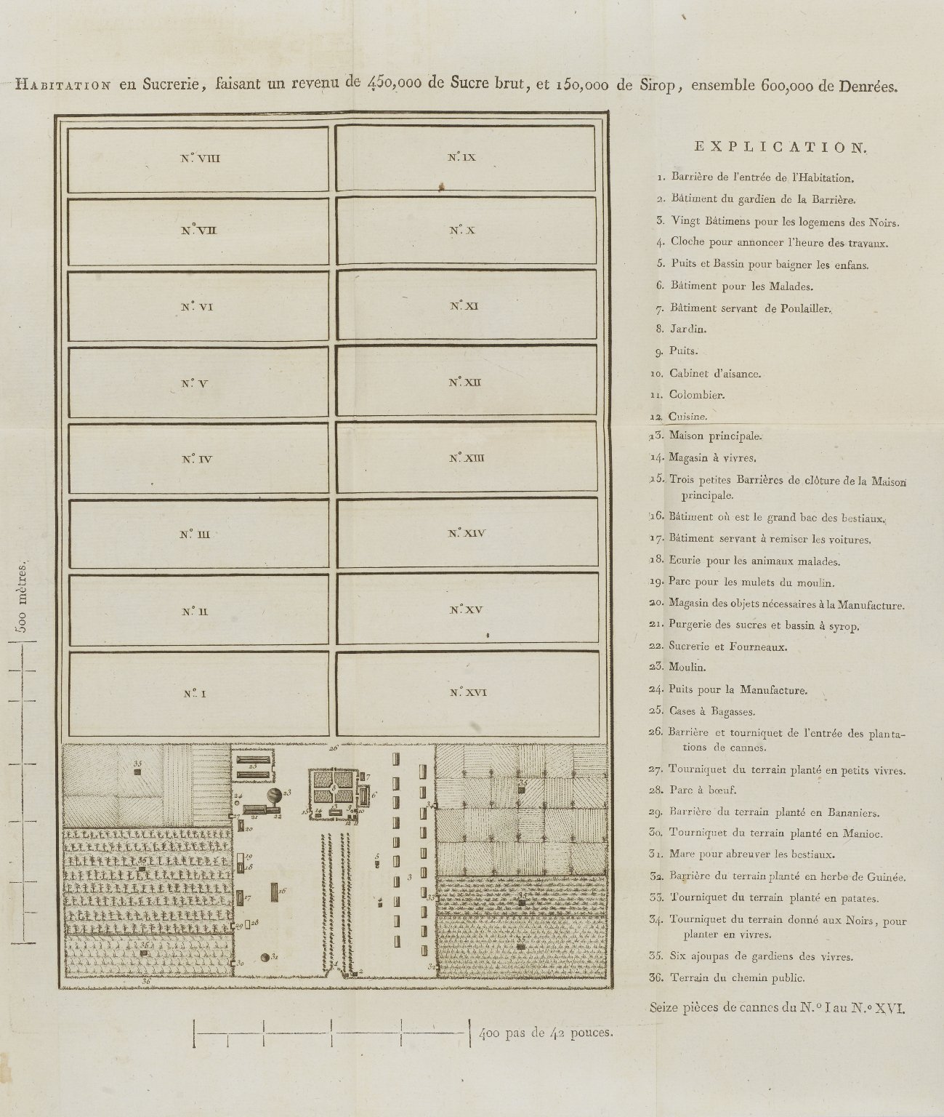
-------------
Image1
-------------
Field Data
Image Number JRL1300857
Reference Number Spencer 13724.1
Link to Catalogue <A href=http://man-fe.hosted.exlibrisgroup.com/MU_VU1:BLENDED:44MAN_ALMA_DS21192662140001631>UoM online catalogue</a>
Image Title Establissement d'une Sucrier en Brut
Alternative Image Title Image of Plantation
Translated Image Title Plan of Raw Sugar Plantation
Parent Work Title La vita di Jacopo Mazzoni
Translated Parent Work Title The life of Jacopo Mazzoni
Creator Mazzoni, Jacopo, 1548-1598
Creator Role Author
Creator Serassi, Pierantonio, 1721-1791
Creator Role Author
Date Created 1790
Description A map with a key of a 'habitation en sucrerie' and a summary of the income it brought in.
Subject Slavery
Category of Material Printed
Sub-Category Maps
Medium Ink
Support Paper
Places Covered West Indies
Item Height 365 mm
Item Width 370 mm
Current Repository The University of Manchester Library, U.K.
Provenance Spencer, George John Spencer, Earl, 1758-1834, former owner
Rights Holder - Image The University of Manchester Library
Rights holder - Work The University of Manchester Library
Date Captured (yyyy-mm-dd) 2012-09-07
Image Creation Technique Digital capture by Heritage Imaging, The University of Manchester Library
Date Image Added (yyyy-mm) 2012-09
Metadata Language eng-GB

