Slide 1
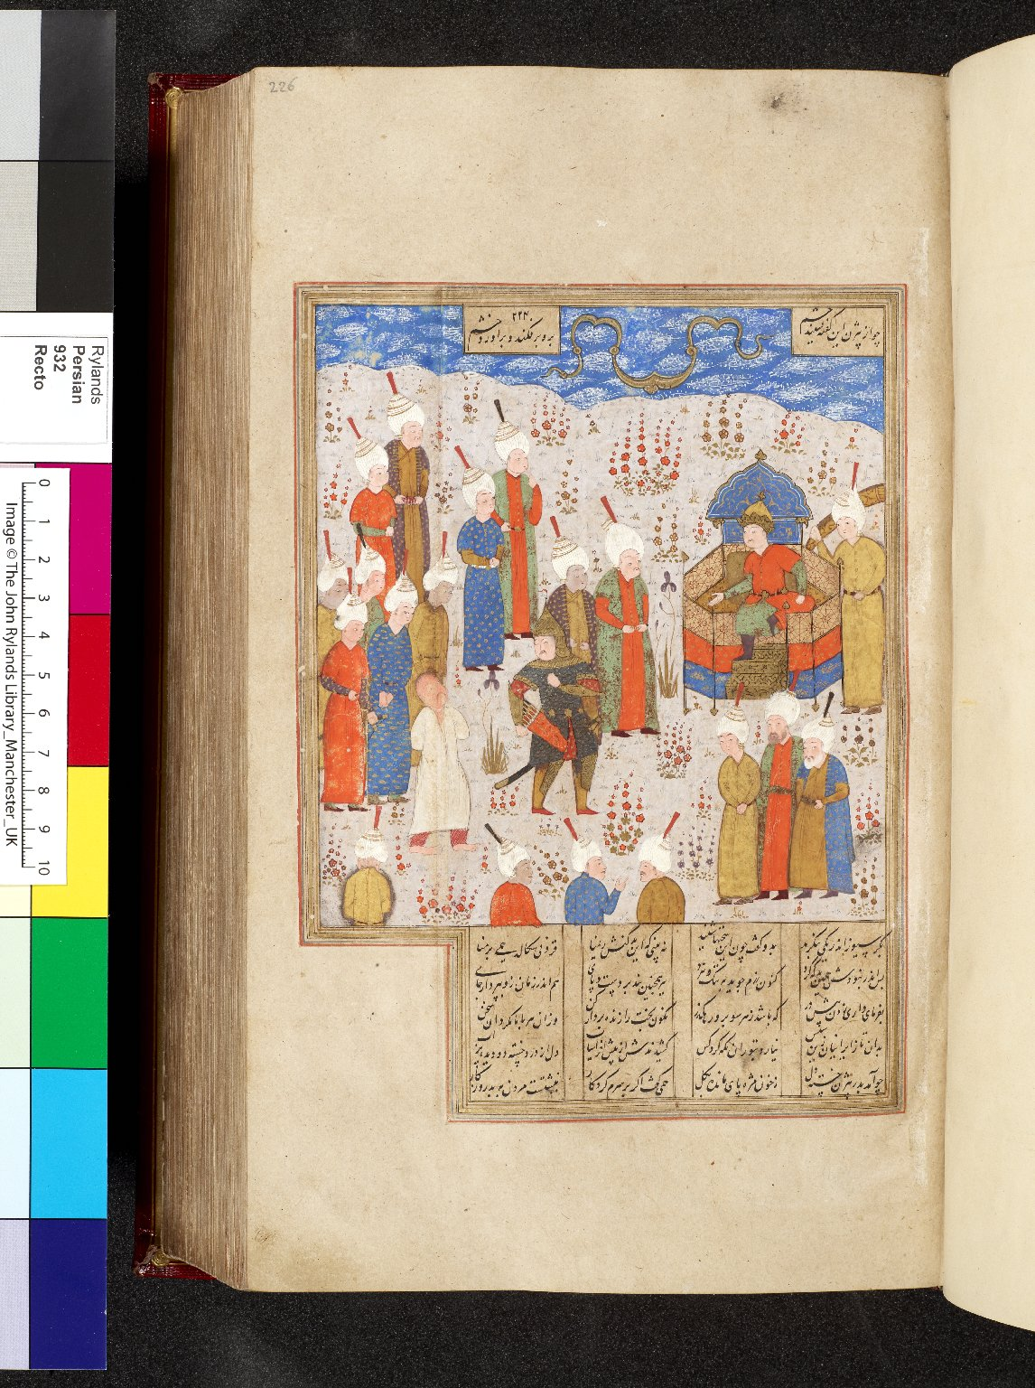
-------------
Image1
-------------
Field Data
Image Number JRL0914631dc
Reference Number Persian MS 932
Image Title Bizhan captive
Parent Work Title Shahnama
Translated Parent Work Title Book of Kings
Creator Firdawsī
Creator Role Author
Date Created 1542 CE [949]
Page/Sheet 226a
Image Sequence Number 226a
Description Illustrated: miniature: Captive Bizhan brought before Afrasiyab. Painter A. Miniature dimensions: 165 x 146 mm.
Language Code per
Subject Iran--History
Subject Epic poetry
Subject Persian literature
Category of Material Manuscripts
Sub-Category Miniatures (paintings)
Technique Used Painting (image-making)
Technique Used Handwriting
Support Paper
Style Period Shiraz style
Style Period Safawid period
Item Height 330 mm
Item Width 202 mm
Current Repository The University of Manchester Library, U.K.
Provenance Macan, Turner, 1792-1836, former owner
Provenance Lindsay family Earls of Crawford and Balcarres, former owner
Provenance Hawtrey, Edward Craven, Dr, former owner
Provenance Kings of Oudh, former owner
Rights Holder - Image The University of Manchester Library
Rights holder - Work The University of Manchester Library
References B.W. Robinson, 'Persian Paintings in the John Rylands Library' (1980)
Notes Digitisation sponsored by <a href="http://www.islamicmanuscript.org/">The Islamic Manuscript Association</a>
Date Captured (yyyy-mm-dd) 2009-06-09
Multi Page Number 2285
Image Creation Technique Digital capture by Heritage Imaging, The University of Manchester Library
Date Image Added (yyyy-mm) 2009-07
Metadata Language eng-GB

Slide 2
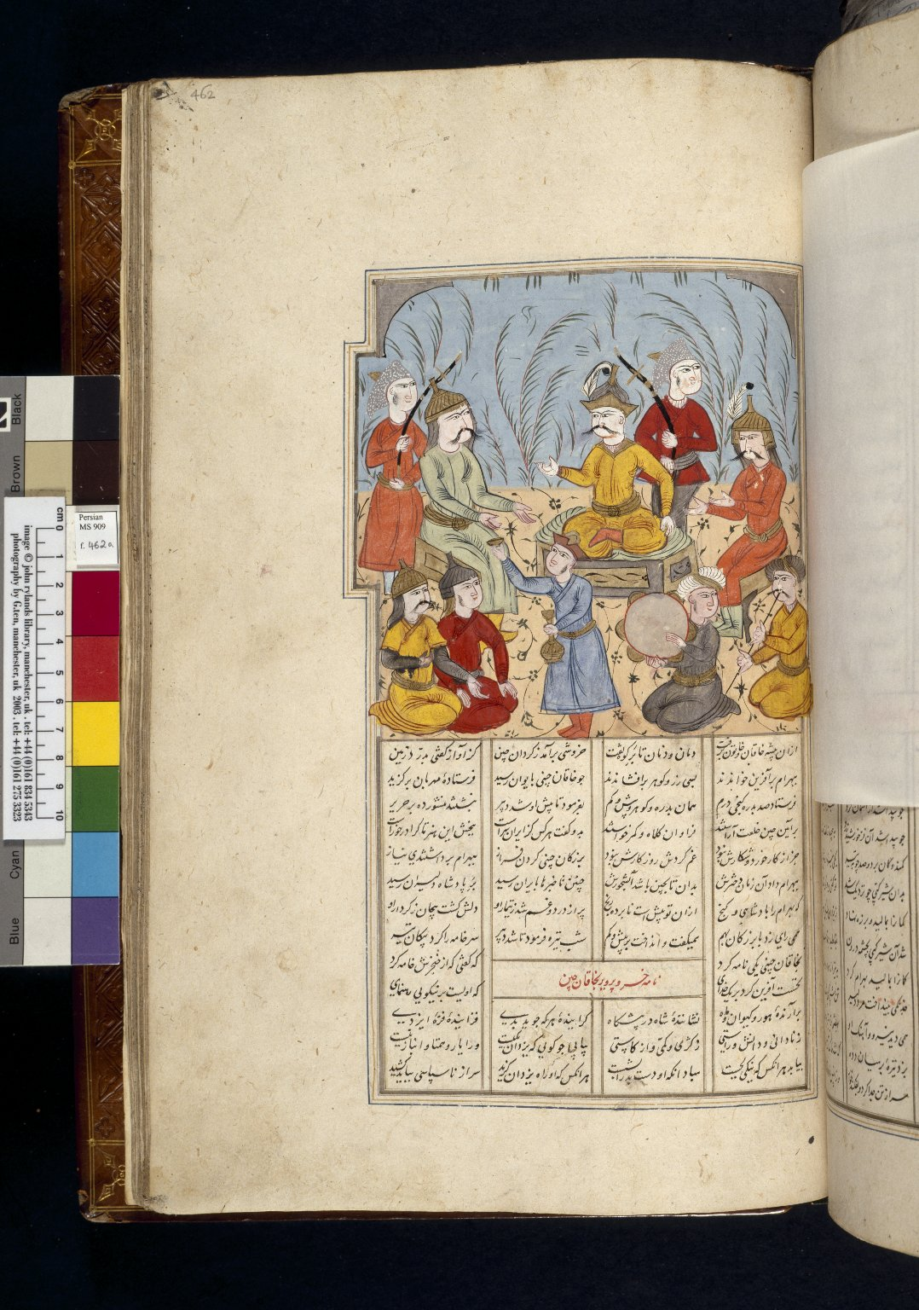
-------------
Image1
-------------
Field Data
Image Number JRL030343tr
Reference Number Persian MS 909
Image Title Bahram Chubina
Parent Work Title Shahnama
Translated Parent Work Title Book of Kings
Creator Firdawsī
Creator Role Author
Date Created 1650-06-23 [23 Jumada II, 1060]
Page/Sheet 462a
Image Sequence Number 462a
Description Illustrated: miniature: Bahram Chubina at the court of the Khaqan. Miniature dimensions: 158 x 158 mm.
Language Code per
Subject Persian literature
Subject Epic poetry
Category of Material Manuscripts
Sub-Category Miniatures (paintings)
Technique Used Handwriting
Technique Used Painting (image-making)
Style Period Safawid period
Style Period Isfahan style
Item Height 407 mm
Item Width 255 mm
Current Repository The University of Manchester Library, U.K.
Rights Holder - Image The University of Manchester Library
Rights holder - Work The University of Manchester Library
References B.W. Robinson, 'Persian Paintings in the John Rylands Library' (1980)
Image Creation Technique Scanned from colour transparency by Gten, September 2004
Metadata Language eng-GB

Slide 3
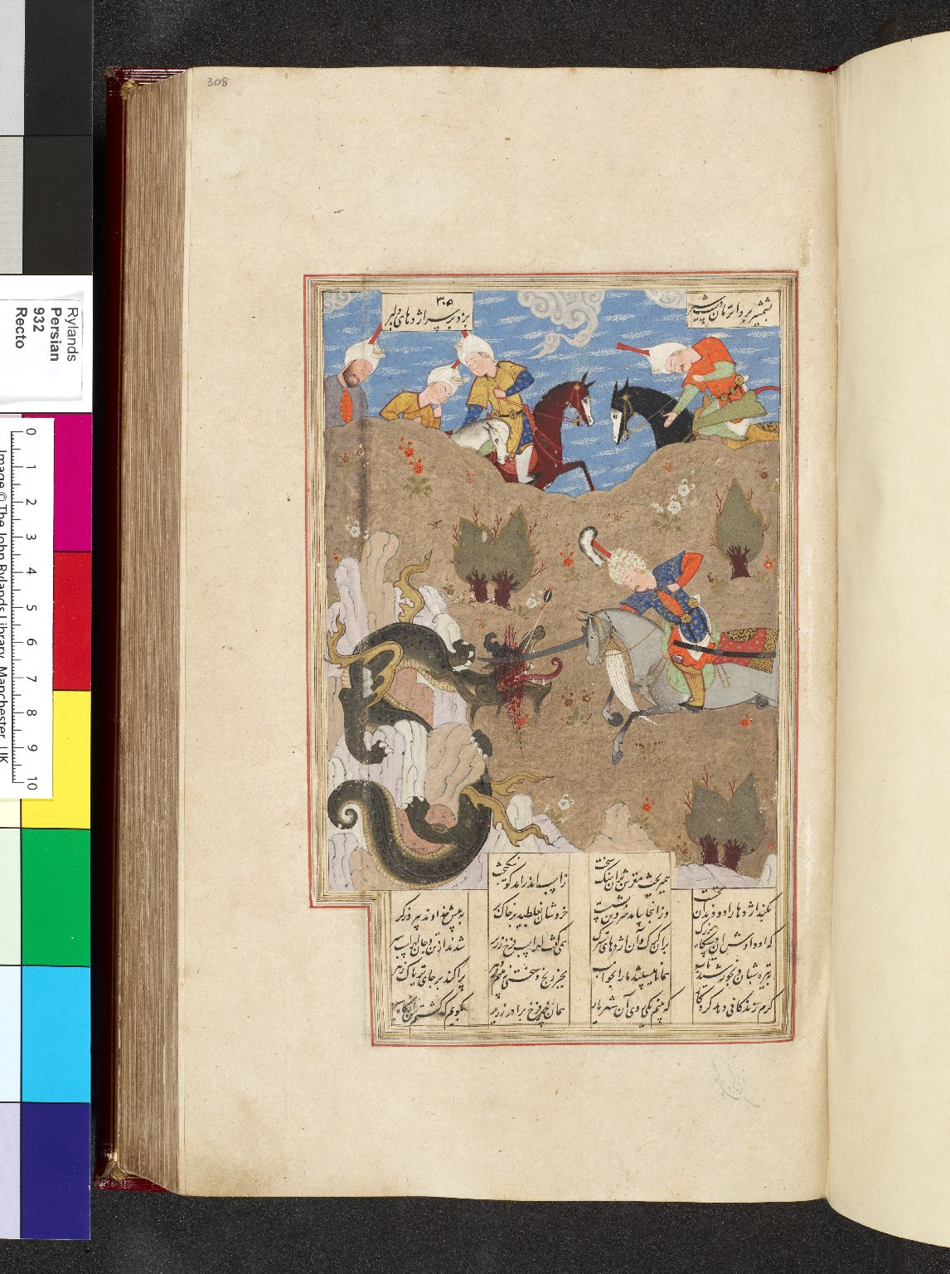
-------------
Image1
-------------
Field Data
Image Number JRL0914795dc
Reference Number Persian MS 932
Image Title Gushtasp & the dragon
Parent Work Title Shahnama
Translated Parent Work Title Book of Kings
Creator Firdawsī
Creator Role Author
Date Created 1542 CE [949]
Page/Sheet 308a
Image Sequence Number 308a
Description Illustrated: miniature: Gushtasp and the dragon. Painter B. Miniature dimensions: 172 x 127 mm.
Language Code per
Subject Iran--History
Subject Epic poetry
Subject Persian literature
Category of Material Manuscripts
Sub-Category Miniatures (paintings)
Technique Used Handwriting
Technique Used Painting (image-making)
Support Paper
Style Period Shiraz style
Style Period Safawid period
Item Height 330 mm
Item Width 202 mm
Current Repository The University of Manchester Library, U.K.
Provenance Macan, Turner, 1792-1836, former owner
Provenance Lindsay family Earls of Crawford and Balcarres, former owner
Provenance Hawtrey, Edward Craven, 1789-1862, former owner
Provenance Kings of Oudh, former owner
Rights Holder - Image The University of Manchester Library
Rights holder - Work The University of Manchester Library
References B.W. Robinson, 'Persian Paintings in the John Rylands Library' (1980)
Notes Digitisation sponsored by <a href="http://www.islamicmanuscript.org/">The Islamic Manuscript Association</a>
Date Captured (yyyy-mm-dd) 2009-06-09
Multi Page Number 3105
Image Creation Technique Digital capture by Heritage Imaging, The University of Manchester Library
Date Image Added (yyyy-mm) 2009-07
Metadata Language eng-GB

Slide 4
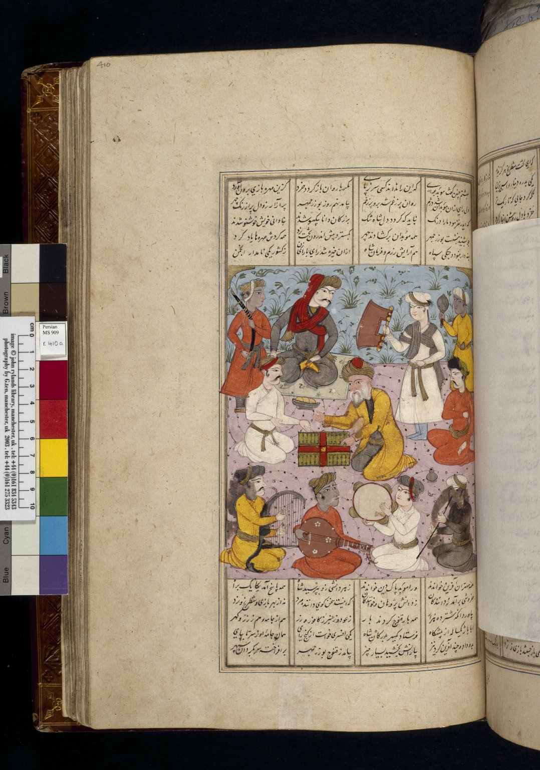
-------------
Image1
-------------
Field Data
Image Number JRL030333tr
Reference Number Persian MS 909
Image Title Intoduction of backgammon
Parent Work Title Shahnama
Translated Parent Work Title Book of Kings
Creator Firdawsī
Creator Role Author
Date Created 1650-06-23 [23 Jumada II, 1060]
Page/Sheet 410a
Image Sequence Number 410a
Description Illustrated: miniature: The sage Buzurjmihr intoducing backgammon to the Indian court. Miniature dimensions: 178 x 152 mm.
Language Code per
Subject Persian literature
Subject Epic poetry
Category of Material Manuscripts
Sub-Category Miniatures (paintings)
Technique Used Handwriting
Technique Used Painting (image-making)
Style Period Isfahan style
Style Period Safawid period
Item Height 407 mm
Item Width 255 mm
Current Repository The University of Manchester Library, U.K.
Rights Holder - Image The University of Manchester Library
Rights holder - Work The University of Manchester Library
References B.W. Robinson, 'Persian Paintings in the John Rylands Library' (1980)
Image Creation Technique Scanned from colour transparency by Gten, September 2004
Metadata Language eng-GB

Slide 5
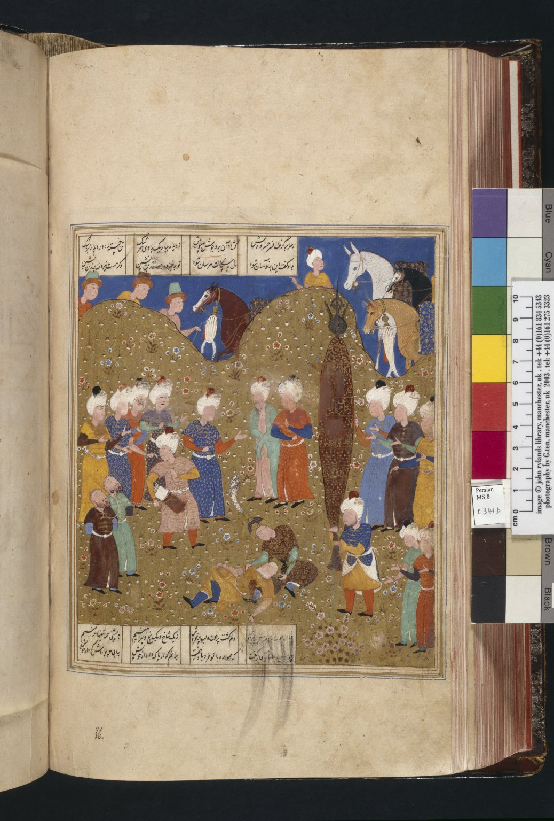
-------------
Image1
-------------
Field Data
Image Number JRL030162tr
Reference Number Persian MS 8
Image Title Dara comforted by Iskandar
Parent Work Title Shahnama
Translated Parent Work Title Book of Kings
Creator Firdawsī
Creator Role Author
Date Created 16th century [mid]
Page/Sheet 341b
Image Sequence Number 341b
Description Illustrated: miniature: The dying Dara comforted by Iskandar, while the captive murderers are brought on. Painter B. Miniature dimensions: 202 x 172 mm.
Language Code per
Subject Death
Subject Epic poetry
Subject Persian literature
Category of Material Manuscripts
Sub-Category Codex
Sub-Category Miniatures (paintings)
Style Period Shiraz style
Style Period Safawid period
People Covered Alexander, the Great, 356-323 B.C.
Item Height 362 mm
Item Width 216 mm
Current Repository The University of Manchester Library, U.K.
Rights Holder - Image The University of Manchester Library
Rights holder - Work The University of Manchester Library
References B.W. Robinson, 'Persian Paintings in the John Rylands Library' (1980)
Metadata Language eng-GB

Slide 6
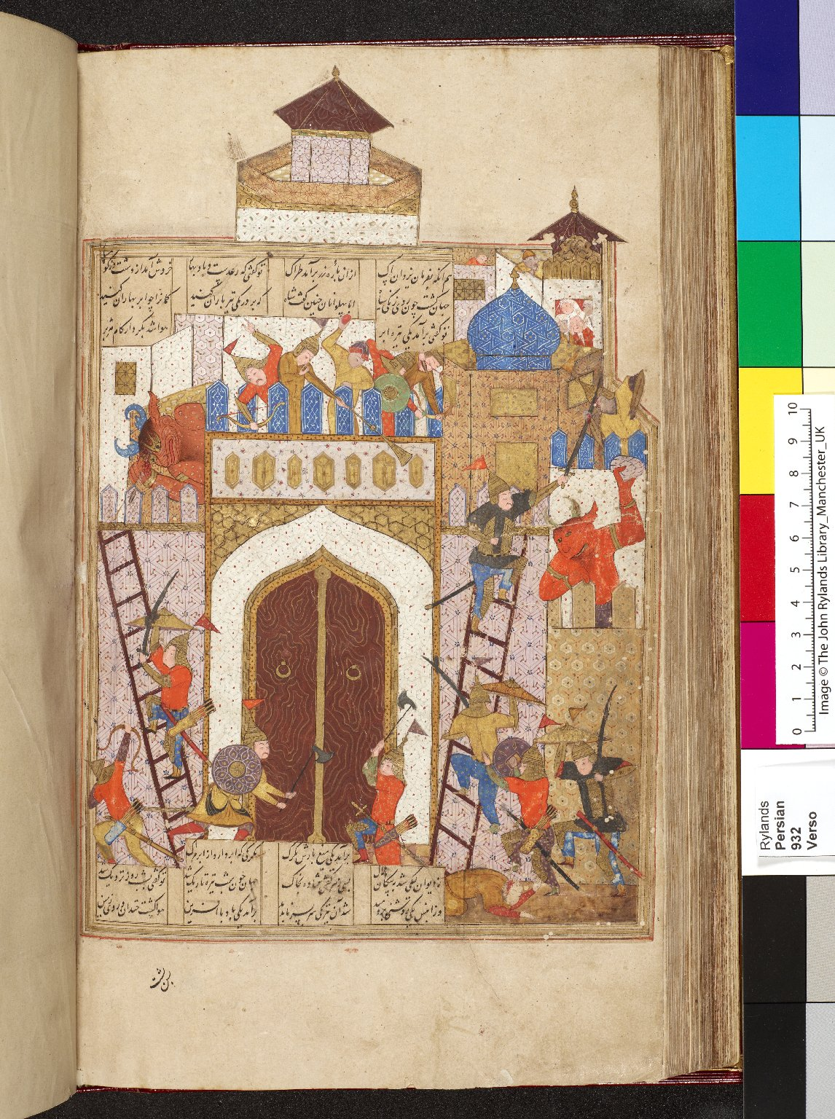
-------------
Image1
-------------
Field Data
Image Number JRL0914508dc
Reference Number Persian MS 932
Image Title Kay Khusraw
Parent Work Title Shahnama
Translated Parent Work Title Book of Kings
Creator Firdawsī
Creator Role Author
Date Created 1542 CE [949]
Page/Sheet 164b
Image Sequence Number 164b
Description Illustrated: miniature: Kay Khusraw attacking the fortress of Bahman; the defenders include both humans and demons. Painter A. Miniature dimensions: 260 x 172 mm.
Language Code per
Subject Epic poetry
Subject Persian literature
Subject Iran--History
Category of Material Manuscripts
Sub-Category Miniatures (paintings)
Technique Used Painting (image-making)
Technique Used Handwriting
Support Paper
Style Period Shiraz style
Style Period Safawid period
Item Height 330 mm
Item Width 202 mm
Current Repository The University of Manchester Library, U.K.
Provenance Lindsay family Earls of Crawford and Balcarres, former owner
Provenance Macan, Turner, 1792-1836, former owner
Provenance Hawtrey, Edward Craven, Dr, former owner
Provenance Kings of Oudh (former owner)
Rights Holder - Image The University of Manchester Library
Rights holder - Work The University of Manchester Library
References B.W. Robinson, 'Persian Paintings in the John Rylands Library' (1980)
Notes Digitisation sponsored by <a href="http://www.islamicmanuscript.org/">The Islamic Manuscript Association</a>
Date Captured (yyyy-mm-dd) 2009-06-09
Multi Page Number 1670
Image Creation Technique Digital capture by Heritage Imaging, The University of Manchester Library
Date Image Added (yyyy-mm) 2009-07
Metadata Language eng-GB

Slide 7
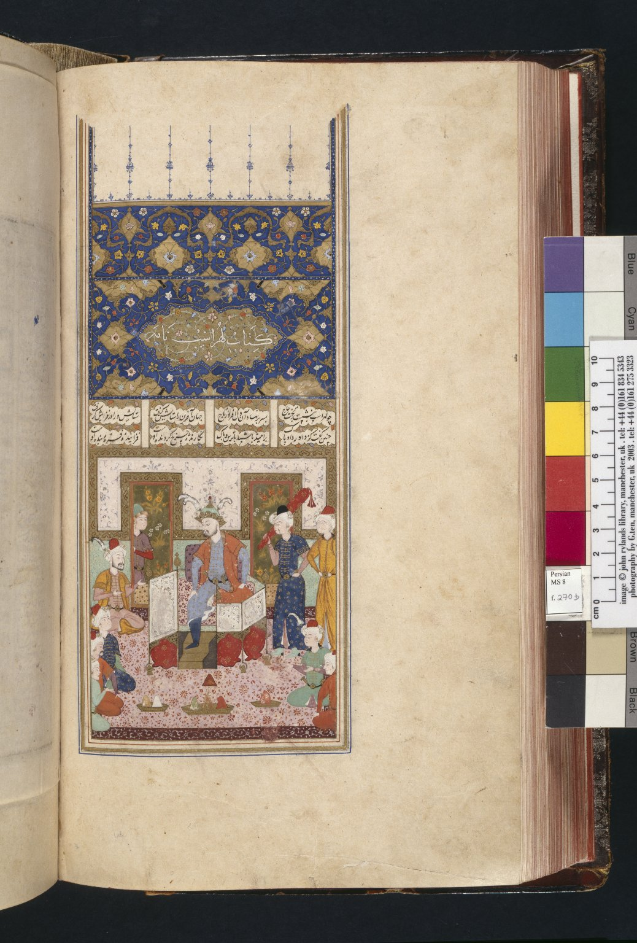
-------------
Image1
-------------
Field Data
Image Number JRL030159tr
Reference Number Persian MS 8
Image Title Enthronement of Luhrasp
Parent Work Title Shahnama
Translated Parent Work Title Book of Kings
Creator Firdawsī
Creator Role Author
Date Created 16th century [mid]
Page/Sheet 270b
Image Sequence Number 270b
Description Illustrated: miniature: The enthronement of Luhrasp. Painter A. Miniature dimensions: 121 x 102 mm.
Language Code per
Subject Epic poetry
Subject Persian literature
Category of Material Manuscripts
Sub-Category Codex
Sub-Category Miniatures (paintings)
Style Period Shiraz style
Style Period Safawid period
Item Height 362 mm
Item Width 216 mm
Current Repository The University of Manchester Library, U.K.
Rights Holder - Image The University of Manchester Library
Rights holder - Work The University of Manchester Library
References B.W. Robinson, 'Persian Paintings in the John Rylands Library' (1980)
Image Creation Technique Scanned from colour transparency by Gten, October 2004
Metadata Language eng-GB

Slide 8
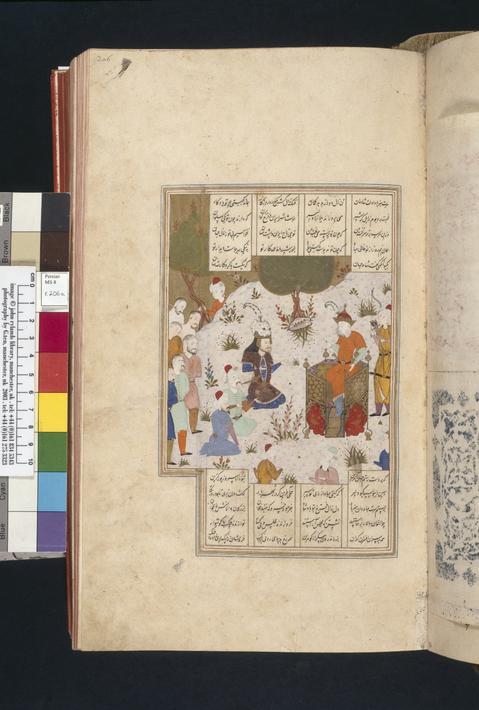
-------------
Image1
-------------
Field Data
Image Number JRL030157tr
Reference Number Persian MS 8
Image Title Rustam brings captives to Kay Khusraw
Parent Work Title Shahnama
Translated Parent Work Title Book of Kings
Creator Firdawsī
Creator Role Author
Date Created 16th century [mid]
Page/Sheet 206a
Image Sequence Number 206a
Description Illustrated: miniature: Rustam brings captives to Kay Khusraw after his sack of Afrasiyab's palace. Painter A. Miniature dimensions: 165 x 127 mm.
Language Code per
Subject Epic poetry
Subject Persian literature
Category of Material Manuscripts
Sub-Category Codex
Sub-Category Miniatures (paintings)
Style Period Shiraz style
Style Period Safawid period
Item Height 362 mm
Item Width 216 mm
Current Repository The University of Manchester Library, U.K.
Rights Holder - Image The University of Manchester Library
Rights holder - Work The University of Manchester Library
References B.W. Robinson, 'Persian Paintings in the John Rylands Library' (1980)
Image Creation Technique Scanned from colour transparency by Gten, October 2004
Metadata Language eng-GB

