Slide 1
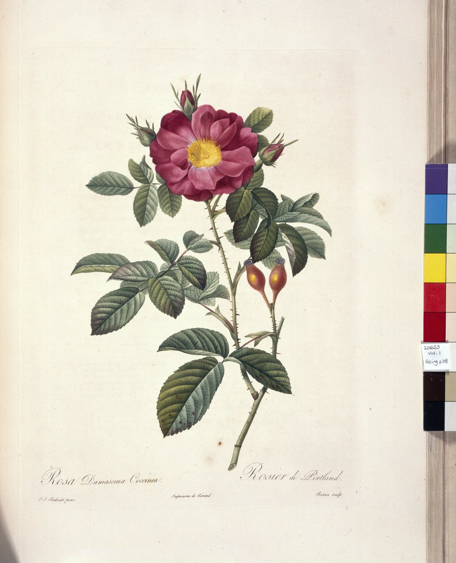
-------------
Image1
-------------
Field Data
Image Number JRL022724tr
Reference Number Spencer 20653
Link to Catalogue <A href=http://man-fe.hosted.exlibrisgroup.com/MU_VU1:BLENDED:44MAN_ALMA_DS21153177750001631>UoM online catalogue.</a>
Image Title Rosier de Portland
Translated Image Title Portland rose
Parent Work Title Les roses
Creator Redouté, Pierre Joseph, 1759-1840
Creator Role Artist
Creator Thory, Claude-Antoine
Creator Role Author
Date Created 1817-1824
Publication Details Paris : Didot
Volume 1
Page/Sheet Opposite page 108
Image Sequence Number 1-108
Description Illustrated: Rosier de Portland
Language Code fre-FR
Subject Botany
Subject Flowers
Subject Natural History
Category of Material Printed
Sub-Category Illustrated works
Current Repository The University of Manchester Library, U.K.
Provenance Spencer, George John Spencer, Earl, 1758-1834, former owner
Rights Holder - Image The University of Manchester Library
Rights holder - Work The University of Manchester Library
Image Creation Technique Scanned from colour transparency by Gten, April 2004
Metadata Language eng-GB

Slide 2
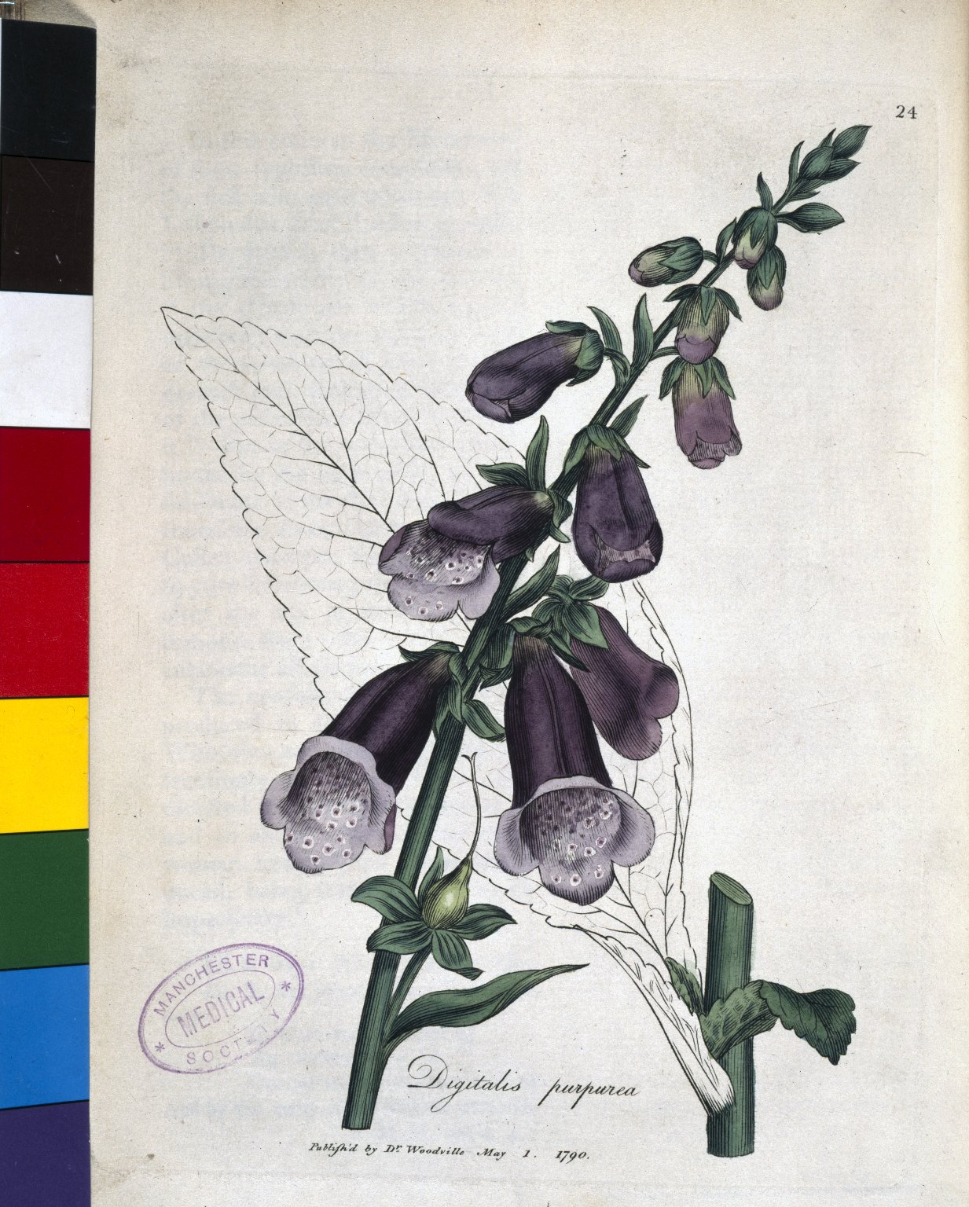
-------------
Image1
-------------
Field Data
Image Number JRL021173tr
Reference Number H8.1,W54
Link to Catalogue <A href=http://man-fe.hosted.exlibrisgroup.com/MU_VU1:BLENDED:44MAN_ALMA_DS21204041430001631>UoM online catalogue.</a>
Image Title Digitalis
Alternative Image Title Foxglove
Parent Work Title Medical botany: containing systematic and general descriptions, with plates, of all the medicinal plants, indigenous and exotic, [...] in the catalogues of the Materia Medica, [...] accompanied with a circumstantial detail of their medicinal effects, etc.
Creator Woodville, William
Creator Role Author
Date Created 1790-1793
Publication Details London: printed and sold for the author by James Phillips
Volume 1 (?)
Page/Sheet Plate 24, opposite page 71
Image Sequence Number 1-071
Description Illustrated: Digitalis (Foxglove)
Language Code eng-GB
Subject Botany
Subject Flowers
Subject Natural History
Subject Herbs--Therapeutic use
Category of Material Printed
Sub-Category Illustrated works
Current Repository The University of Manchester Library, U.K.
Rights Holder - Image The University of Manchester Library
Rights holder - Work The University of Manchester Library
Notes Also available as Microfilm
Image Creation Technique Scanned from colour transparency by Gten, July 2004
Metadata Language eng-GB

Slide 3
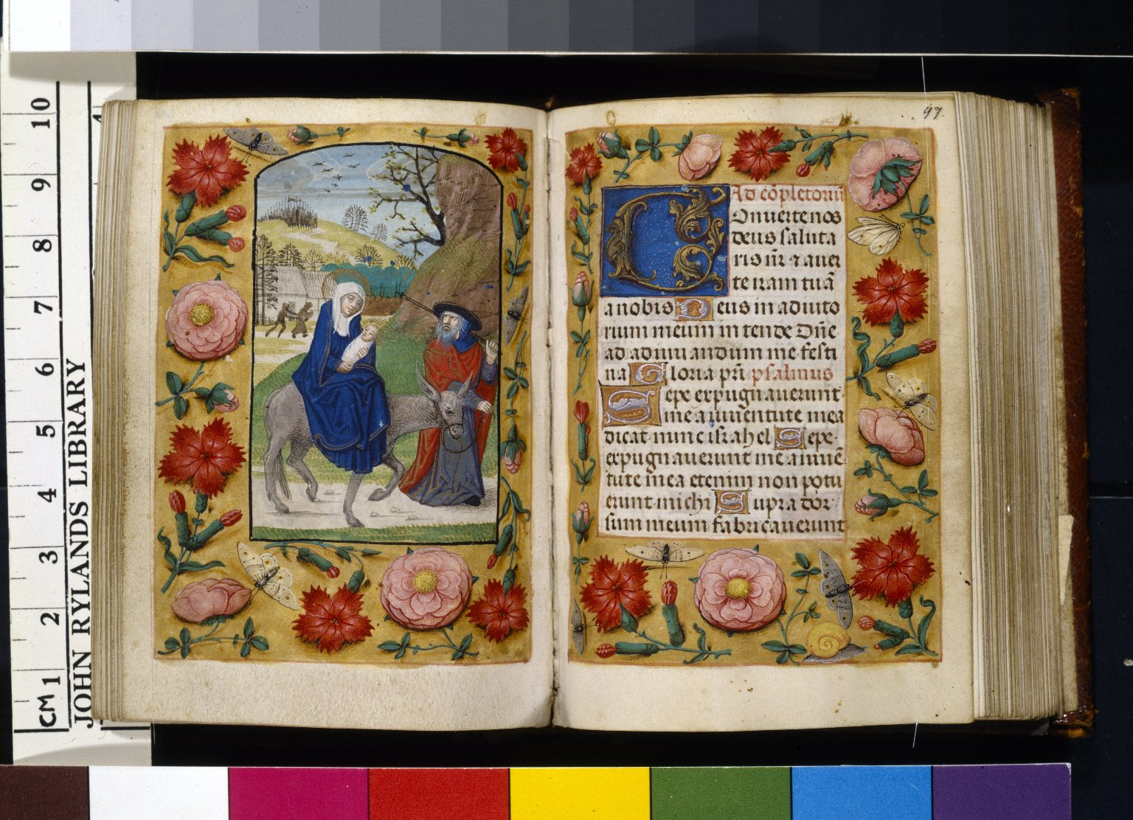
-------------
Image1
-------------
Field Data
Image Number JRL020517tr
Reference Number Latin MS 161
Image Title Joseph leading ass
Parent Work Title Horae
Translated Parent Work Title Book of Hours
Date Created 15th century [late]
Page/Sheet 96v-97r
Image Sequence Number 096v
Description Illustrated: decorated borders, flora & fauna; f.96v: Joseph leading ass carrying Virgin & Child. Italian-Gothic hand, written by a Flemish scribe. Fifteenth century.
Language Code lat
Subject Insects
Subject Lepidoptera
Subject Butterflies
Subject Flowers
Subject Catholic Church
Subject Religion
Subject Christianity
Subject Natural History
Subject Books of hours
Category of Material Manuscripts
Sub-Category Codex
Sub-Category Miniatures (paintings)
Support Vellum
Item Height Folio: 101 mm
Item Width Folio: 75 mm
Current Repository The University of Manchester Library, U.K.
Rights Holder - Image The University of Manchester Library
Rights holder - Work The University of Manchester Library
Image Creation Technique Scanned from colour transparency by Gten, July 2004
Metadata Language eng-GB

Slide 4
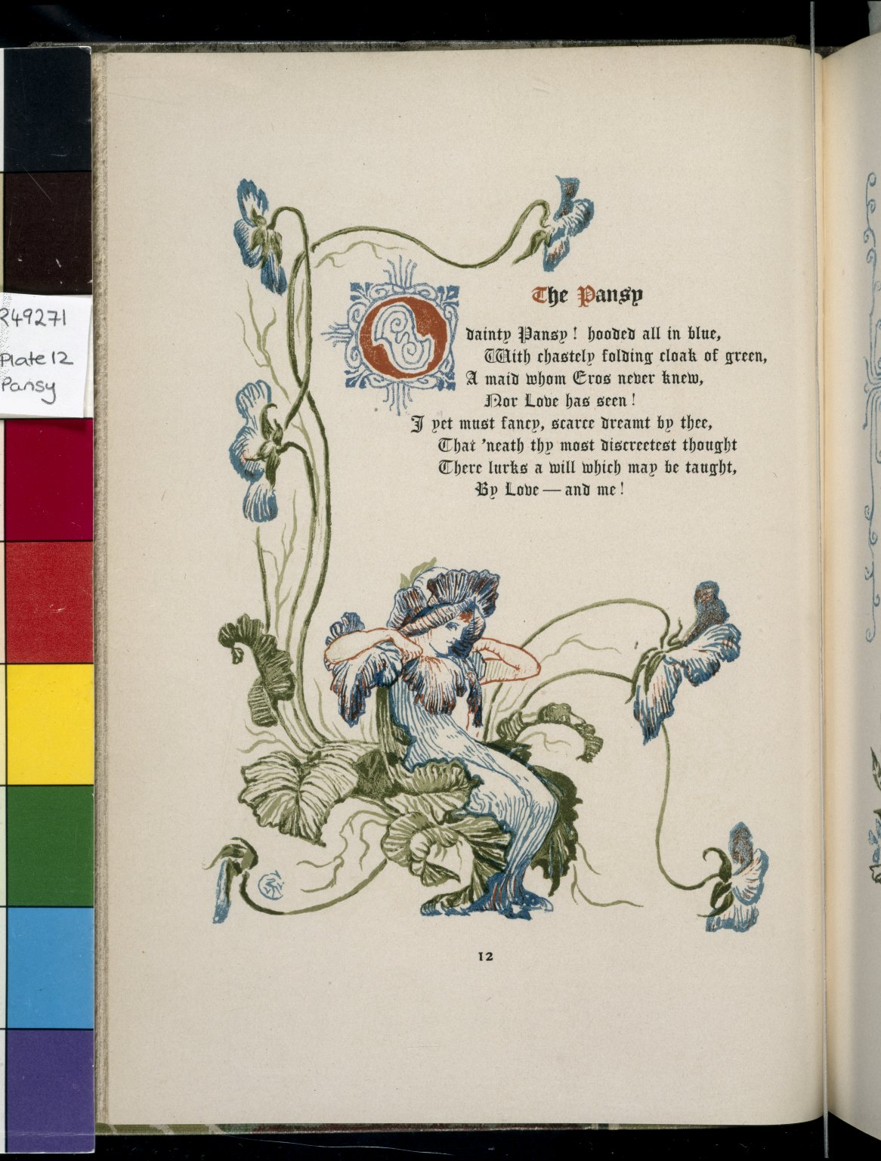
-------------
Image1
-------------
Field Data
Image Number JRL022954tr
Reference Number R49271
Link to Catalogue <A href=http://man-fe.hosted.exlibrisgroup.com/MU_VU1:BLENDED:44MAN_ALMA_DS21162783370001631>UoM online catalogue.</a>
Image Title Pansy
Parent Work Title Old garden: and other verses
Creator Crane, Walter, 1845-1915
Creator Role Illustrator
Creator Deland, Margaret Wade Campbell, 1857-1945
Creator Role Author
Date Created 1893
Publication Details London: Osgood McIlvaine
Page/Sheet Plate 12
Image Sequence Number 012
Description Illustrated: Pansy.
Language Code eng-GB
Subject Arts and crafts movement
Subject Flowers
Subject Botany
Subject Art
Subject Natural History
Category of Material Printed
Sub-Category Illustrated works
Current Repository The University of Manchester Library, U.K.
Rights Holder - Image The University of Manchester Library
Rights holder - Work The University of Manchester Library
Image Creation Technique Scanned from colour transparency by Gten, June 2005
Metadata Language eng-GB

